Slide 1
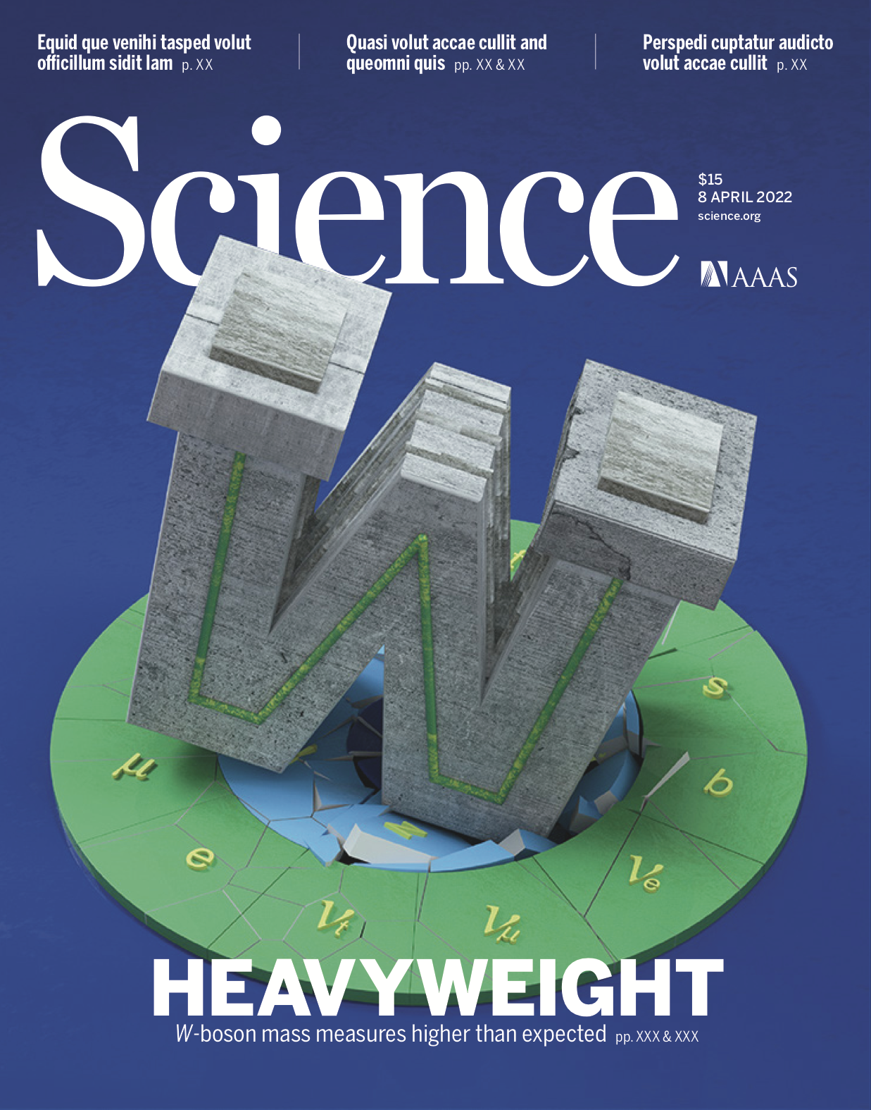
The Higgs is Not Enough Verdict from the Heavyweight W boson
Ashutosh Kotwal
Duke University

Slide 2
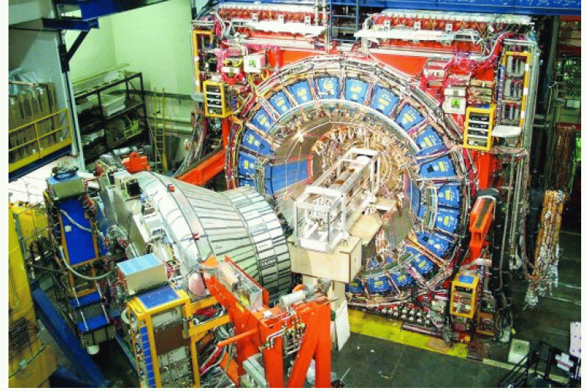
Collider Detector at Fermilab (CDF)
Muon
detector
Central
hadronic
calorimeter
Central EM
calorimeter
Drift
chamber

Slide 3
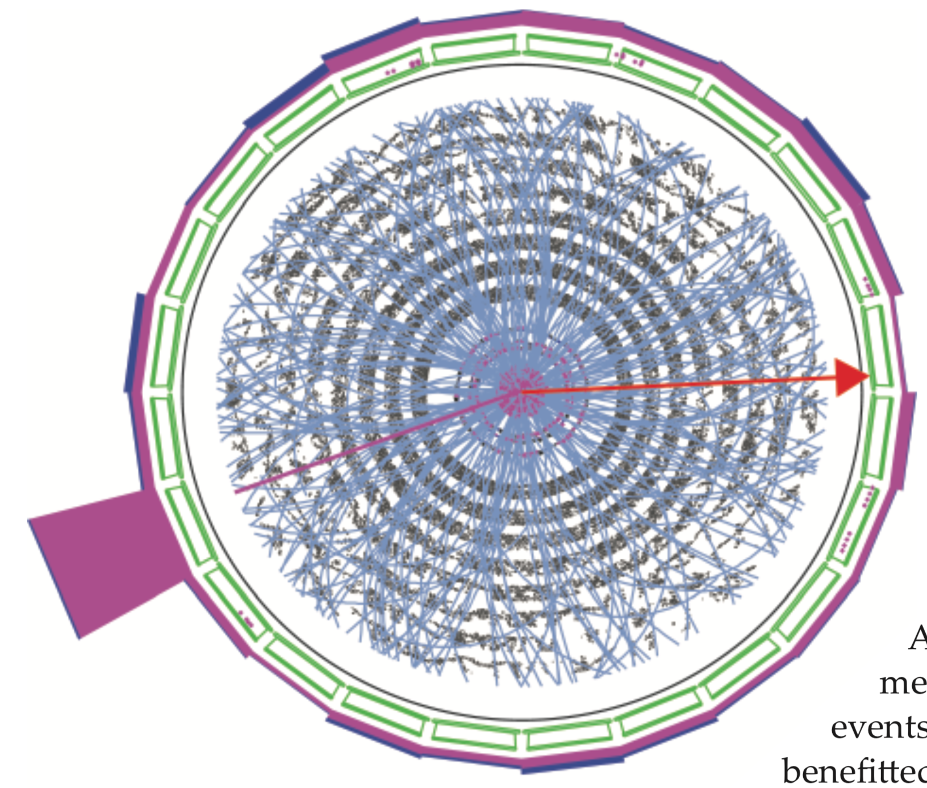
W boson Production Event
electron
hadronic
calorimeter
inferred neutrino
Central
outer
tracker
(COT)
electron
calorimeter

Slide 4
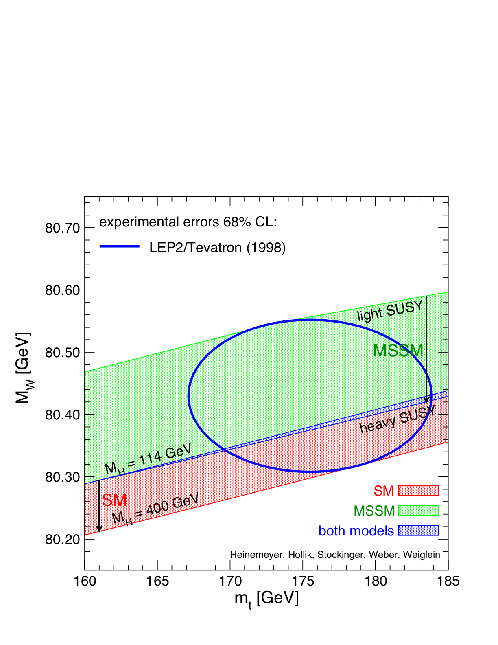
1998 Status of M_{W} vs M_{top}

Slide 5
1998 Status of M_{W} vs M_{top}
Standard Model
after 2012 Higgs
discovery

Slide 6
2022 Status of M_{W} vs M_{top}
Standard Model
after 2012 Higgs
discovery
Science 376, 170 (April 7, 2022); DOI: 10.1126/science.abk1781

Slide 7
Synopsis
The W boson mass is sensitive to new laws of nature through quantum fluctuations
New measurement is twice as precise as previous measurements
M_{W} = 80433.5 ± 9.4 MeV
Significant difference from Standard Model calculation of M_{W} = 80,357 ± 6 MeV
significance of 7.0σ (>5σ is considered scientific discovery)

Slide 8
Synopsis
The W boson mass is sensitive to new laws of nature through quantum fluctuations
New measurement is twice as precise as previous measurements
M_{W} = 80433.5 ± 9.4 MeV
Significant difference from Standard Model calculation of M_{W} = 80,357 ± 6 MeV
significance of 7.0σ (>5σ is considered scientific discovery)
The Higgs boson is not the end of the story

Slide 9
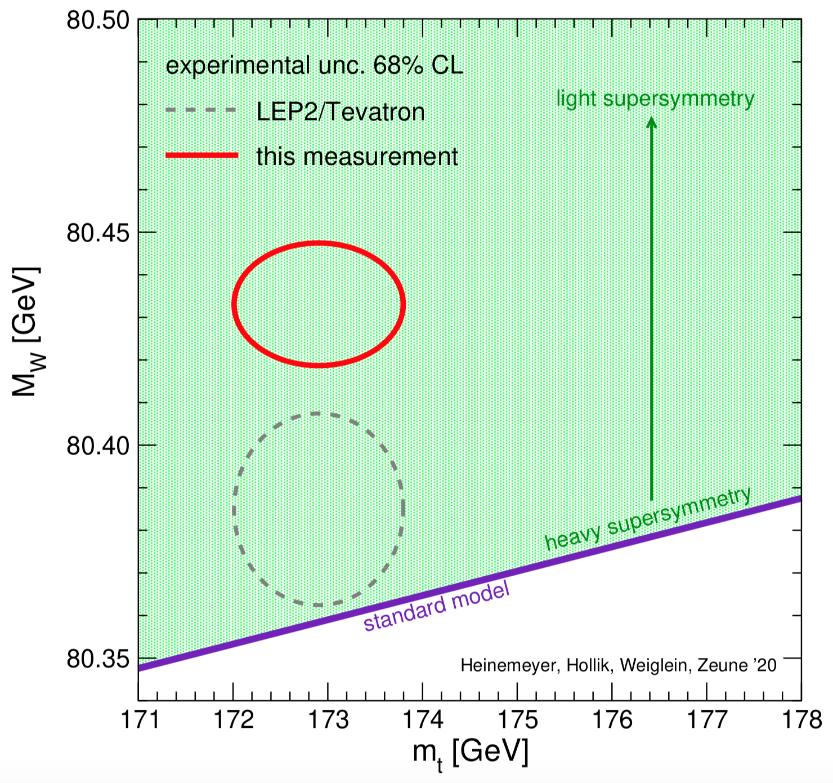
CDF M_{W} vs m_{top}
Fig. 1
from paper
7 sigma difference from Standard Model theory
(exceeds 5 sigma scientific threshold for discovery)

Slide 10
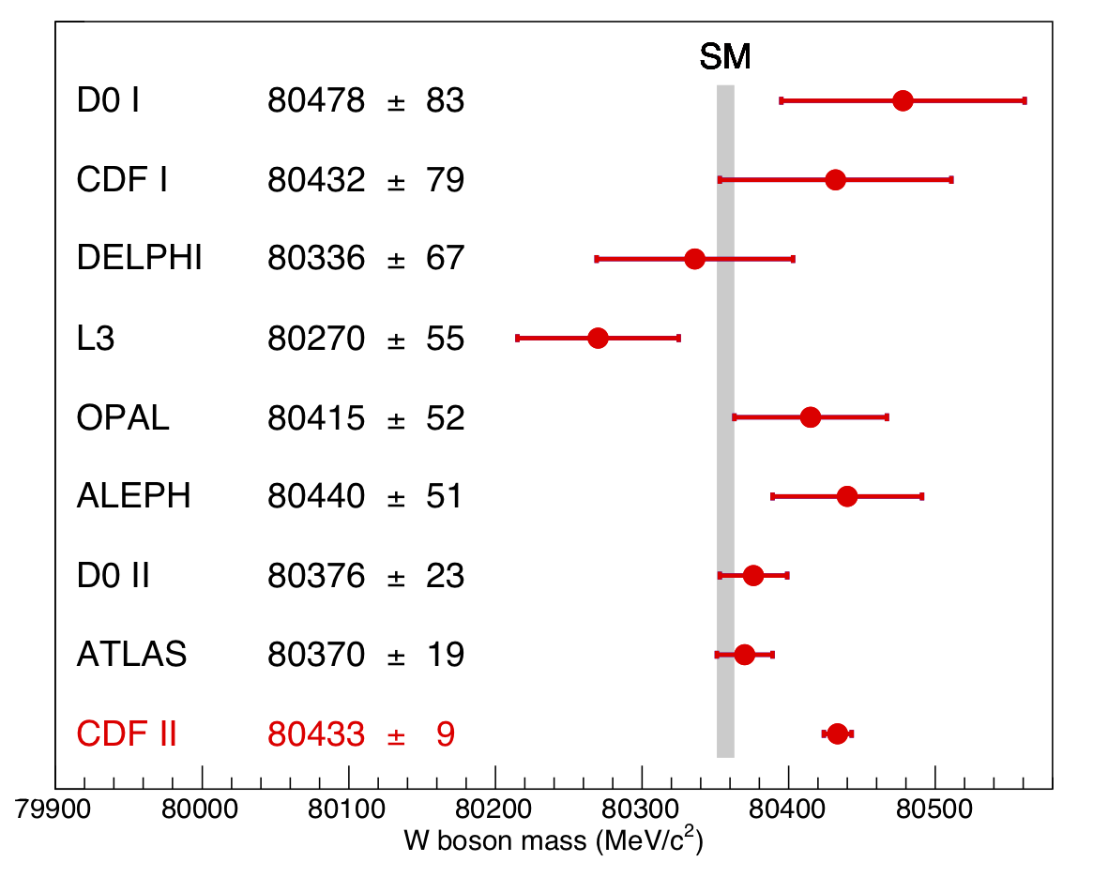
W Boson Mass Measurements from Different Experiments
Fig. 5
from paper
SM expectation: M_{W} = 80,357 ± 4_{inputs} ± 4_{theory} MeV

Slide 11
What’s Next?
Citations in 2 months since publication (April 8, 2022): 133

Slide 12
The Heavyweight W boson & The Mystery of the Missing AntiMatter

Slide 13
Matter-AntiMatter Symmetry
Laws of nature have been proven to be (almost) exactly identical for matter and antimatter
There should be equal amounts of matter and antimatter in the Universe
Where is the MISSING antimatter?
WE need an excess of matter over antimatter in order for galaxies, stars, planets and us to exist…

Slide 14
Sakharov Conditions for Matter Excess
Andrei Sakharov calculated three conditions that must exist in early Universe for creation of matter excess
The Standard Model of Particle Physics satisfies only one of these conditions

Slide 15
Sakharov Conditions for Matter Excess
If the Higgs boson had a partner
i.e. a second Higgs-like particle existed…
The second Sakharov condition can be satisfied !

Slide 16
Higgs Condensation after Big Bang aided by Higgs-like Partner
Higgs droplets form and expand, filling the whole Universe
Satisfies second Sakharov Condition

Slide 17
Higgs Condensation after Big Bang aided by Higgs-like Partner
Higgs droplets form and expand, filling the whole Universe
Satisfies second Sakharov Condition
Higgs-like partner’s existence increases the W boson mass by the observed 0.1%

Slide 18
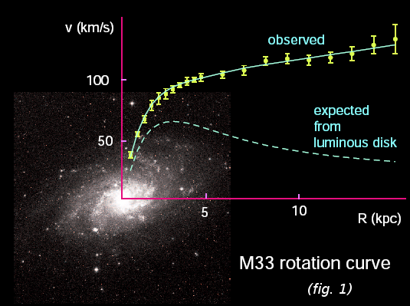
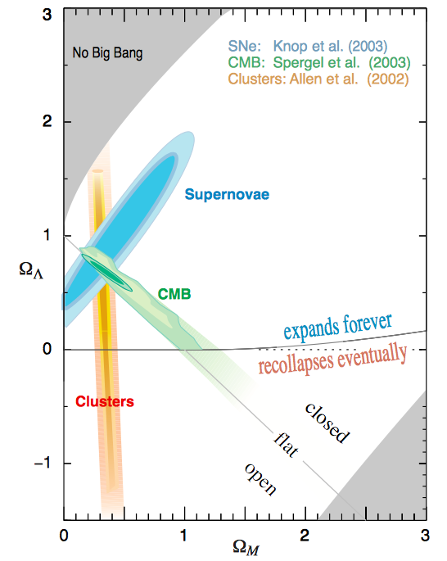
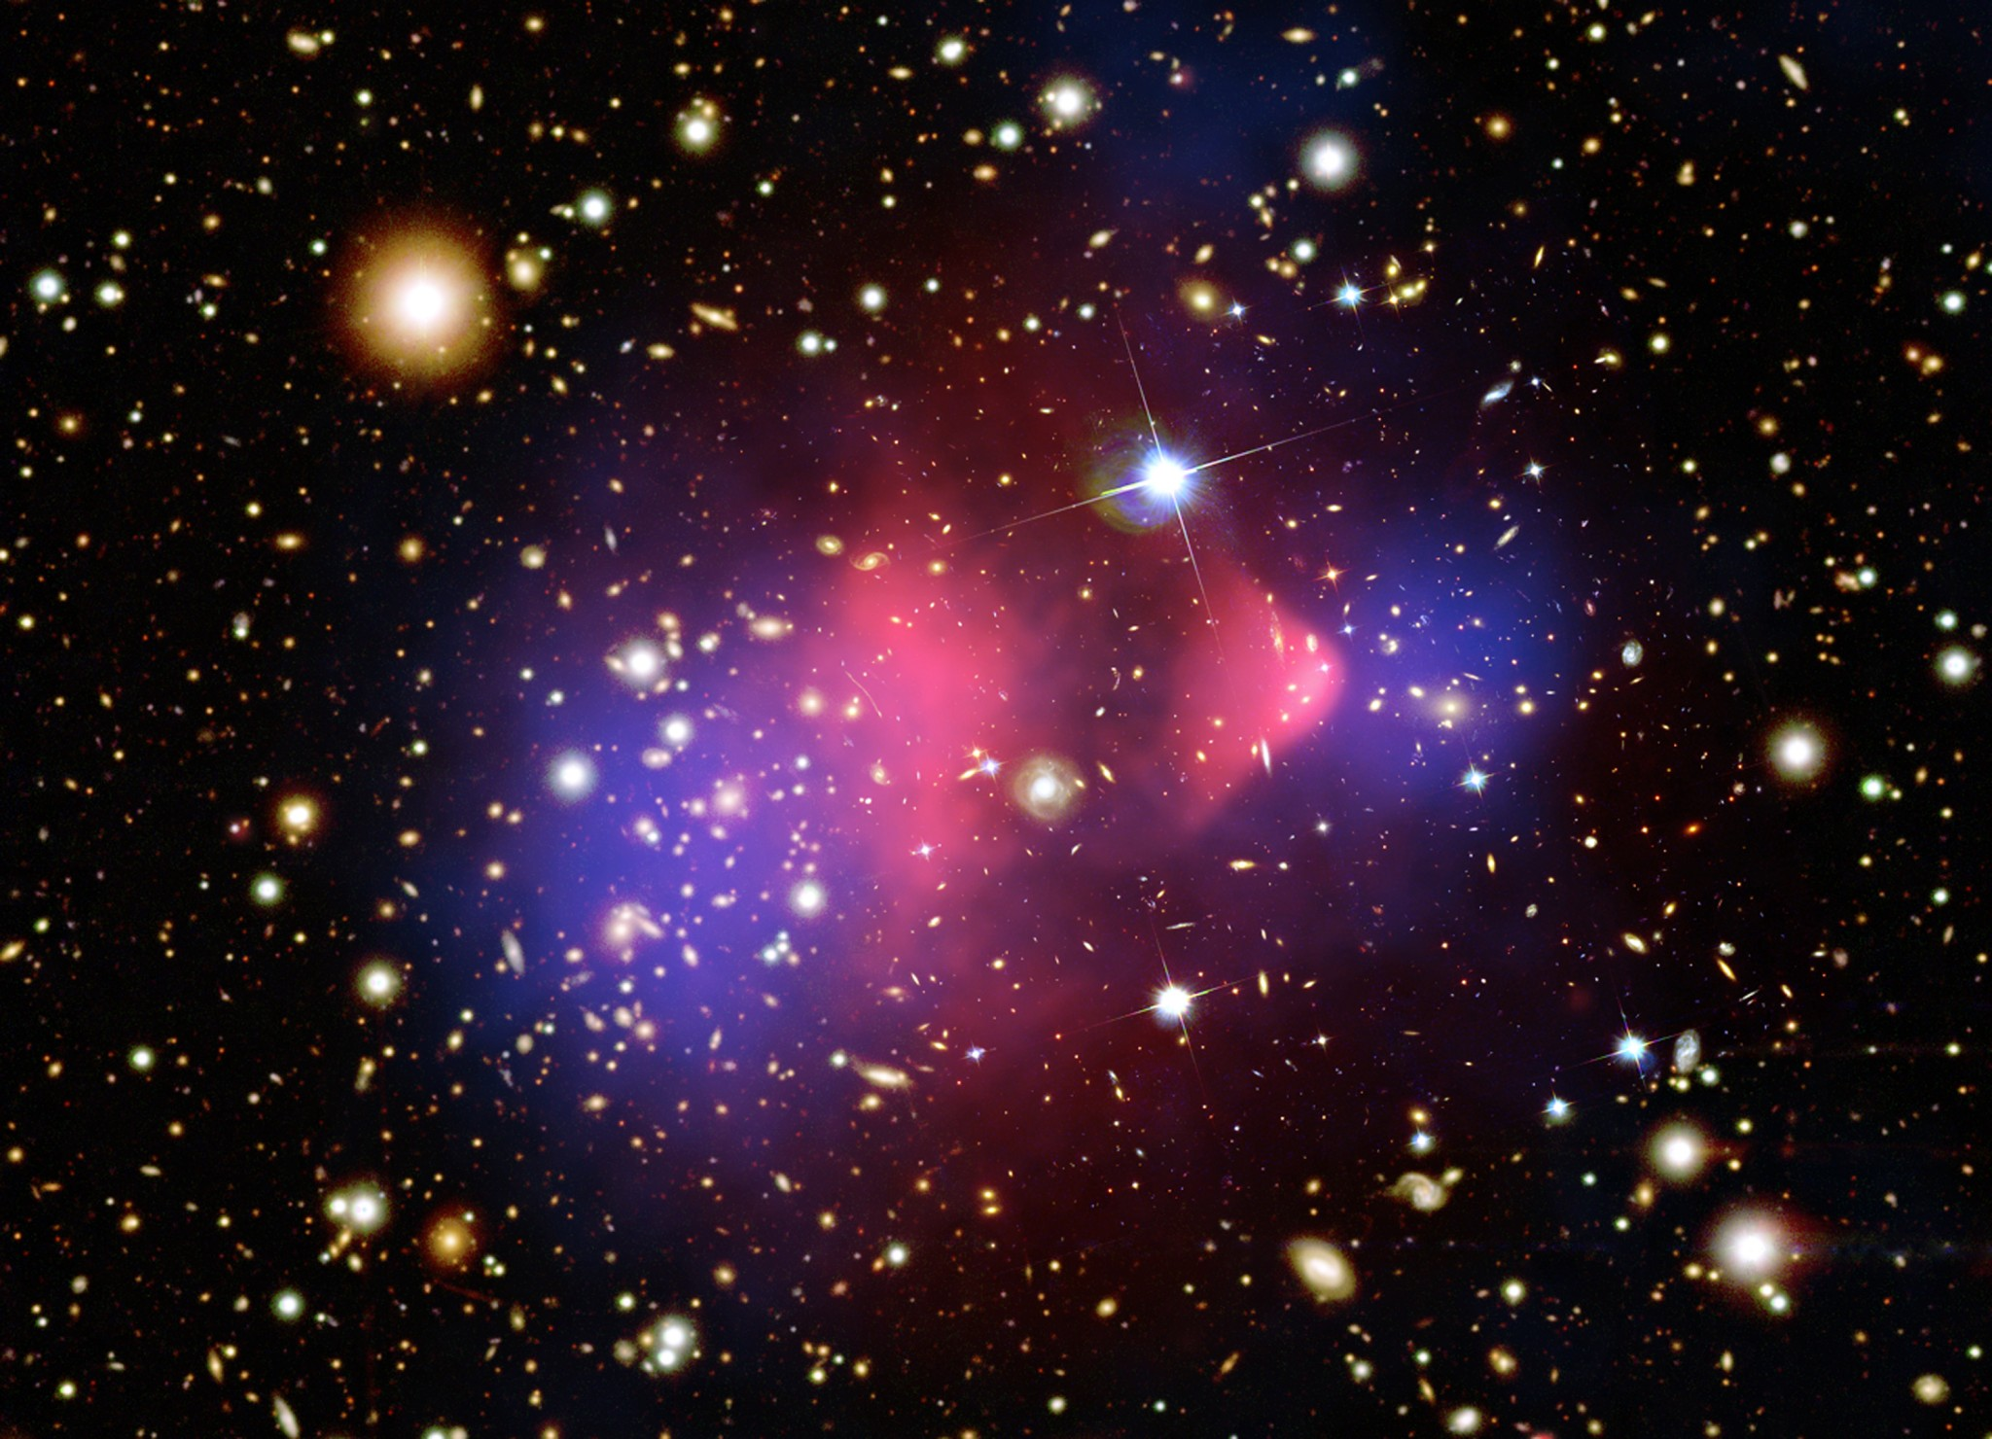
Dark Matter Particles
A consistent hypothesis is the
existence of new particles beyond the Standard Model
W boson mass is sensitive to new, dark matter particles

Slide 19
My Next Research Project Detect Dark Matter Production at Large Hadron Collider (LHC)

Slide 20
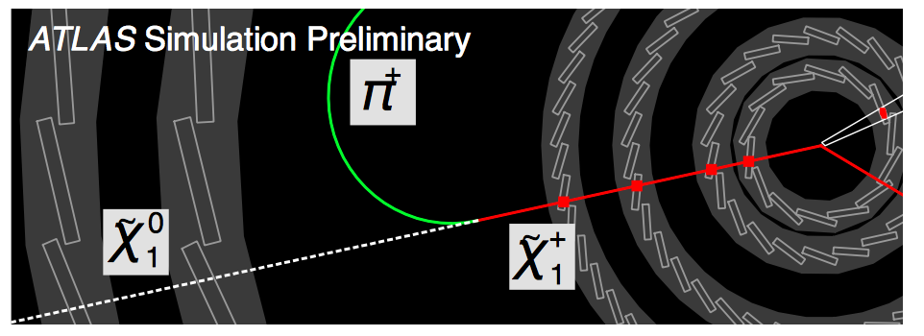
Dark Matter Production at Large Hadron Collider (LHC)
Explains Dark Matter production by the Big Bang in the Universe
I have designed a silicon chip that uses Artificial Intelligence to
identify this process at the LHC
Published in Nature Scientific Reports 11, 18543 (2021)
Operates 100 times faster than latest computers

Slide 21
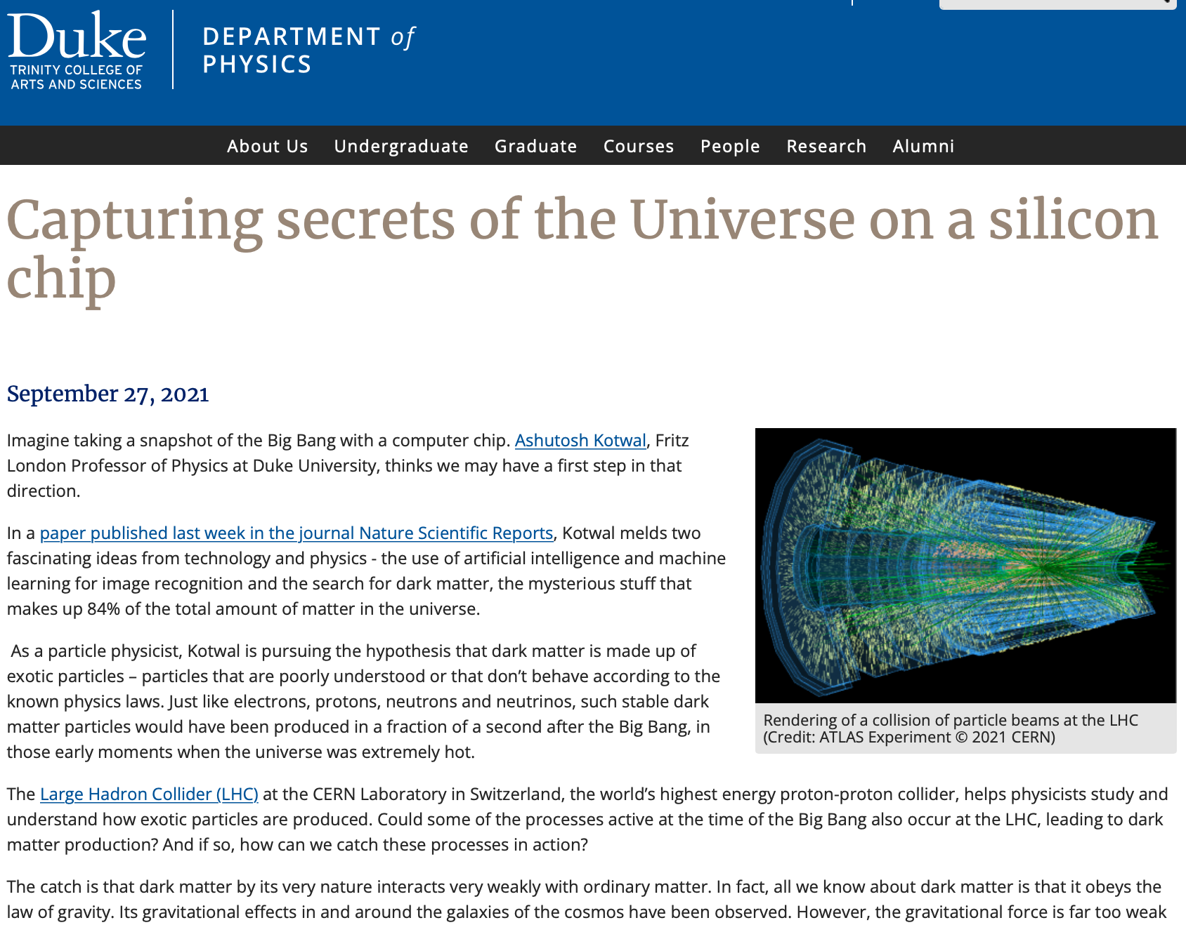
https://physics.duke.edu/news/capturing-secrets-universe-silicon-chip

