Slide 1
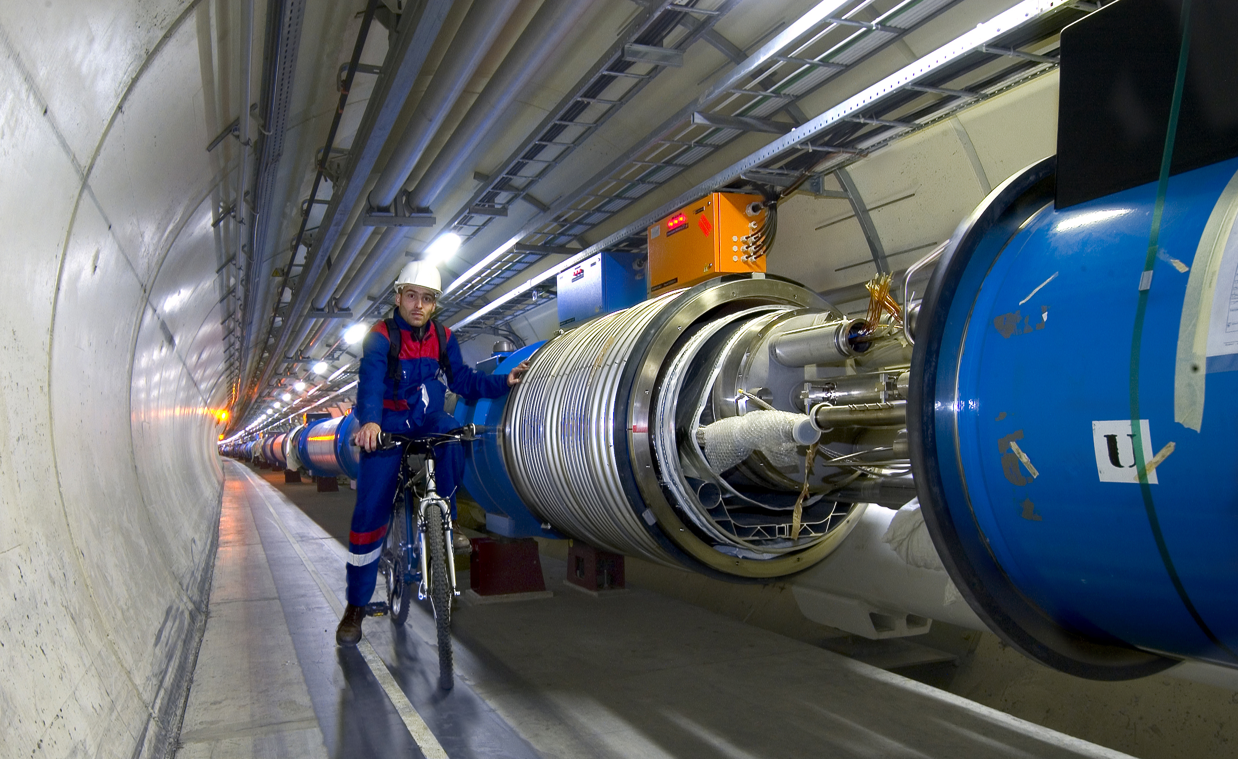
The Higgs Boson, Dark Matter and all that: Revolutionizing the Laws of the Universe with the LHC
Ashutosh Kotwal
Duke University

Slide 3
Alternate title of my talk:

Slide 6
The Higgs boson and Dark Matter are both intimately connected with properties of empty space…
(or what we thought was “empty space”)
…Making these phenomena unlike any other we have observed in the past

Slide 7
Why have we been hunting for the Higgs for more than half a century?
Search culminating in the construction of the
Large Hadron Collider at the CERN Laboratory of Particle
Physics in Geneva, Switzerland

Slide 8
Why have we been hunting for the Higgs for more than half a century?
To solve a deep riddle in Quantum Mechanics, the
proven theory of the microscopic world

Slide 9
20th Century Built on Quantum Mechanics
The scientific advances of the 20th century have transformed our lifestyle
Impact of Quantum Mechanics
All electronics devices, computers and communication
Nuclear power
Atomic and molecular manipulation of materials for chemical and biological applications

Slide 10
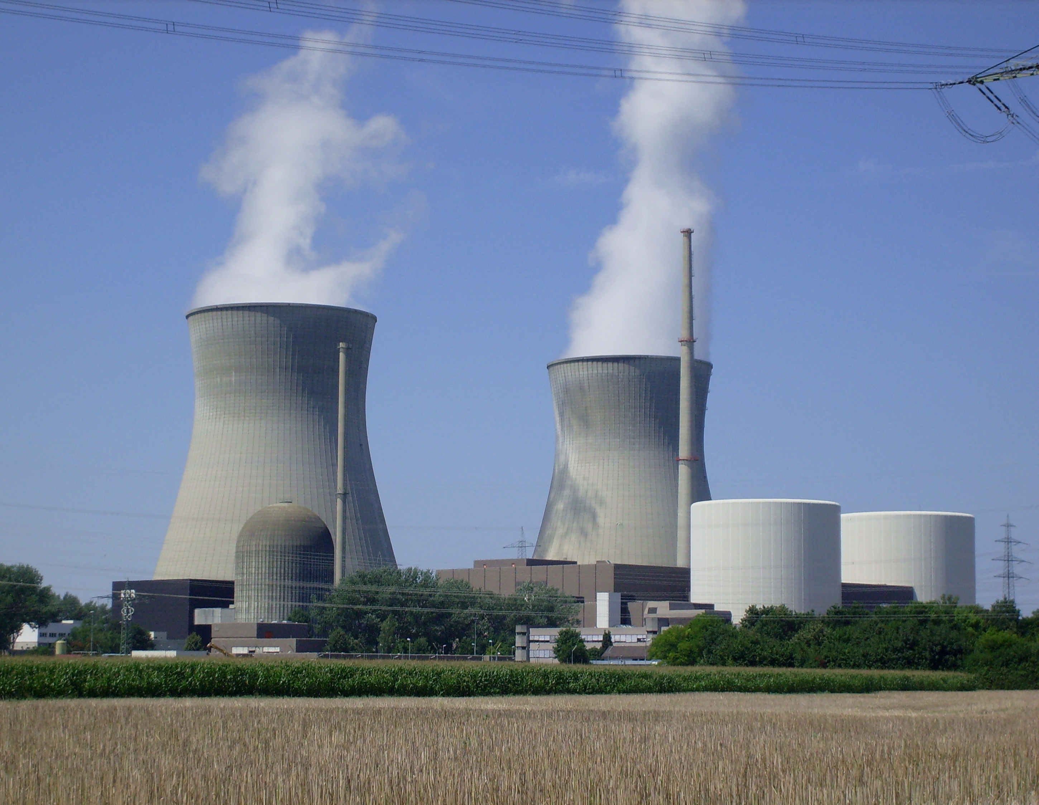
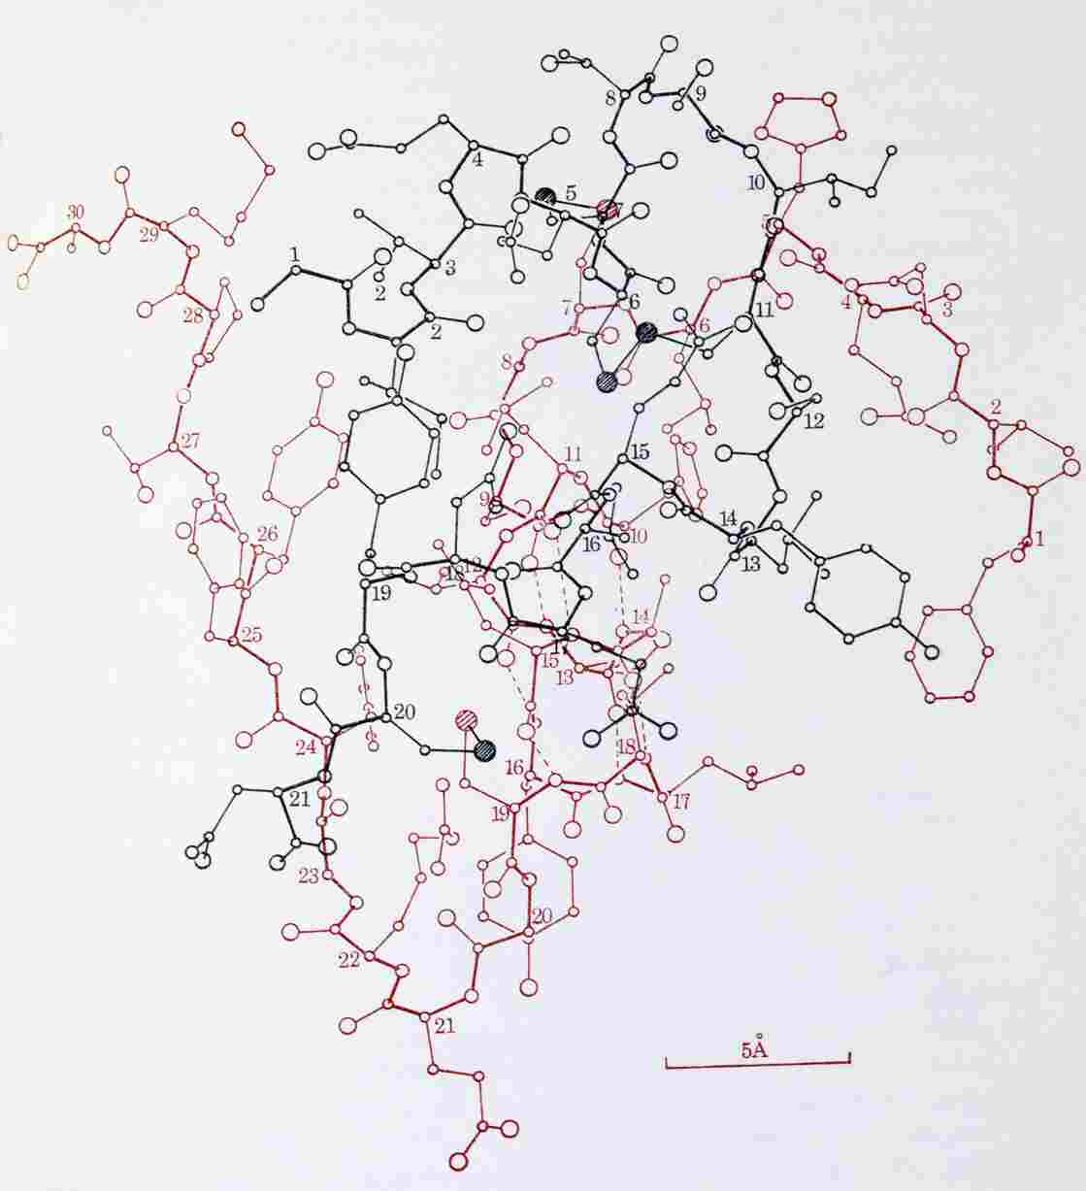
Molecule of Insulin

Slide 11
Conceptual Problem in Quantum Mechanics
In spite of its success, a self-consistent quantum mechanical theory of matter and forces has a huge missing link – the theory requires all fundamental particles to have exactly zero mass
The non-zero electron mass cannot be understood – and yet the electron mass defines the size of the atom and physical and chemical properties of all substances
If the electron’s mass were zero, the atom would not exist

Slide 12
Knowledge from the LHC
Why do fundamental particles have mass?
the Higgs hypothesis
The mystery of Dark Matter –
Could Dark Matter particles be produced at the LHC?

Slide 13
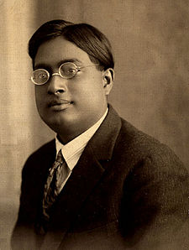
The Higgs Boson
Peter Higgs
Satyendra Nath Bose in 1920’s

Slide 14
How to Predict Fundamental Forces
“fictitious” forces observed in accelerating frame of reference

Slide 15
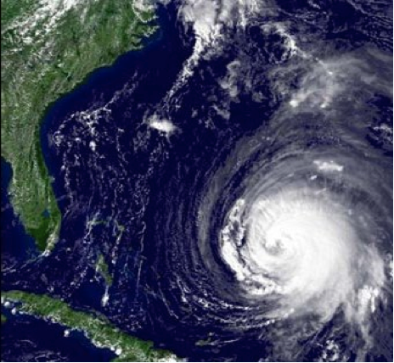
Manifestation of Coriolis Force
Hurricanes appear to rotate in Earth’s frame of reference

Slide 16
Quantum Mechanics force ⬄ particle exchange

Slide 17
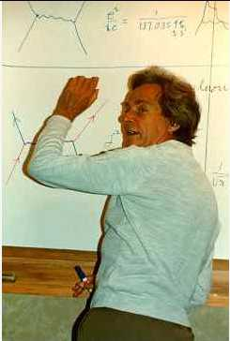
Feynman Diagram: Force by Particle Exchange
Electromagnetic force between two electrons mediated by “photon” exchange
Richard Feynman

Slide 18
Feynman Diagram: Force by Particle Exchange
The most precisely tested theory, ever:
The quantum theory of the electric and magnetic forces, radio waves, light and X-rays:
Measured and predicted magnetic moment of an electron agree within 0.3 parts per trillion accuracy
Electromagnetic force between two electrons mediated by “photon” exchange

Slide 19
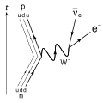
Weak Nuclear Decay
p
ν
The force causing this interaction is described by particles making transitions on a “mathematical sphere”
n
e

Slide 20
Success and Problem of Quantum Mechanics
Success: correct mathematical description of all properties of electromagnetic force and the weak nuclear force
Another prediction: force-mediating particles must be massless
Correct prediction for photon – mediator particle of electric and magnetic forces and all electromagnetic waves: radio, light, microwave, x-rays described by massless photons
Problem: for the weak nuclear force causing nuclear beta-decay, the mediator particle, “W boson” is very heavy
Question: How can we preserve the original theory and simultaneously impart mass to the W boson?

Slide 21
Solution to the Problem of W Boson Mass
Fill all of space with “Higgs” field
W boson propagating through “empty space”
actually propagating though Higgs field
Interaction of W boson with Higgs field slows down the W boson ⬄ imparting the property of mass to it

Slide 22
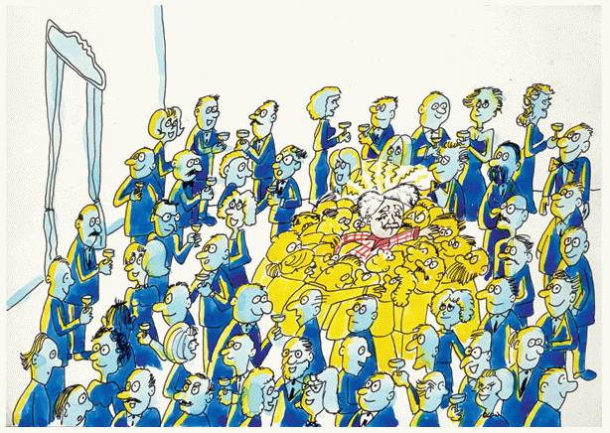
The “Sticky” Higgs Field

Slide 23
Implications of Higgs Hypothesis
Empty space is not really empty
Filled with the Higgs
All fundamental particles interacting with the Higgs field “slow down”
appear to be massive

Slide 24
Light versus Heavy Particles – like moving through water
Streamlined
Moves fast through water
analogous to light particle
Not streamlined
Moves slowly through water
analogous to heavy particle

Slide 25
Detecting the Higgs
Why don’t we see and feel the Higgs?
Our senses and instruments detect electrical charge
Higgs is electrically neutral – has no electric and magnetic interaction!

Slide 26
How can we confirm the existence of the Higgs?
Create ripples in the Higgs field
Ripples ⬄ Higgs boson

Slide 27
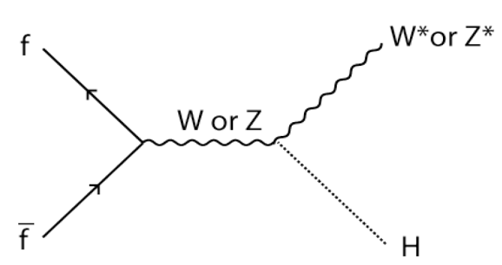
How to Create the Higgs Boson

Slide 28
Evidence of Higgs Boson Production

Slide 29
Evidence of Higgs Boson Production

Slide 30
Higgs Discovery Implications
Provide an understanding of all masses of fundamental particles
Revolutionizes our understanding of empty space ⬄ filled with Higgs
Further studies of the properties of the Higgs are of tremendous importance
Where did this “Higgs field” stuff come from?
Why do different particles interact differently with it?
We are going to be busy studying the Higgs for a while…

Slide 31
The Mystery of Dark Matter

Slide 32
Centripetal Force

Slide 33
Stars Orbiting a Galaxy
Gravity provides the centripetal force

Slide 34
Measuring Velocity with Doppler Shift of Starlight

Slide 35
Galactic Rotation Curve
Stars’ orbit speed too high ⬄ too much centripetal force

Slide 36
Collision of Galaxy Clusters
Luminous Matter (emitting X-rays) separated from total Mass ⬄ confirms Dark Matter hypothesis

Slide 37
Halo of Invisible Dark Matter around Galaxies
Four times as much dark matter as visible matter

Slide 38
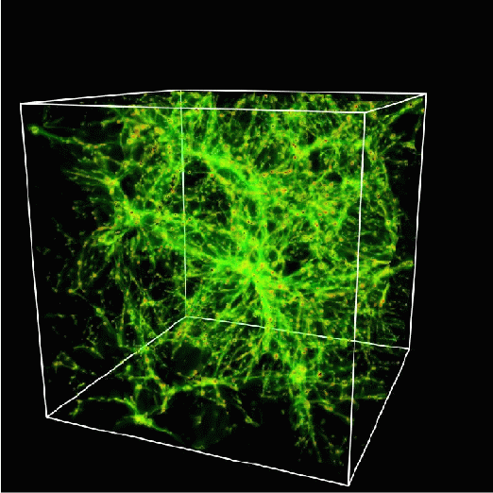
Mapping out the Dark Matter
A lot of dark matter is required to hold galaxies together
It cannot all be made of protons
It must be neutral, stable, heavy
It must be some new form of matter – new fundamental particles

Slide 39
Feynman Diagram depicting Production of Dark Matter Particles at LHC

Slide 40
Feynman Diagram depicting Production of Dark Matter Particles at LHC

Slide 41
Simulated Dark Matter Particle Production at LHC

Slide 42
Dark Matter Particles
Bridge between cosmology, astrophysics and particle physics
“Supersymmetry” theory predicts dark matter particles
Supersymmetry ⬄ quantum properties of space ⬄ dawn of a “new quantum mechanics”

Slide 43
Black Holes at the LHC The Possibility and the Myth

Slide 44
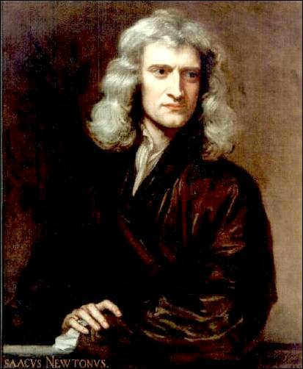
Isaac Newton
1687: Space and time are the static stage
on which physical processes act

Slide 45
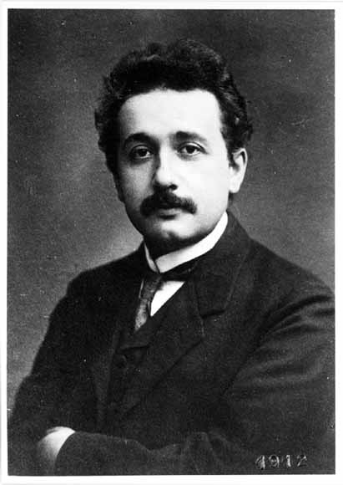
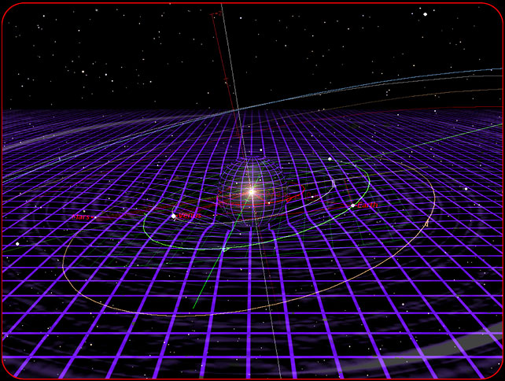
Albert Einsten
1915: Spacetime is an active player:
curves, expands, shrinks, …

Slide 46
Matter and Energy Curves Space

Slide 47
Einstein’s Attempt to Unify Electromagnetism and Gravity

Slide 48
The problem with gravity
Gravity is a very weak force
F_{gravity} ~ 10⁻³⁶ F_{EM}
Very likely, we are missing something important. Why is gravity so weak compared to other forces?
Maybe it isn’t…

Slide 49
Curled-up Extra Dimensions of Space

Slide 50
Newton’s Law
In this case, gravity may be strong but appear weak only because its strength is diluted by extra dimensions.
F_{gravity} ~ 1/r ^{2+n}
for small lengths r, where n is the number of extra dimensions

Slide 51
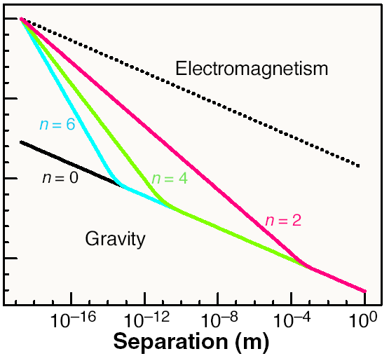
1
10⁻²⁰
10⁻⁴⁰
Feng, Science (2003)
10⁻⁶⁰

Slide 52
Microscopic Black Holes at LHC
If two particles pass close enough with enough energy, they will form a microscopic black hole
For 3 spatial dimensions, gravity is too weak for this to happen. But with extra dimensions, gravity becomes stronger, micro black holes can be created in particle collisions!

Slide 53
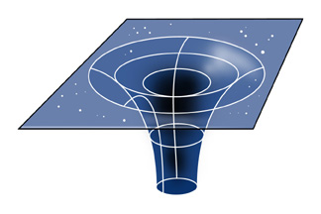
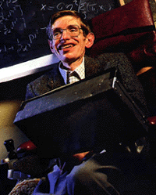
Microscopic Black Holes
In Einstein’s theory, light and other particles do not escape; black holes are black.
γ
γ
But quantum mechanically, black holes radiate according to Stephen Hawking; black holes emit light!

Slide 54
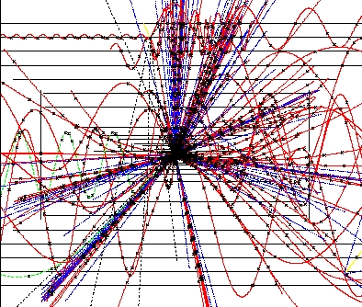
Black Hole Evaporation
“Normal” black holes:
Mass: M_{BH} ~ M_{sun}
Size: kilometer
Temperature: 0.01 K
Lifetime: ~ forever
Micro black holes:
Mass: M_{BH} ~ 1000 M_{proton}
Size: 10⁻¹⁸ m
Temperature: 10¹⁶ K
Lifetime: 10⁻²⁷ seconds
Microscopic black holes explode!

Slide 55
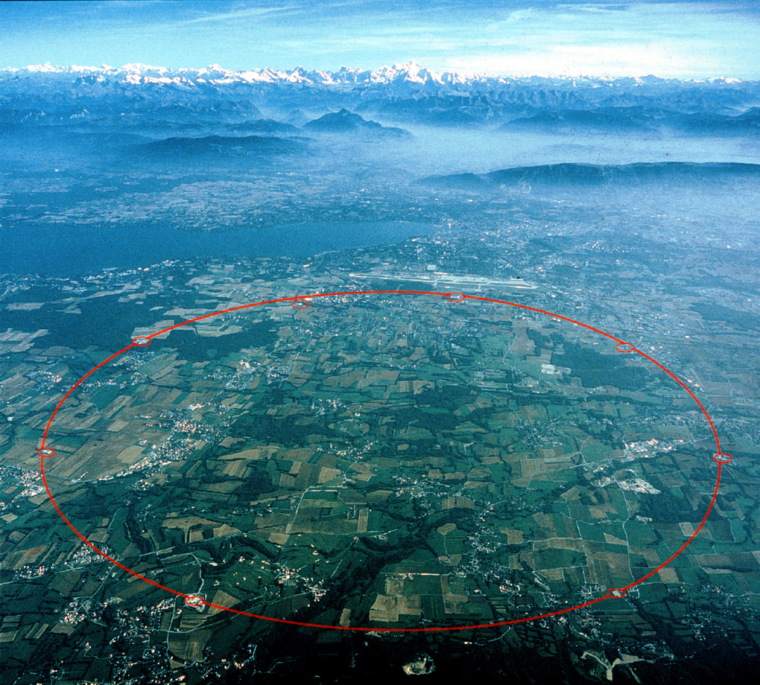
Black Holes at LHC
If effects of strong gravity, for example black holes, are observed ⬄ revolutionize our understanding of space itself
Closer to Einstein’s last dream
Closer to a quantum theory
of Gravity
p
p

Slide 56
How does LHC work?

Slide 57
How does a particle accelerator work?

Slide 58
LHC below Geneva, Switzerland

Slide 59
LHC below Geneva, Switzerland
Accelerates and collides proton beams, each 4 micrometers wide

Slide 60
LHC Accelerator in Tunnel
Vacuum in the beampipe is better than vacuum in outer space

Slide 61
LHC Superconducting Magnet
Weight 35 tons, magnetic field 100,000 times Earth’s magnetic field
Magnetic force is thousands of tons

Slide 62
LHC Superconducting Magnet
Similar magnet design used in MRI machines

Slide 63
LHC Superconducting Magnet
1200 magnets lowered 100 meters down into tunnel,
distributed over 27 kilometers

Slide 64
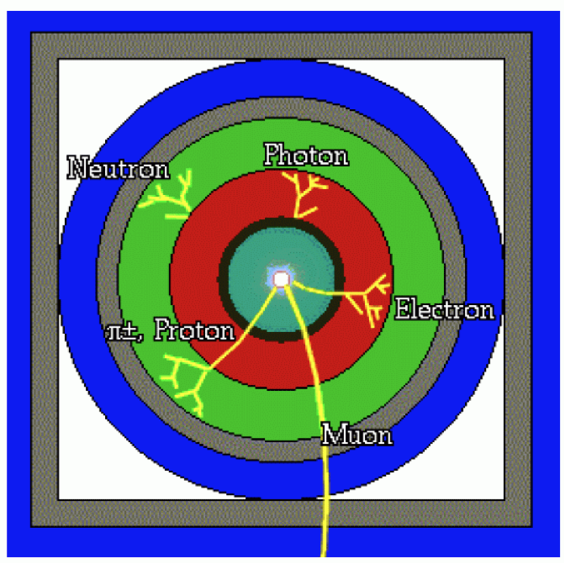
Particle Detector Design
Concentric cylinders of different kinds of detector technologies
Decay products of unstable particles identified

Slide 65
LHC Particle Detector – CMS Experiment
size about 20 meters
weight 12,000 tons (more than Eiffel Tower)

Slide 66
CMS (Compact Muon Solenoid) Experiment
Very large, very fast “digital camera”
60 million pixels, can take 40 million snapshots per second

Slide 67
Physicists in the Control Room
24 hours x 7 days x 365 days x 10 years operation

Slide 68
Why LHC Works

Slide 69
Life after LHC?
Interest in Europe, USA and China to build a higher-energy proton-proton collider
Need a bigger tunnel !
Need more powerful magnets !!

Slide 70
Life after LHC?
A possible big tunnel close to CERN, Geneva, Switzerland

Slide 71
Life after LHC?
A possible even bigger tunnel close to Chicago !!

Slide 72
Conclusion
LHC is operating successfully – a great achievement of science and engineering and of international cooperation
Higgs boson discovery confirms theory of massive particles
Vacuum is actually permeated with the Higgs field
Discovering other Higgs properties could start a new revolution in physics
As grand as the revolution started by quantum mechanics and theories of relativity a century ago
Phenomena still not understood
What causes the Higgs field to condense?
What is Dark Matter ?
Can we understand the force of gravity from the Quantum perspective?

Slide 73
Thank You!

Slide 74
Thank You!

