Slide 1
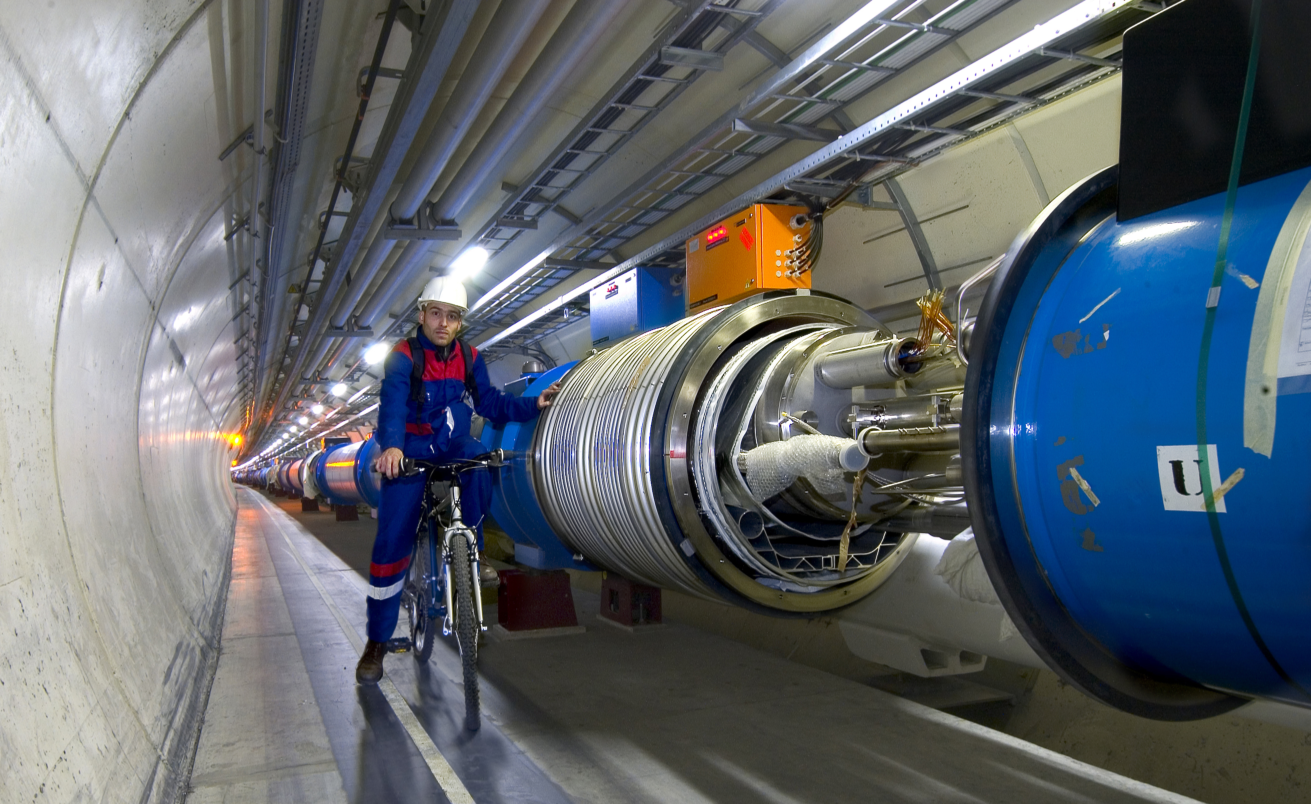
Beyond the Higgs boson – the Origin of Matter, Dark Matter and the Collider after LHC
Ashutosh Kotwal
Duke University

Slide 2
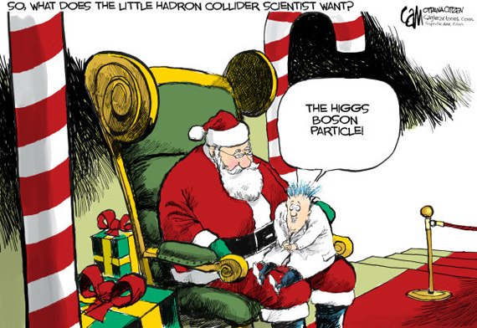

Slide 3

Alternate title of my talk:

Slide 4
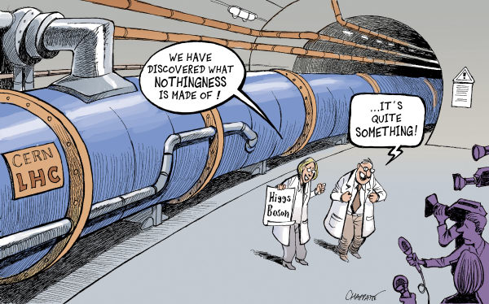

Slide 5
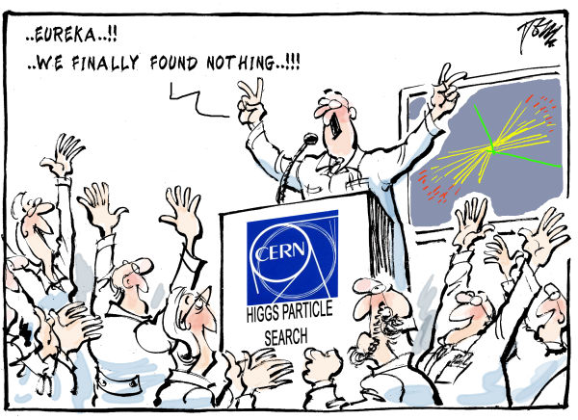

Slide 6
The Higgs boson and Dark Matter are both intimately connected with properties of empty space…
(or what we thought was “empty space”)
…Making these phenomena unlike any other we have observed in the past

Slide 7
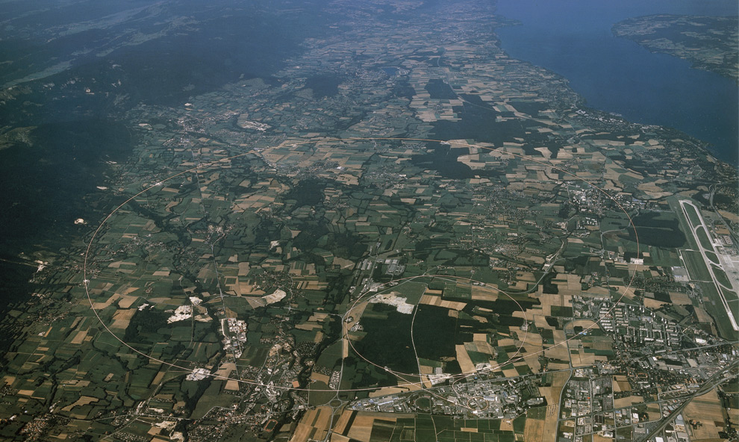
Why have we been hunting for the Higgs for more than half a century?
Search culminating at the Large Hadron Collider at the CERN Laboratory of Particle Physics in Geneva, Switzerland

Slide 8
Dawn of a New Age of Exploration into Nature
The Higgs is unlike any other fundamental state of nature
It is not matter
It is not a force
The Higgs field is a completely new kind of “stuff”, observed for the first time ever

Slide 9
20th Century Built on Quantum Mechanics
The scientific advances of the 20th century have transformed our lifestyle
Impact of Quantum Mechanics
  All electronics devices, computers and communication
  Nuclear power
  Atomic and molecular manipulation of materials for chemical and biological applications

Slide 10
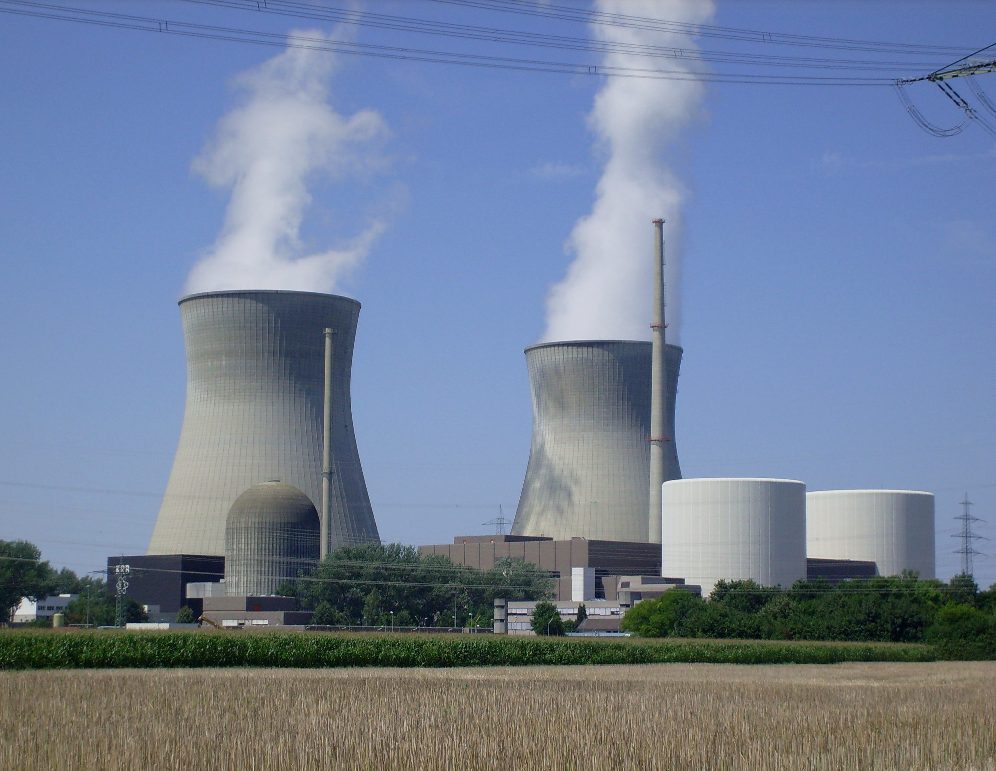
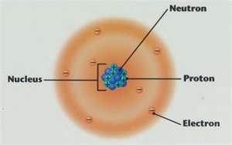
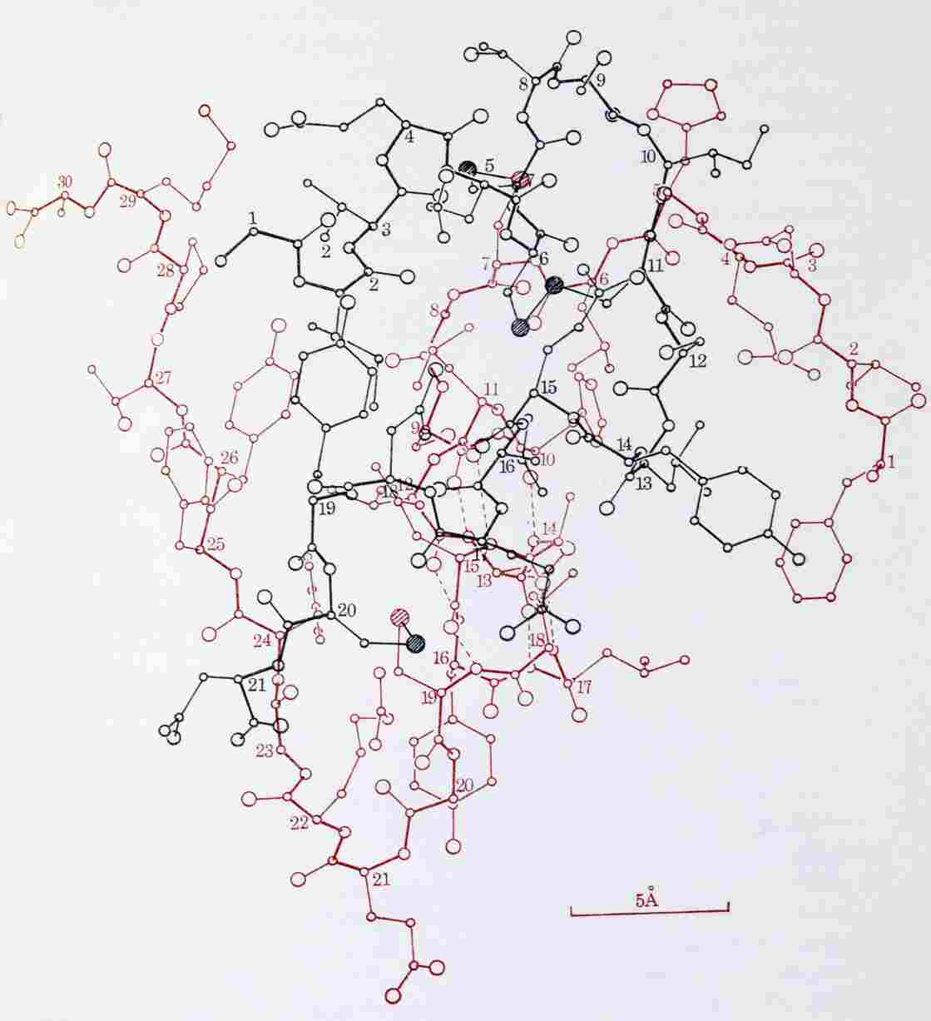

Molecule of Insulin

Slide 11
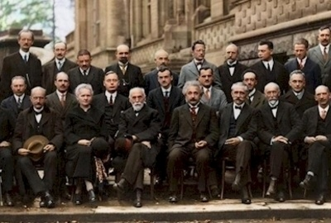
Founders of 20th Century Physics

Slide 12
Foundations of 20th Century Physics
Quantum Mechanics
Special Relativity
Combination of these fundamental principles – Relativistic Quantum Theory

Slide 13
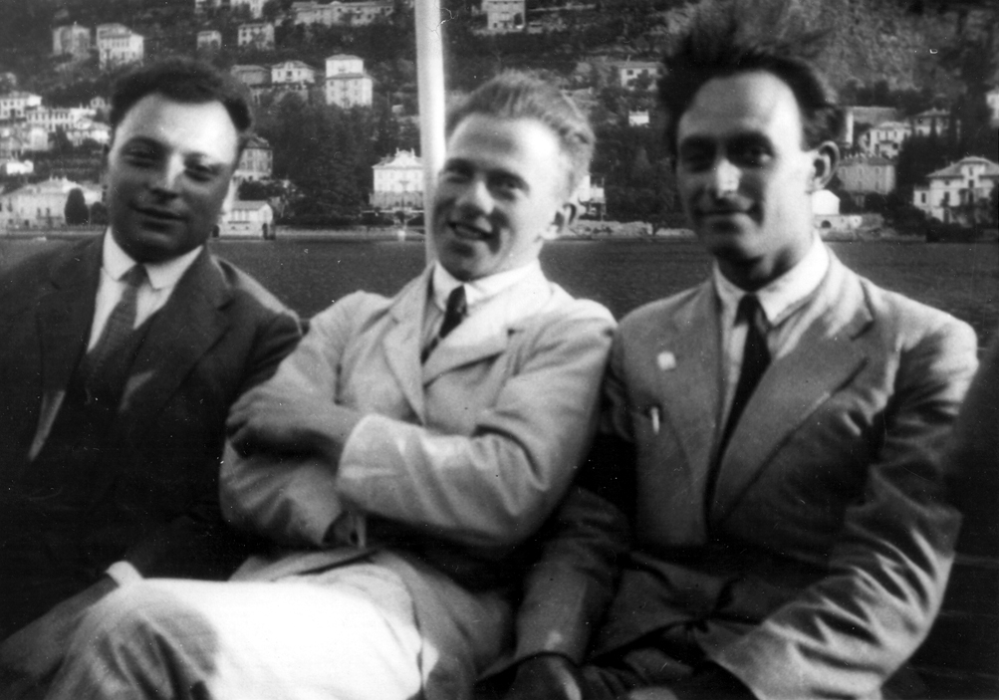
Pauli, Heisenberg and Fermi

Slide 14
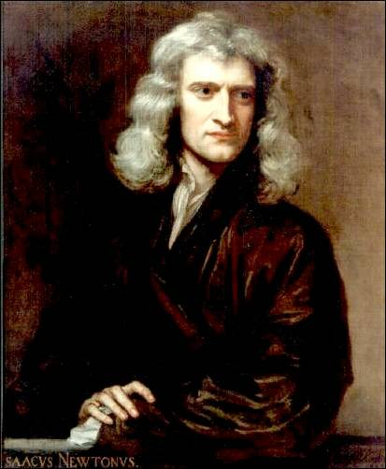

Isaac Newton
Y
X
1687: Space and time are the static stage on which physical processes act
Space and time are disconnected from each other

Slide 15
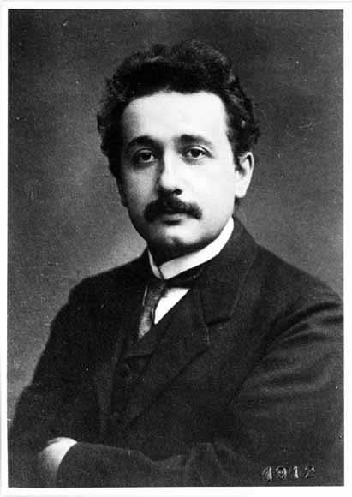
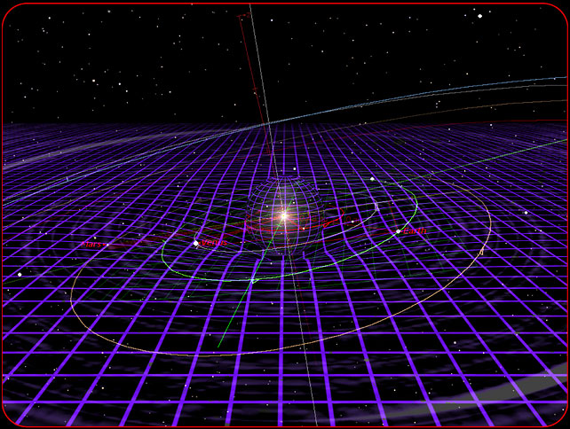
Albert Einstein
1915: Spacetime is active: curves, expands, shrinks, …
3-space directions and time direction are combined into a single 4-dimensional spacetime

Slide 16
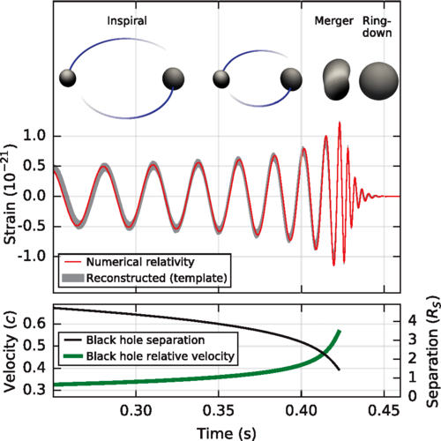
Gravitational Wave from Black Holes Inspiral
Courtesy CalTech/MIT/LIGO Laboratory

Slide 17
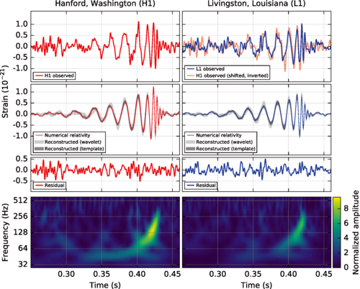
Gravitational Wave Detection
Courtesy CalTech/MIT/LIGO Laboratory

Slide 18
Founders of 20th Century Physics

Slide 19
Founders of 20th Century Physics

Slide 20
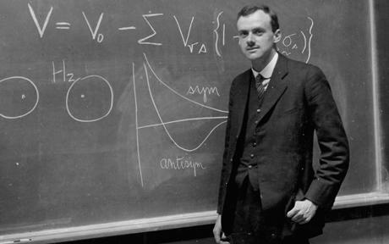
Einstein’s Equal?

Slide 21
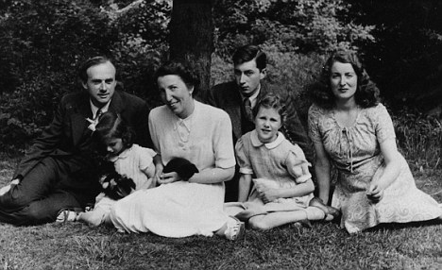
Paul Dirac with Family

Slide 22
Foundations of 20th Century Physics
Quantum Mechanics
Special Relativity
Combination of these fundamental principles – Relativistic Quantum Theory
  Initiated by Paul Dirac

Slide 23
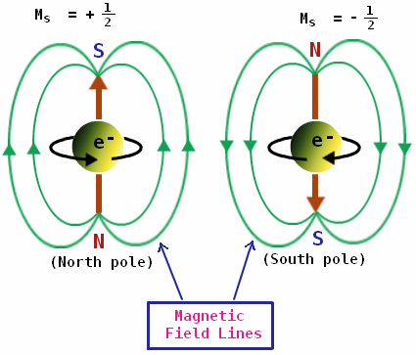
Fundamental Properties of Electrons

Slide 24
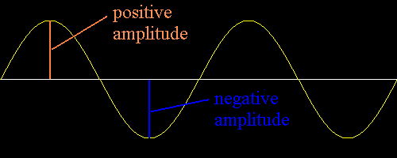
Effect of Complete Rotation
Quantum Mechanics + Special Relativity => Dirac and others showed mathematically that electron can be the type of particle that becomes negative of itself under a complete rotation

Slide 25
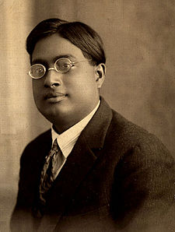
Identical Particles are Indistinguishable
Bose solved a major puzzle in quantum mechanics by proving that particles of the same type are indistinguishable
Satyendra Nath Bose in 1920’s

Slide 26
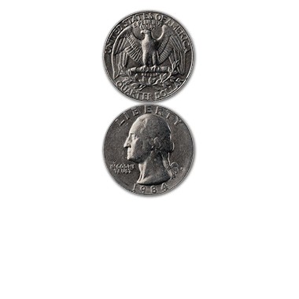
Towards a Fundamental Theory of Matter
Interchange between two electrons ⬄ rotate one by 360 deg.

Slide 27
Why Matter Occupies Volume
ψ(e₁, e₂) = - ψ(e₂, e₁)
But if two electrons occupied the same spot in space
ψ(e₁, e₂) = ψ(e₂, e₁)
Wave that both equal to itself and equal to negative of itself must be ZERO
Pauli Exclusion Principle – identical particles like electrons, protons, neutrons cannot be at the same point in space at the same time
This is a fundamental explanation for why matter is made up of fermions and why matter occupies volume

Slide 28
Dirac’s Theory of Matter Particles (Fermions)

Slide 29
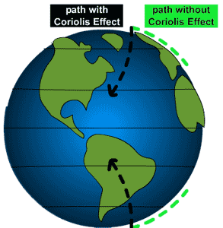
How to Predict Fundamental Forces
“fictitious” forces observed in accelerating frame of reference

Slide 30
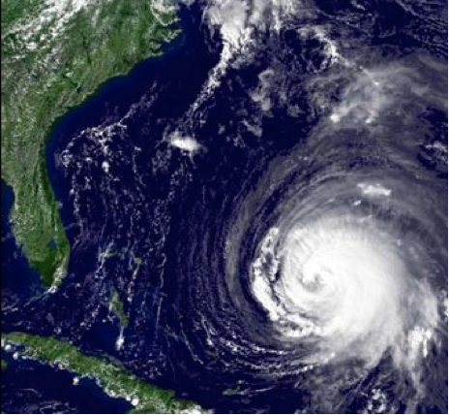
Manifestation of Coriolis Force
Hurricanes appear to rotate in Earth’s frame of reference

Slide 31

Quantum Mechanics force ⬄ particle exchange

Slide 32
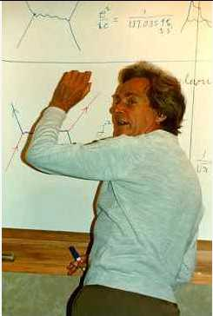
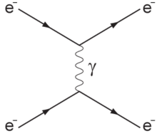
Feynman Diagram: Force by Particle Exchange
Electromagnetic force between two electrons mediated by “photon” exchange
Richard Feynman

Slide 33
Feynman Diagram: Force by Particle Exchange
The most precisely tested theory, ever:
The quantum theory of the electric and magnetic forces, radio waves, light and X-rays:
Measured and predicted magnetic moment of an electron agree within 0.3 parts per trillion accuracy
Electromagnetic force between two electrons mediated by “photon” exchange

Slide 34

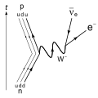

Weak Nuclear Decay
p
ν
The force causing this interaction is described by particles making transitions on a “mathematical sphere”
n
e

Slide 35
Success and Problem of Force Theory
Success: correct mathematical description of all properties of electromagnetic force and the weak nuclear force
Another prediction: force-mediating particles must be massless
Correct prediction for photon – mediator particle of electric and magnetic forces and all electromagnetic waves: radio, light, microwave, x-rays described by massless photons
Problem: for the weak nuclear force causing nuclear beta-decay, the mediator particle, “W boson” is very heavy
Question: How can we preserve the original theory and simultaneously impart mass to the W boson?

Slide 36
Scorecard
Combining quantum mechanics and special relativity gave exact prediction of
  Matter particles (fermions)
  Force mediating particles (gauge bosons)

Slide 37
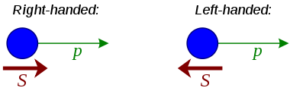
Dirac Encore - handed Fermions
Dirac predicted electrons (and all fermions) to be left- or right-handed
Dirac predicted that electrons (and all fermions) need not have the same interactions for left-handed and right-handed
Predated by two decades the Nobel-prize winning discovery that the weak interaction was felt by left-handed fermions only

Slide 38

Mirror Images Behave Differently

Slide 39
“Massive” Problem
Left-handed and right-handed fermions interact differently => they must all be massless
Force-mediators must also be massless
All particles must be massless
Mass cannot be a fundamental property, it must be an emergent property
Mass must arise from within the dynamics of the theory

Slide 40
Solution to the Problem of Mass
Fill all of space with “Higgs” field
Particles propagating through “empty space”
actually propagating though Higgs field
Interaction of particles with Higgs field slows down the particle ⬄ imparting the property of mass to it

Slide 41
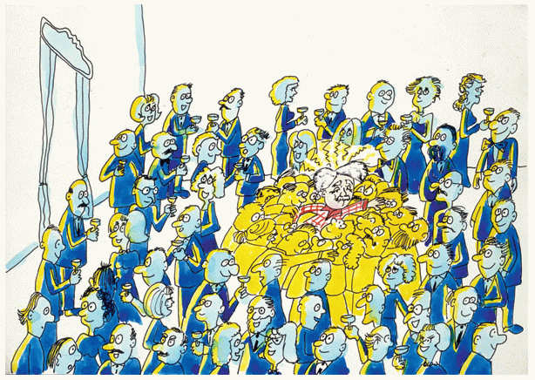
The “Sticky” Higgs Field

Slide 42
Implications of Higgs Discovery
Empty space is not really empty
Filled with the Higgs
All fundamental particles interacting with the Higgs field “slow down”
  appear to be massive

Slide 43


Light versus Heavy Particles – like moving through water
Streamlined
Moves fast through water
analogous to light particle
Not streamlined
Moves slowly through water
analogous to heavy particle

Slide 44
Detecting the Higgs
Why don’t we see and feel the Higgs?
Our senses and instruments detect electrical charge
Higgs is electrically neutral – has no electric and magnetic interaction!

Slide 45

How can we confirm the existence of the Higgs?
Create ripples in the Higgs field
Ripples ⬄ Higgs boson

Slide 46
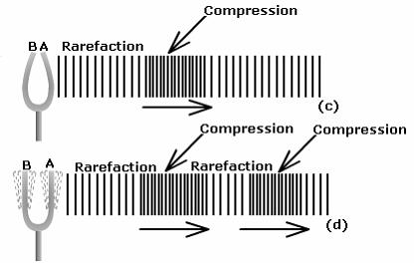
How can we confirm the existence of the Higgs?
Create ripples in the Higgs field
Ripples ⬄ phonons ⬄ Higgs boson

Slide 47
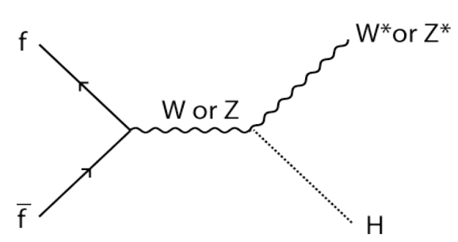
How to Create the Higgs Boson

Slide 48
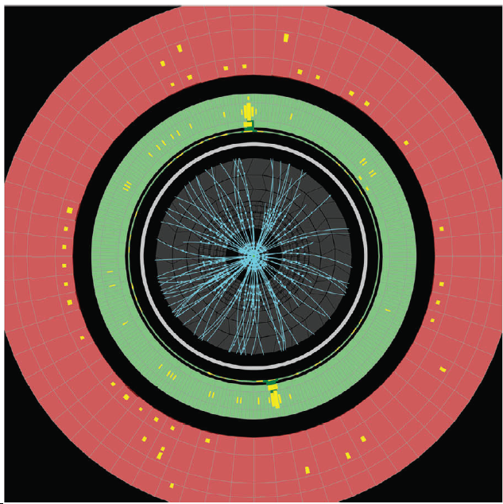
Evidence of Higgs Boson Production

Slide 49
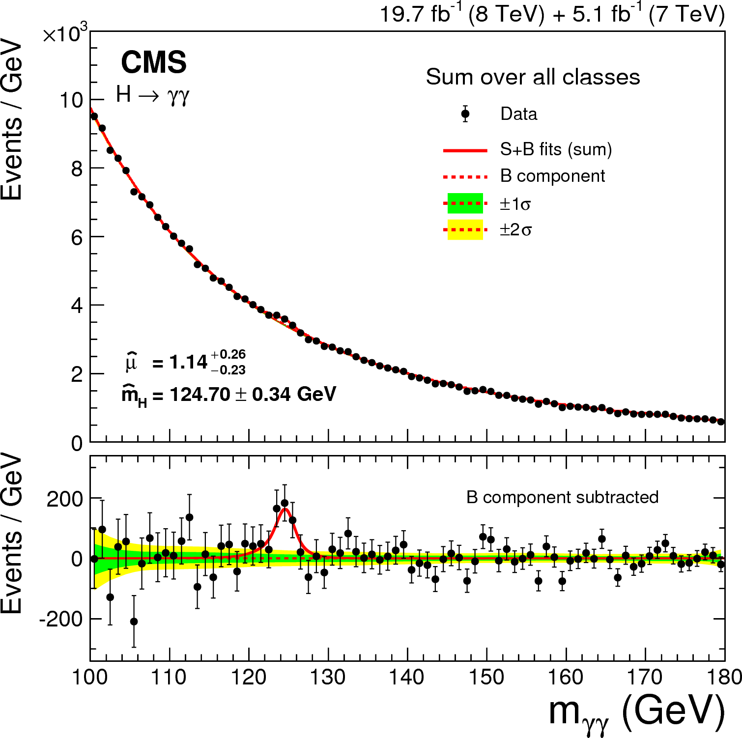
Observation of Higgs Boson Production

Slide 50
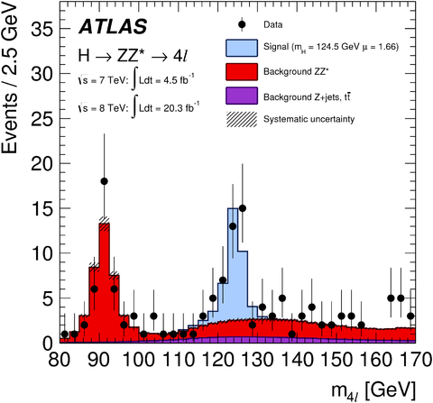
Observation of Higgs Boson Production

Slide 51
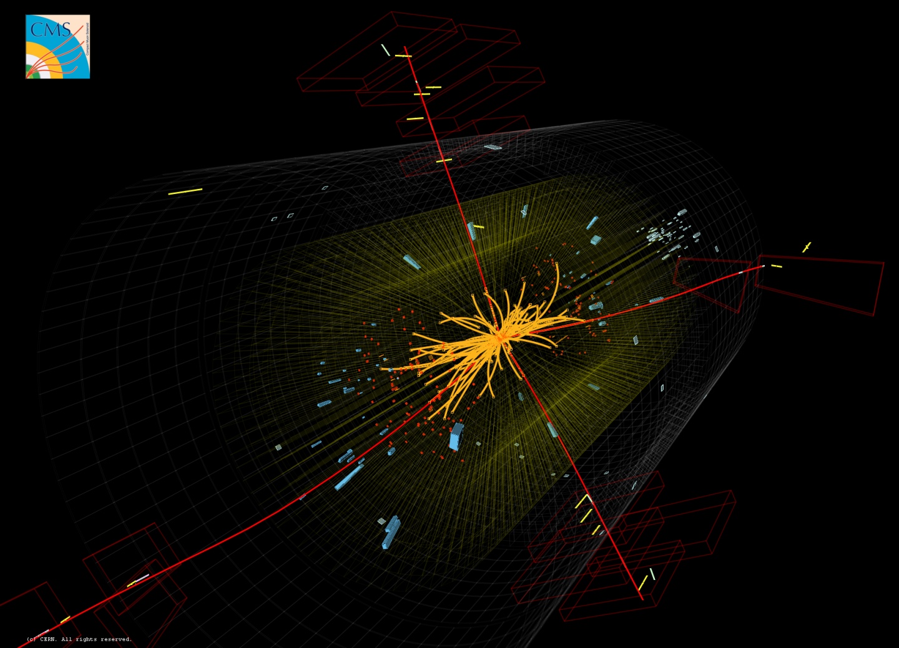
Higgs Boson Production and Detection at CMS

Slide 52
Higgs Discovery Implications
Provide an understanding of all masses of fundamental particles
Revolutionizes our understanding of empty space ⬄ filled with Higgs

Slide 53
Why aren’t we satisfied?
Why does the Higgs field condense all over space ?
  We understand other condensation phenomena at the microscopic level…condensation of gases to liquids and solids for example
We need a similar, dynamical explanation for condensation of the Higgs field
Additional ingredients and new physics principles are required to explain this condensation process..
  The confirmed theory of fundamental particles and forces – “the Standard Model of Particle Physics’, CANNOT explain this condensation process

Slide 54
The Mystery of
AntiMatter

Slide 55
Dirac…Yet Again
Upon Combining quantum mechanics and special relativity, Dirac made another revolutionary prediction…
his prediction of antimatter
For every fermion there is a corresponding fermion with all identical properties except opposite charge

Slide 56



AntiMatter

Slide 57
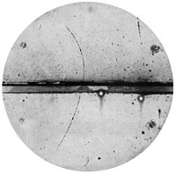
Positron Discovery (Anderson, 1932)
Same charge/mass ratio as electron, but bends the opposite
direction in a magnetic Field
=> opposite charge compared to electron

Slide 58
Anti-Matter Property Measurements
Anti-Hydrogen atom (anti-proton + positron) identical to hydrogen within 1/100 million
Anti-proton identical to proton
  within 1/billion for mass
  1/trillion for charge/mass ratio
Heavier atomic nuclei of antimatter also produced and measured
Routinely used as tracer for medical diagnosis

Slide 59
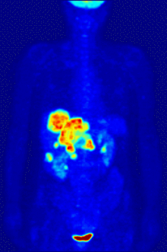
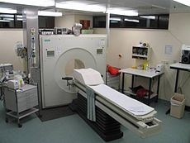

Positron Emission Tomography

Slide 60
The Mystery of the Missing
AntiMatter

Slide 61
Matter-AntiMatter Symmetry
Laws of nature have been proven to be (almost) exactly identical for matter and antimatter
There should be equal amounts of matter and antimatter in the Universe
Where is the MISSING antimatter?
WE need an excess of matter over antimatter in order for galaxies, stars, planets and us to exist…

Slide 62
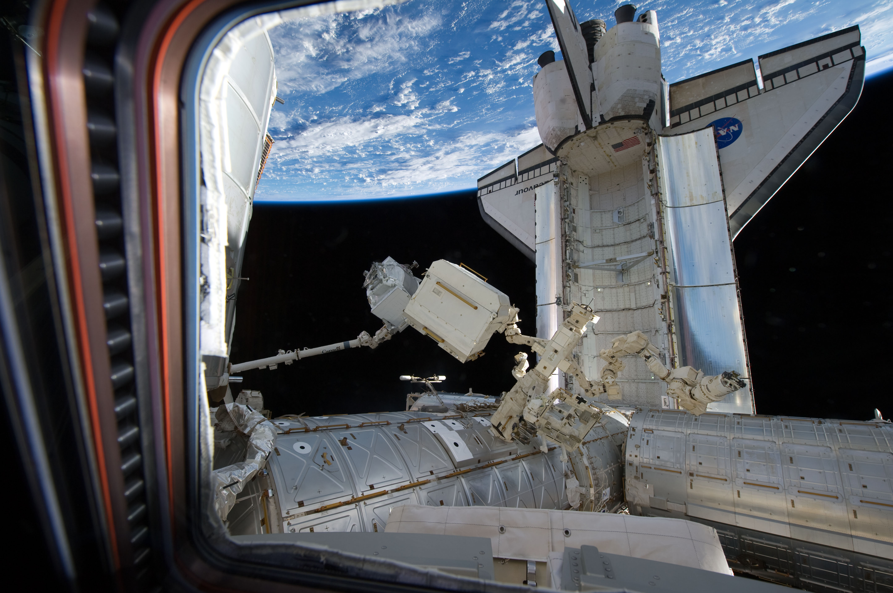
Antimatter Detector in Space

Slide 63
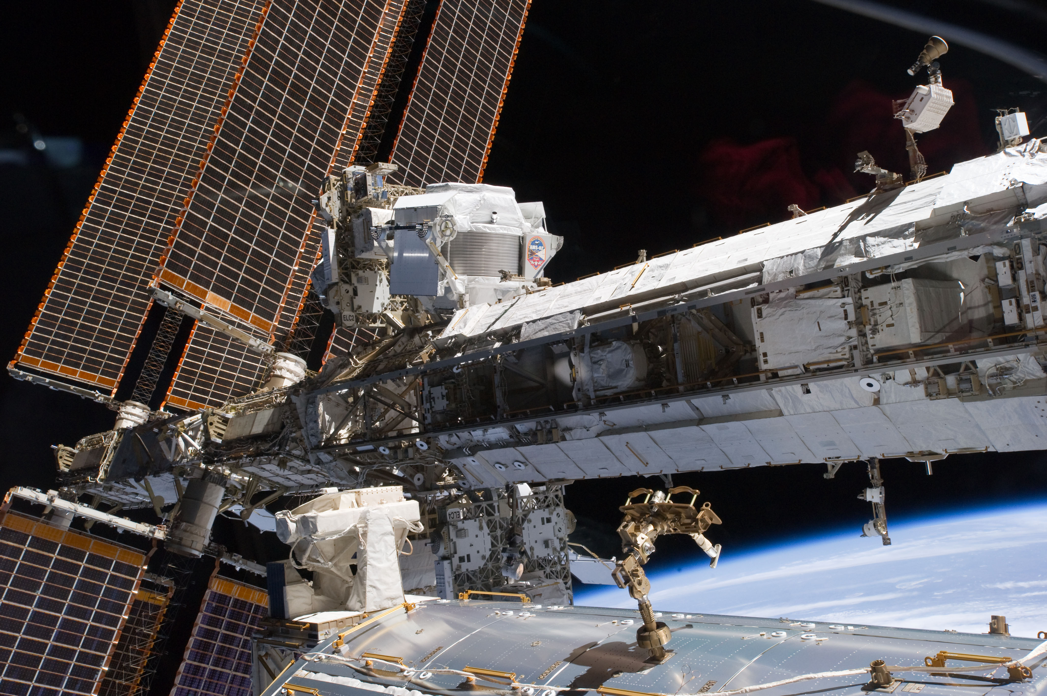
Antimatter Detector in Space
Very little antimatter found in space

Slide 64
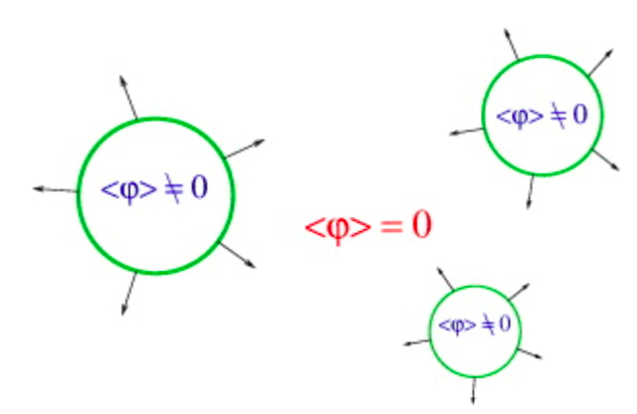
Higgs Condensation

Slide 65
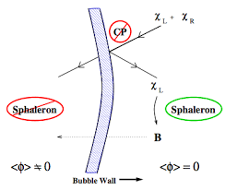
Matter Excess during Higgs Condensation

Slide 66
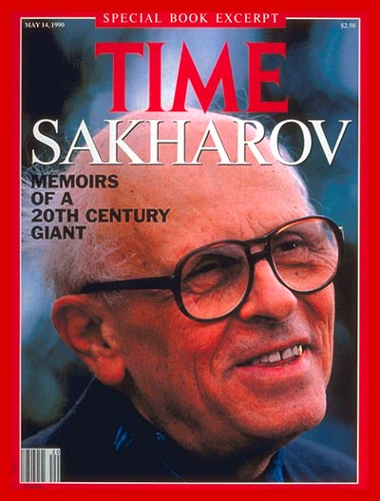
Sakharov Conditions for Matter Excess
Andrei Sakharov calculated three conditions that must exist in early Universe for creation of matter excess
Current proven theory, the Standard Model of Particle Physics, satisfies only one of these conditions

Slide 67
Sakharov Conditions for Matter Excess
By invoking new physics principles, we can calculate that all Sakharov conditions can be
satisfied…in the same processes that cause Higgs condensation
A bigger accelerator than Large Hadron Collider can achieve the Sakharov conditions

Slide 68
Where we have arrived…
Following the brilliant insights of Dirac and others, we can understand
  Why there is matter and antimatter
  Why matter occupies volume
  How matter interacts via forces
  The properties of forces
  The need for the Higgs field

Slide 69
But still open questions remain…
The Higgs is a completely new kind of “stuff”, never before seen in nature
It is NOT matter
It is NOT a force
it has condensed everywhere, even in empty space in the entire Universe
We have no proven theory of this condensation process

Slide 70
And still more open questions remain…
All the antimatter that should exist is missing
Could the Higgs condensation process and the excess of matter-over-antimatter creation be related?
YES
Could we discover these mechanisms at a higher energy particle collider?
YES
Is such a collider technically feasible?
YES

Slide 71
The Mystery of
Dark Matter

Slide 72

Centripetal Force

Slide 73
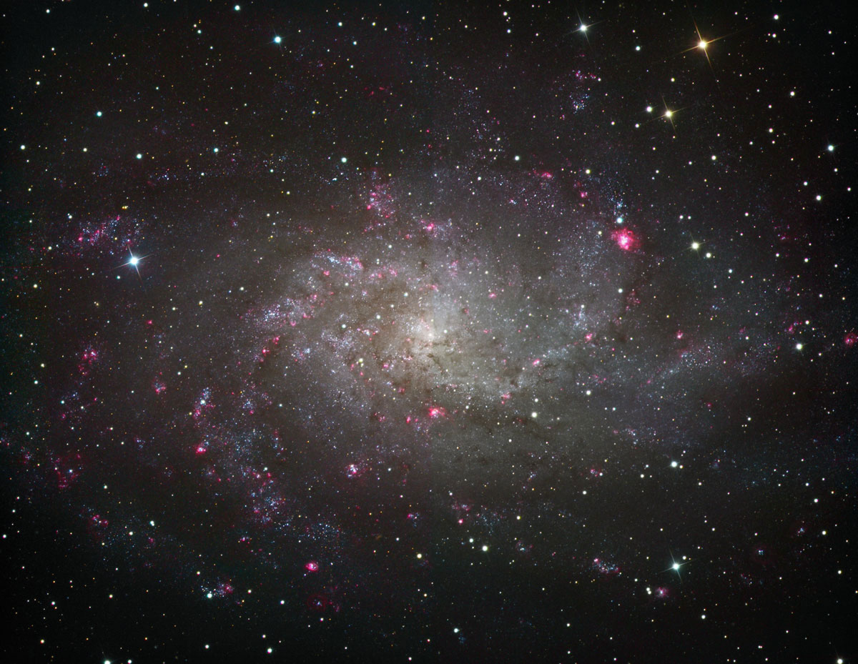
Stars Orbiting a Galaxy
Gravity provides the centripetal force

Slide 74
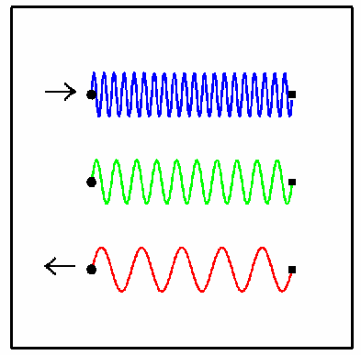
Measuring Velocity with Doppler Shift of Starlight

Slide 75
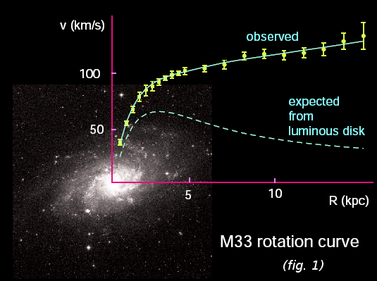
Galactic Rotation Curve
Stars’ orbit speed too high ⬄ too much centripetal force

Slide 76

Collision of Galaxy Clusters
Luminous Matter (emitting X-rays) separated from total Mass ⬄ confirms Dark Matter hypothesis

Slide 77
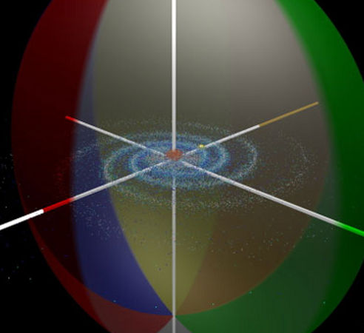
Halo of Invisible Dark Matter around Galaxies
Four times as much dark matter as visible matter

Slide 78
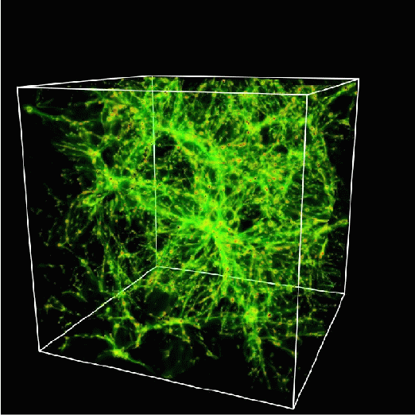
Mapping out the Dark Matter
A lot of dark matter is required to hold galaxies together
It cannot all be made of protons
It must be neutral, stable, heavy
It must be some new form of matter – new fundamental particles

Slide 79
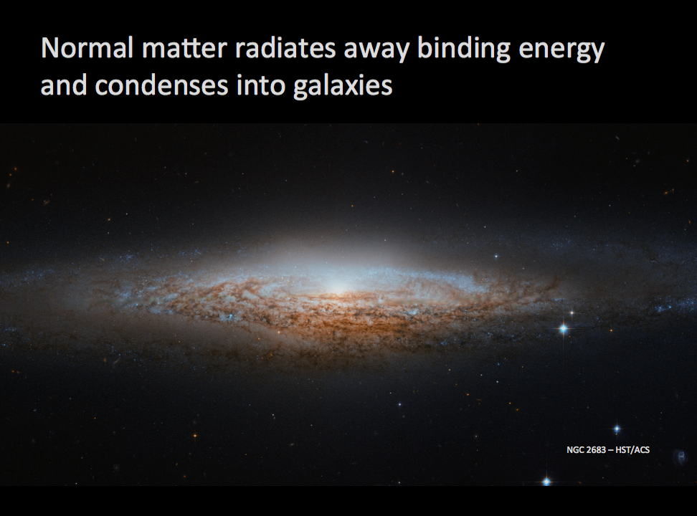

Slide 80
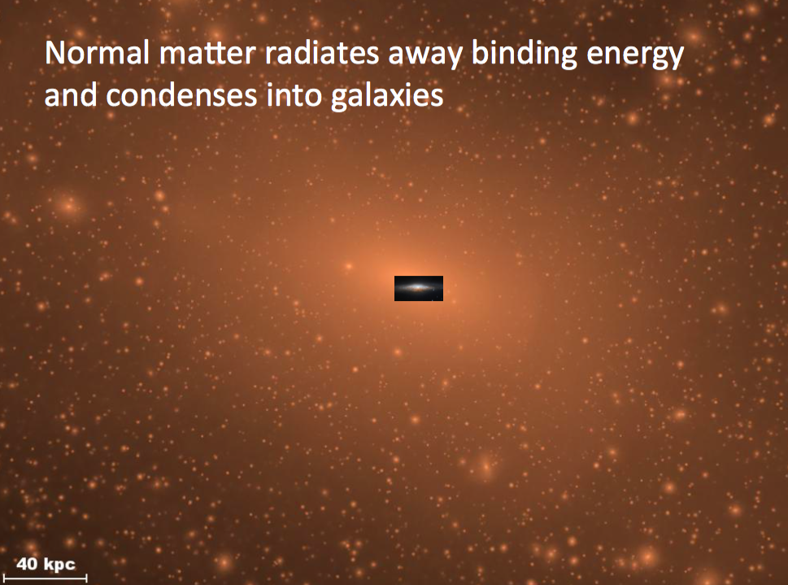

Slide 81
But Dark Matter cannot radiate energy so remains a huge cloud

Slide 82
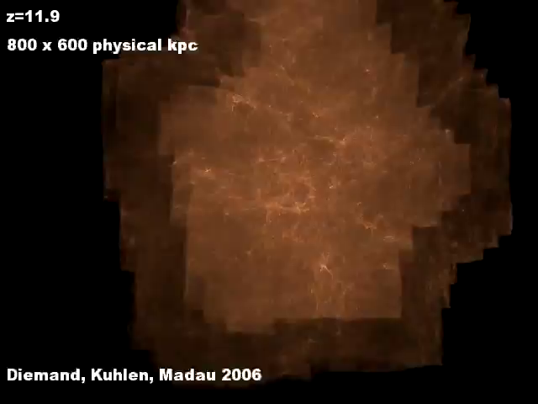

Slide 83
Newly Discovered Dark Matter Galaxies

Slide 84

3D Distribution of Galaxies

Slide 85

Cosmic Microwave Background
Penzias and Wilson (Bell Labs)
discovered in 1964 a constant microwave radiation coming uniformly from all points in the sky
This radiation was emitted at the beginning of the Universe
Nobel-prize winning discovery

Slide 86

Cosmic Microwave Background Anisotropy
Full sky measurement of variation of radiation
0.001% variation with direction in sky, measured by COBE satellite (Nobel-prize winning discovery)

Slide 87

Cosmic Microwave Background Anisotropy
Full sky measurement of variation of radiation
Improved direction precision measured by WMAP satellite

Slide 88

Cosmic Microwave Background Anisotropy
Full sky measurement of variation of radiation
Further improved direction precision measured by PLANCK satellite

Slide 89
Origin of Galaxies Requires Dark Matter
Quantum fluctuations at the Big Bang cause density variations
  We are seeing the imprint of these density variations on the earliest light
Density variations seeded the accretion of dark matter
Dark matter accretion causes accretion of visible matter
  Leading to galaxies we see today

Slide 90

Origin of Galaxies Requires Dark Matter

Slide 91

Feynman Diagram depicting Production of Dark Matter Particles at proton collider

Slide 92
Feynman Diagram depicting Production of Dark Matter Particles at proton collider

Slide 93

Simulated Dark Matter Particle Production at LHC

Slide 94
Dark Matter Particles
Bridge between cosmology, astrophysics and particle physics
“Supersymmetry” theory predicts dark matter particles
Supersymmetry ⬄ quantum properties of space ⬄ dawn of a “new quantum mechanics”

Slide 95
And yet more open questions remain…
Could the Higgs condensation process and the excess of matter-over-antimatter creation be related?
YES
Could we discover these mechanisms at a higher energy particle collider?
YES
Is such a collider technically feasible?
YES
Could the next big collider discover Supersymmetry and Dark Matter particles?
YES

Slide 96
How does a proton collider work?

Slide 97

How does a particle accelerator work?

Slide 98

LHC below Geneva, Switzerland

Slide 99

LHC Accelerator in Tunnel
Vacuum in the beampipe is better than vacuum in outer space

Slide 100

LHC Superconducting Magnet
Weight 35 tons, magnetic field 100,000 times Earth’s magnetic field
Magnetic force is thousands of tons

Slide 101

LHC Superconducting Magnet
Similar magnet design used in MRI machines

Slide 102
The Collider after LHC
A larger proton collider is being designed to achieve 7-10 times higher energy than LHC
It will be 70-200 km in circumference
At this energy, we can discover
  The explanation for the strange properties of the Higgs boson
  The mechanism causing Higgs condensation
    A new “super-strong force” can cause this condensation
  The process by which excess matter over antimatter was created
  Dark matter particles and probe the “hidden Universe”

Slide 103

50-90 KM Collider in China
A possible big tunnel east of Beijing

Slide 104

European Proposal: 100 KM at Geneva
A possible big tunnel close to CERN, Geneva, Switzerland

Slide 105

European Proposal: 100 KM at Geneva
LHC
Future Circular 100 km Collider
A possible larger tunnel close to CERN, Geneva, Switzerland

Slide 106
American Proposal: 233 KM outside Chicago
A possible even bigger tunnel close to Chicago, USA

Slide 107
Key Technology Requirement
Need Superconducting magnets twice as strong as LHC magnets
  New superconducting alloys
  High-temperature superconductors
Also useful in power distribution and magnetic-levitation high-speed trains

Slide 108

Magnetic Levitation Train
Shanghai Maglev
Japanese train speed record: 600 km/hour

Slide 109
Conclusion
LHC is operating successfully – a great achievement of science and engineering and of international cooperation
Higgs boson discovery confirms theory of massive particles
  Vacuum is actually permeated with the Higgs field
Understanding the strange Higgs properties will start a new revolution in physics
  As grand as the revolution started by quantum mechanics and theories of relativity a century ago
Phenomena still not understood
  What causes the Higgs field to condense? Is it a new “super-strong force” ?
  What is Dark Matter ?
  Why is there more matter than anti-matter in the Universe?

Slide 110
Next Step after LHC
Interest in China, Europe, and USA to build higher-energy collider
  Need a bigger tunnel !
  Need more powerful magnets !!
A new era of transformative discoveries is about to begin

Slide 111

Thank You!

Slide 112
Problems with Higgs Theory and
Supersymmetry to the Rescue

Slide 113


Slide 114


Slide 115


Slide 116


Slide 117


Slide 118


Slide 119
Black Holes at the LHC
The Possibility and the Myth

Slide 120


Slide 121

Matter and Energy Curves Space

Slide 122

Einstein’s Attempt to Unify Electromagnetism and Gravity

Slide 123

The problem with gravity
Gravity is a very weak force
F_{gravity} ~ 10⁻³⁶ F_{EM}
Very likely, we are missing something important. Why is gravity so weak compared to other forces?
Maybe it isn’t…

Slide 124

Curled-up Extra Dimensions of Space

Slide 125
Newton’s Law
In this case, gravity may be strong but appear weak only because its strength is diluted by extra dimensions.
F_{gravity} ~ 1/r ^{2+n}
  for small lengths r, where n is the number of extra dimensions

Slide 126


1
10⁻²⁰
10⁻⁴⁰
Feng, Science (2003)
10⁻⁶⁰

Slide 127

Microscopic Black Holes at LHC
If two particles pass close enough with enough energy, they will form a microscopic black hole
For 3 spatial dimensions, gravity is too weak for this to happen. But with extra dimensions, gravity becomes stronger, micro black holes can be created in particle collisions!

Slide 128


Microscopic Black Holes
In Einstein’s theory, light and other particles do not escape; black holes are black.
γ
γ
But quantum mechanically, black holes radiate according to Stephen Hawking; black holes emit light!

Slide 129


Black Hole Evaporation
“Normal” black holes:
Mass: M_{BH} ~ M_{sun}
Size: kilometer
Temperature: 0.01 K
Lifetime: ~ forever
Micro black holes:
Mass: M_{BH} ~ 1000 M_{proton}
Size: 10⁻¹⁸ m
Temperature: 10¹⁶ K
Lifetime: 10⁻²⁷ seconds
Microscopic black holes explode!

Slide 130

Black Holes at LHC
If effects of strong gravity, for example black holes, are observed ⬄ revolutionize our understanding of space itself
Closer to Einstein’s last dream
Closer to a quantum theory
of Gravity
p
p

Slide 131

Thank You!

Slide 132

LHC Superconducting Magnet
1200 magnets lowered 100 meters down into tunnel,
distributed over 27 kilometers

Slide 133

Particle Detector Design
Concentric cylinders of different kinds of detector technologies
Decay products of unstable particles identified

Slide 134

LHC Particle Detector – CMS Experiment
size about 20 meters
weight 12,000 tons (more than Eiffel Tower)

Slide 135

CMS (Compact Muon Solenoid) Experiment
Very large, very fast “digital camera”
60 million pixels, can take 40 million snapshots per second

Slide 136

Physicists in the Control Room
24 hours x 7 days x 365 days x 10 years operation

Slide 137

Why LHC Works

