Slide 1
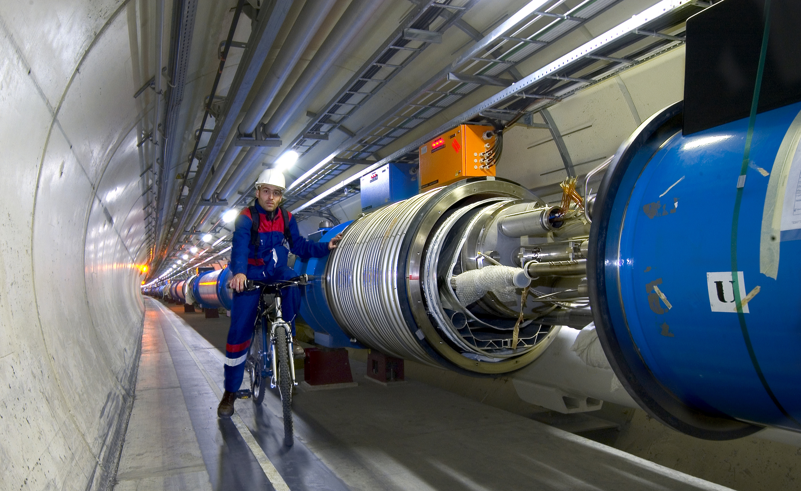
The Higgs Boson, Dark Matter and all that: Revolutionizing the Laws of the Universe with the LHC
Ashutosh Kotwal
Duke University

Slide 2
Egyptian Pyramids: Monument for Glory

Slide 3
Great Wall of China: Monument for Defense

Slide 4
Monument for Knowledge: The Large Hadron Collider

Slide 5
The Higgs boson and Dark Matter are both intimately connected with properties of empty space…
(or what we thought was “empty space”)
…Making these phenomena unlike any other we have observed in the past

Slide 6
Why have we been hunting for the Higgs for more than half a century?
Search culminating in the construction of the
Large Hadron Collider at the CERN Laboratory of Particle
Physics in Geneva, Switzerland

Slide 7
Why have we been hunting for the Higgs for more than half a century?
To solve a deep riddle in Quantum Mechanics, the
proven theory of the microscopic world

Slide 8
20th Century Built on Quantum Mechanics
The scientific advances of the 20th century have transformed our lifestyle
Impact of Quantum Mechanics
All electronics devices, computers and communication
Nuclear power
Atomic and molecular manipulation of materials for chemical and biological applications

Slide 9
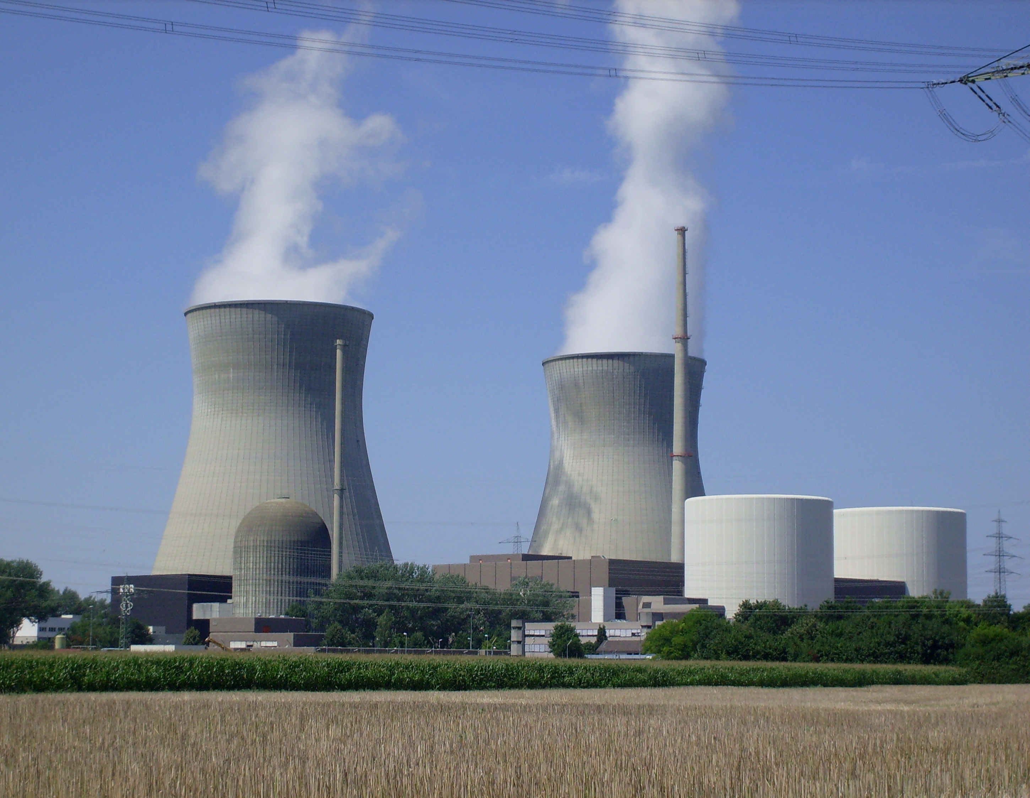
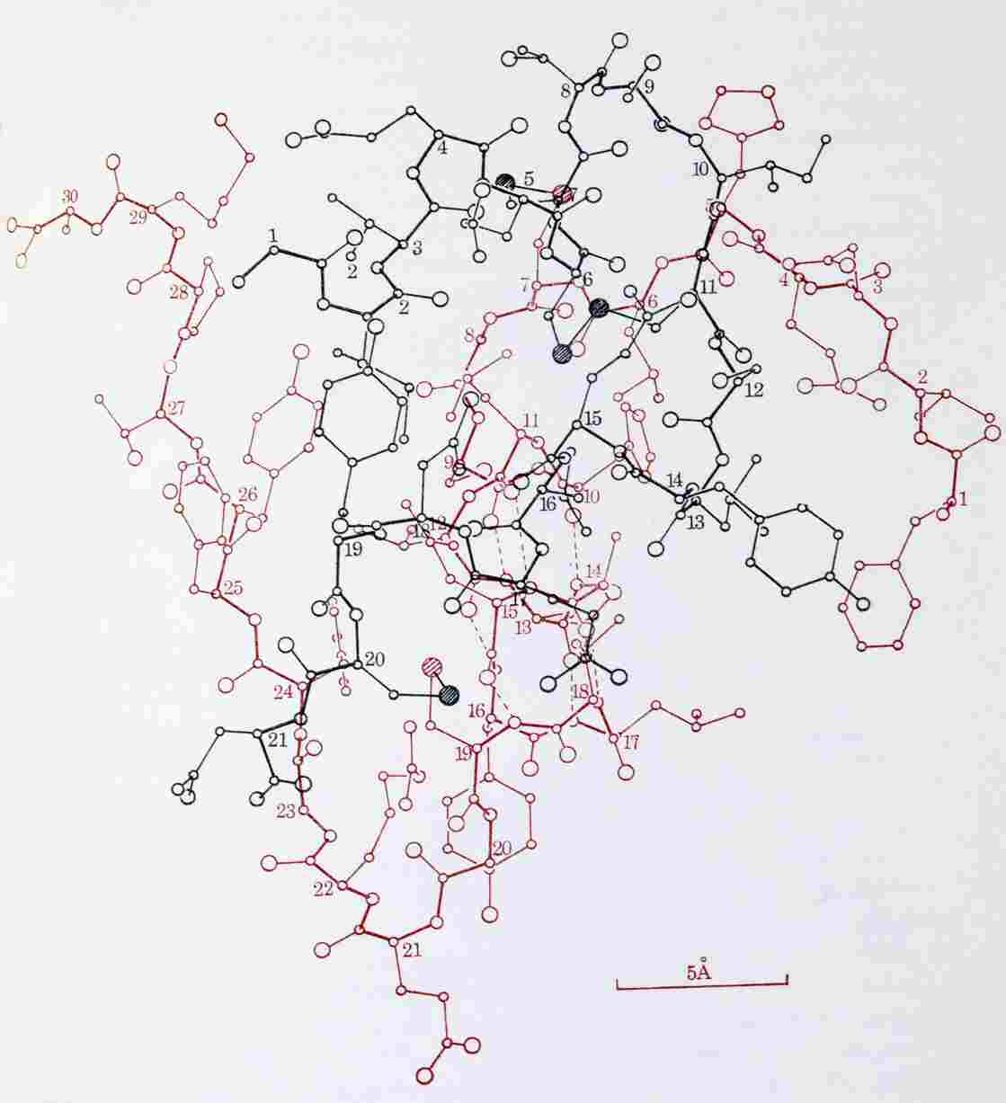
Molecule of Insulin

Slide 10
Conceptual Problem in Quantum Mechanics
In spite of its success, a self-consistent quantum mechanical theory of matter and forces has a huge missing link – the theory requires all fundamental particles to have exactly zero mass
The non-zero electron mass cannot be understood – and yet the electron mass defines the size of the atom and physical and chemical properties of all substances
If the electron’s mass were zero, the atom would not exist

Slide 11
Knowledge from the LHC
Why do fundamental particles have mass?
the Higgs hypothesis
The mystery of Dark Matter –
Could Dark Matter particles be produced at the LHC?

Slide 12
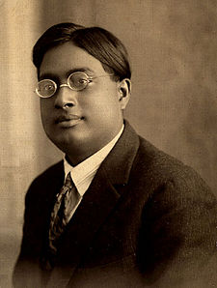
The Higgs Boson
Peter Higgs
Satyendra Nath Bose in 1920’s

Slide 13
How to Predict Fundamental Forces
“fictitious” forces observed in accelerating frame of reference

Slide 14
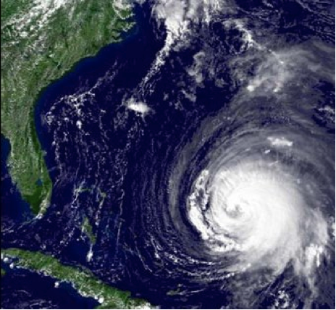
Manifestation of Coriolis Force
Hurricanes appear to rotate in Earth’s frame of reference

Slide 15
Quantum Mechanics force ⬄ particle exchange

Slide 16
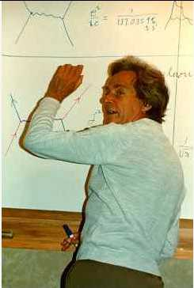
Feynman Diagram: Force by Particle Exchange
Electromagnetic force between two electrons mediated by “photon” exchange
Richard Feynman

Slide 17
Feynman Diagram: Force by Particle Exchange
The most precisely tested theory, ever:
The quantum theory of the electric and magnetic forces, radio waves, light and X-rays:
Measured and predicted magnetic moment of an electron agree within 0.3 parts per trillion accuracy
Electromagnetic force between two electrons mediated by “photon” exchange

Slide 18
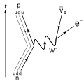
Weak Nuclear Decay
p
ν
The force causing this interaction is described by particles making transitions on a “mathematical sphere”
n
e

Slide 19
Success and Problem of Quantum Mechanics
Success: correct mathematical description of all properties of electromagnetic force and the weak nuclear force
Another prediction: force-mediating particles must be massless
Correct prediction for photon – mediator particle of electric and magnetic forces and all electromagnetic waves: radio, light, microwave, x-rays described by massless photons
Problem: for the weak nuclear force causing nuclear beta-decay, the mediator particle, “W boson” is very heavy
Question: How can we preserve the original theory and simultaneously impart mass to the W boson?

Slide 20
Solution to the Problem of W Boson Mass
Fill all of space with “Higgs” field
W boson propagating through “empty space”
actually propagating though Higgs field
Interaction of W boson with Higgs field slows down the W boson ⬄ imparting the property of mass to it

Slide 21
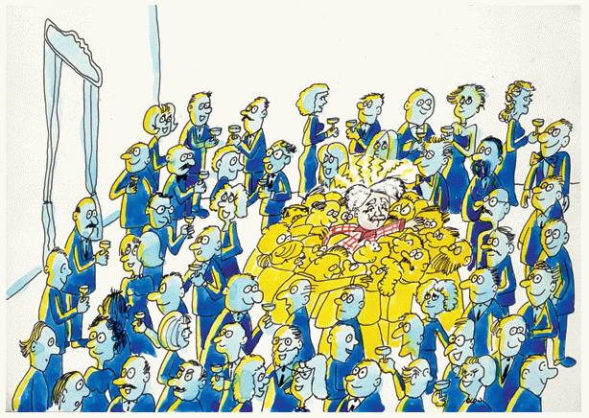
The “Sticky” Higgs Field

Slide 22
Implications of Higgs Hypothesis
Empty space is not really empty
Filled with the Higgs
All fundamental particles interacting with the Higgs field “slow down”
appear to be massive

Slide 23
Light versus Heavy Particles – like moving through water
Streamlined
Moves fast through water
analogous to light particle
Not streamlined
Moves slowly through water
analogous to heavy particle

Slide 24
Alternate title of my talk:

Slide 27
Detecting the Higgs
Why don’t we see and feel the Higgs?
Our senses and instruments detect electrical charge
Higgs is electrically neutral – has no electric and magnetic interaction!

Slide 28
How can we confirm the existence of the Higgs?
Create ripples in the Higgs field
Ripples ⬄ Higgs boson

Slide 29
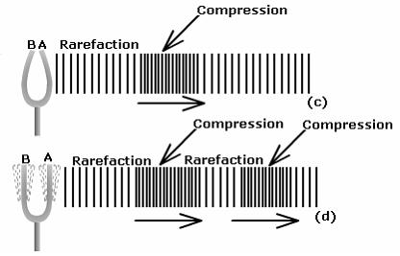
How can we confirm the existence of the Higgs?
Create ripples in the Higgs field
Ripples ⬄ phonons ⬄ Higgs boson

Slide 30
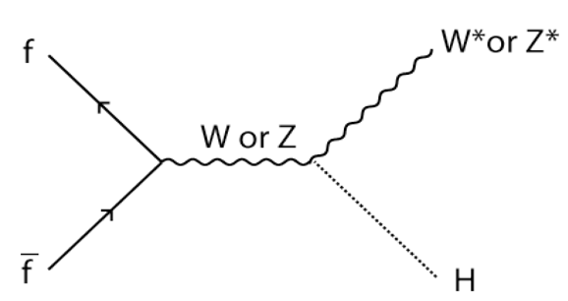
How to Create the Higgs Boson

Slide 31
Observation of Higgs Boson Production

Slide 32
Observation of Higgs Boson Production

Slide 33
Observation of Higgs Boson Production

Slide 34
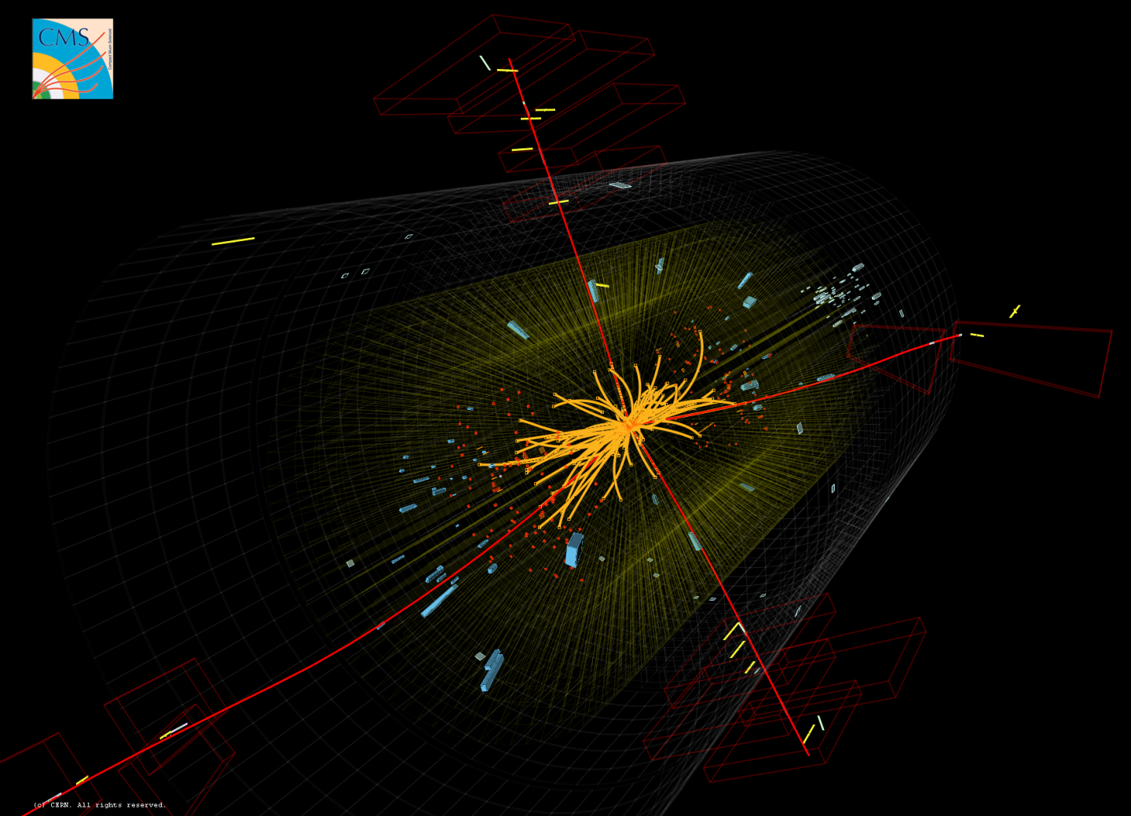
Higgs Boson Production and Detection at CMS

Slide 35
Higgs Discovery Implications
Provide an understanding of all masses of fundamental particles
Revolutionizes our understanding of empty space ⬄ filled with Higgs
Further studies of the properties of the Higgs are of tremendous importance
Where did this “Higgs field” stuff come from?
Why do different particles interact differently with it?
We are going to be busy studying the Higgs for a while…

Slide 43
The Mystery of Dark Matter

Slide 44
Centripetal Force

Slide 45
Stars Orbiting a Galaxy
Gravity provides the centripetal force

Slide 46
Measuring Velocity with Doppler Shift of Starlight

Slide 47
Galactic Rotation Curve
Stars’ orbit speed too high ⬄ too much centripetal force

Slide 48
Collision of Galaxy Clusters
Luminous Matter (emitting X-rays) separated from total Mass ⬄ confirms Dark Matter hypothesis

Slide 49
Halo of Invisible Dark Matter around Galaxies
Four times as much dark matter as visible matter

Slide 50
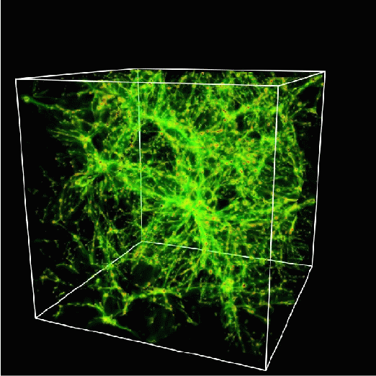
Mapping out the Dark Matter
A lot of dark matter is required to hold galaxies together
It cannot all be made of protons
It must be neutral, stable, heavy
It must be some new form of matter – new fundamental particles

Slide 51
Feynman Diagram depicting Production of SUSY Dark Matter Particles at LHC

Slide 52
Feynman Diagram depicting Production of SUSY Dark Matter Particles at LHC

Slide 53
Simulated SUSY Dark Matter Particle Production at LHC

Slide 54
Dark Matter Particles
Bridge between cosmology, astrophysics and particle physics
“Supersymmetry” theory predicts dark matter particles
Supersymmetry ⬄ quantum properties of space ⬄ dawn of a “new quantum mechanics”

Slide 55
Black Holes at the LHC The Possibility and the Myth

Slide 56
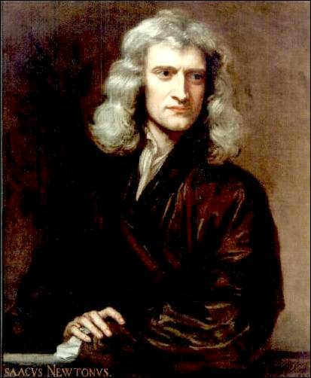
Isaac Newton
1687: Space and time are the static stage
on which physical processes act

Slide 57
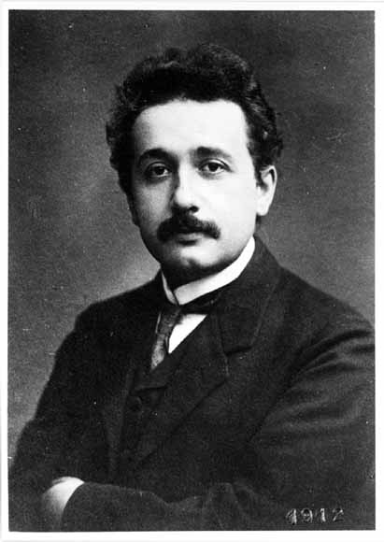
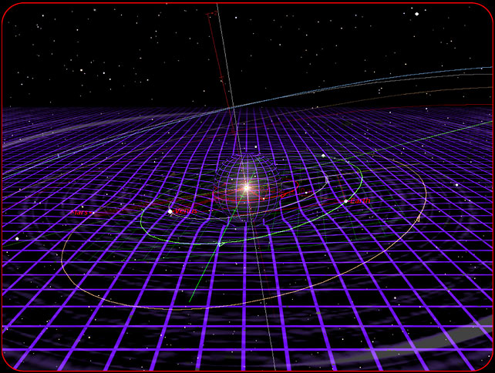
Albert Einsten
1915: Spacetime is an active player:
curves, expands, shrinks, …

Slide 58
Matter and Energy Curves Space

Slide 59
Einstein’s Attempt to Unify Electromagnetism and Gravity

Slide 60
The problem with gravity
Gravity is a very weak force
F_{gravity} ~ 10⁻³⁶ F_{EM}
Very likely, we are missing something important. Why is gravity so weak compared to other forces?
Maybe it isn’t…

Slide 61
Curled-up Extra Dimensions of Space

Slide 62
Newton’s Law
In this case, gravity may be strong but appear weak only because its strength is diluted by extra dimensions.
F_{gravity} ~ 1/r ^{2+n}
for small lengths r, where n is the number of extra dimensions

Slide 63
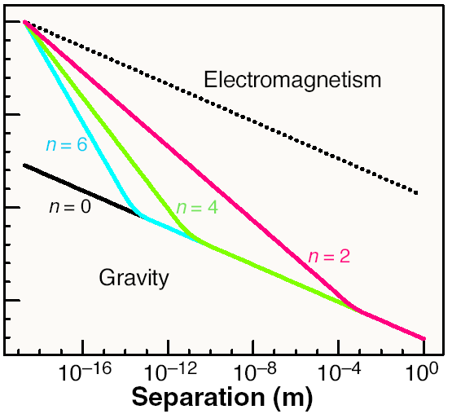
1
10⁻²⁰
10⁻⁴⁰
Feng, Science (2003)
10⁻⁶⁰

Slide 64
Microscopic Black Holes at LHC
If two particles pass close enough with enough energy, they will form a microscopic black hole
For 3 spatial dimensions, gravity is too weak for this to happen. But with extra dimensions, gravity becomes stronger, micro black holes can be created in particle collisions!

Slide 65
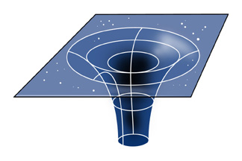
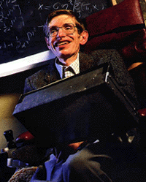
Microscopic Black Holes
In Einstein’s theory, light and other particles do not escape; black holes are black.
γ
γ
But quantum mechanically, black holes radiate according to Stephen Hawking; black holes emit light!

Slide 66
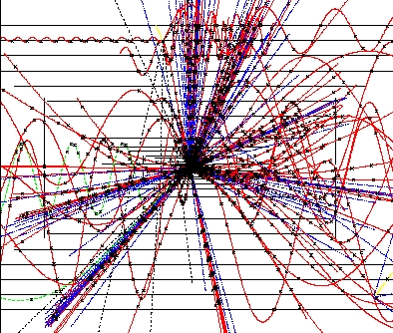
Black Hole Evaporation
“Normal” black holes:
Mass: M_{BH} ~ M_{sun}
Size: kilometer
Temperature: 0.01 K
Lifetime: ~ forever
Micro black holes:
Mass: M_{BH} ~ 1000 M_{proton}
Size: 10⁻¹⁸ m
Temperature: 10¹⁶ K
Lifetime: 10⁻²⁷ seconds
Microscopic black holes explode!

Slide 67
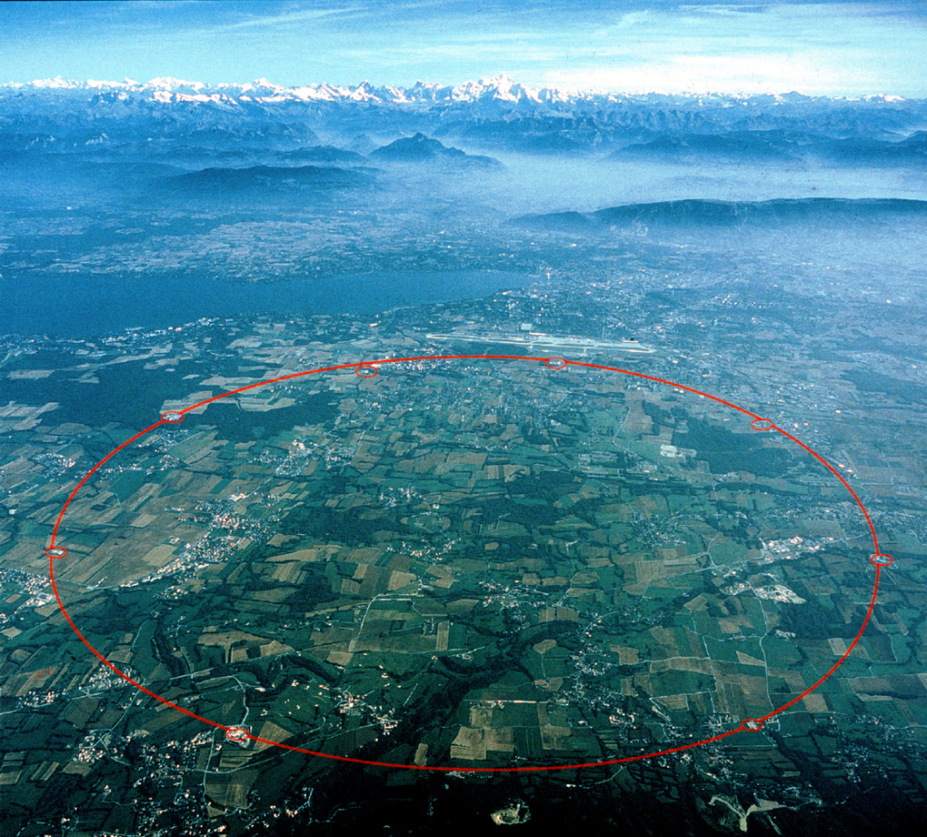
Black Holes at LHC
If effects of strong gravity, for example black holes, are observed ⬄ revolutionize our understanding of space itself
Closer to Einstein’s last dream
Closer to a quantum theory
of Gravity
p
p

Slide 68
How does LHC work?

Slide 69
How does a particle accelerator work?

Slide 70
LHC below Geneva, Switzerland

Slide 71
LHC below Geneva, Switzerland
Accelerates and collides proton beams, each 4 micrometers wide

Slide 72
LHC Accelerator in Tunnel
Vacuum in the beampipe is better than vacuum in outer space

Slide 73
LHC Superconducting Magnet
Weight 35 tons, magnetic field 100,000 times Earth’s magnetic field
Magnetic force is thousands of tons

Slide 74
LHC Superconducting Magnet
Similar magnet design used in MRI machines

Slide 75
LHC Superconducting Magnet
1200 magnets lowered 100 meters down into tunnel,
distributed over 27 kilometers

Slide 76
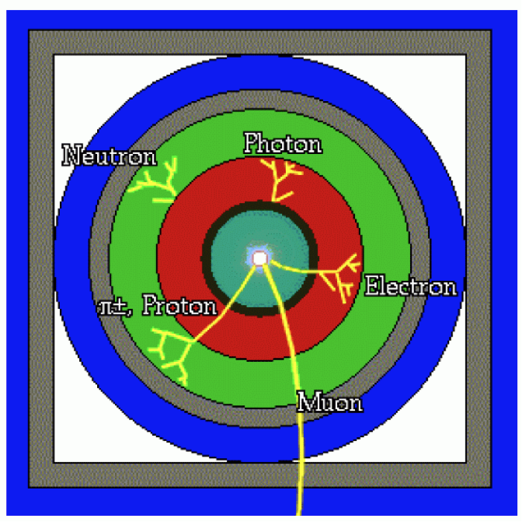
Particle Detector Design
Concentric cylinders of different kinds of detector technologies
Decay products of unstable particles identified

Slide 77
LHC Particle Detector – CMS Experiment
size about 20 meters
weight 12,000 tons (more than Eiffel Tower)

Slide 78
CMS (Compact Muon Solenoid) Experiment
Very large, very fast “digital camera”
60 million pixels, can take 40 million snapshots per second

Slide 79
Physicists in the Control Room
24 hours x 7 days x 365 days x 10 years operation

Slide 80
Why LHC Works

Slide 81
Life after LHC?
Interest in China, Europe, and USA to build higher-energy colliders
Need a bigger tunnel !
Need more powerful magnets !!

Slide 82
Life after LHC?
A possible big tunnel east of Beijing
(from presentation by Prof. Yifang Wang, Director of IHEP Beijing, on 13 February 2014, Geneva)

Slide 83
Life after LHC?
A possible big tunnel close to CERN, Geneva, Switzerland

Slide 84
Life after LHC?
A possible even bigger tunnel close to Chicago, USA

Slide 85
Conclusion
LHC is operating successfully – a great achievement of science and engineering and of international cooperation
Higgs boson discovery confirms theory of massive particles
Vacuum is actually permeated with the Higgs field
Discovering other Higgs properties could start a new revolution in physics
As grand as the revolution started by quantum mechanics and theories of relativity a century ago
Phenomena still not understood
What causes the Higgs field to condense?
What is Dark Matter ?
Can we understand the force of gravity from the Quantum perspective?

Slide 86
Thank You!

Slide 87
Thank You!

