Slide 1
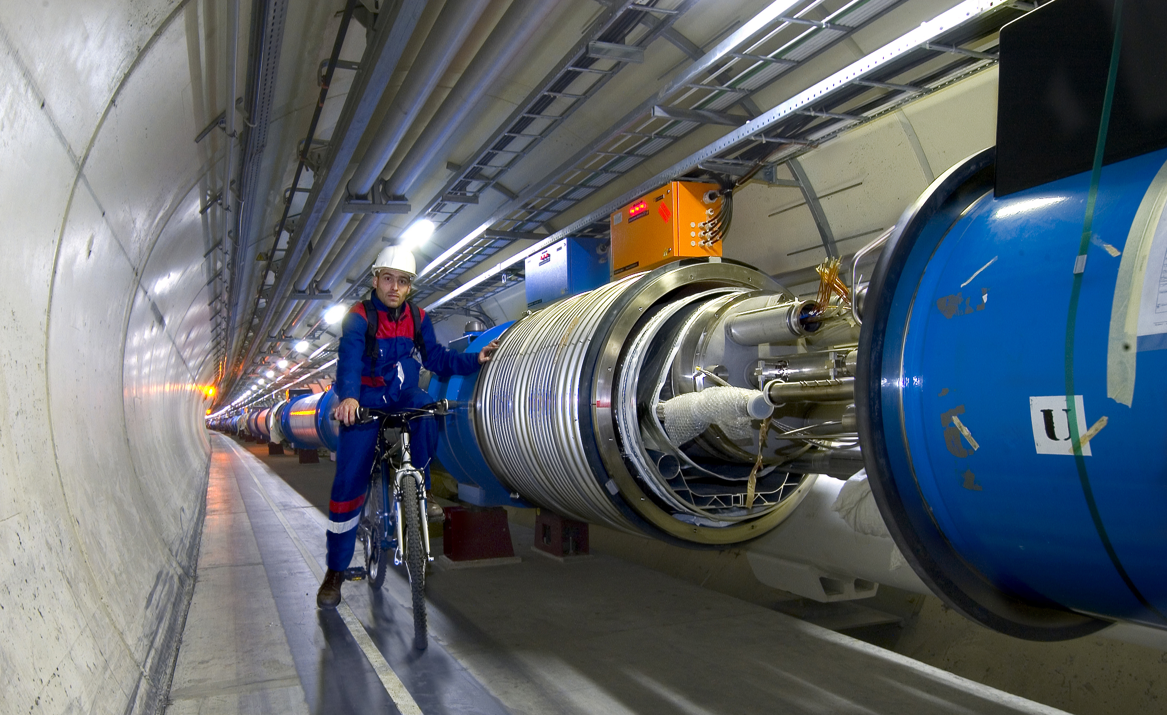
Higgs boson Physics at ATLAS South-Eastern Section of the American Physical Society Annual Meeting 2019
Ashutosh Kotwal
Duke University

Slide 3
Alternate title of my talk:

Slide 6
The Higgs boson is intimately connected with properties of empty space…
(or what we thought was “empty space”)
…Making these phenomena unlike any other we have observed in the past

Slide 7
Why have we been hunting for the Higgs for more than half a century?
Search culminating at the Large Hadron Collider at the CERN Laboratory of Particle Physics in Geneva, Switzerland

Slide 8
Dawn of a New Age of Exploration into Nature
The Higgs is unlike any other fundamental state of nature
It is not matter
It is not a force
The Higgs field is a completely new kind of “stuff”, observed for the first time ever

Slide 9
20th Century Built on Quantum Mechanics
The scientific advances of the 20th century have transformed our lifestyle
Impact of Quantum Mechanics
All electronics devices, computers and communication
Nuclear power
Atomic and molecular manipulation of materials for chemical and biological applications

Slide 10
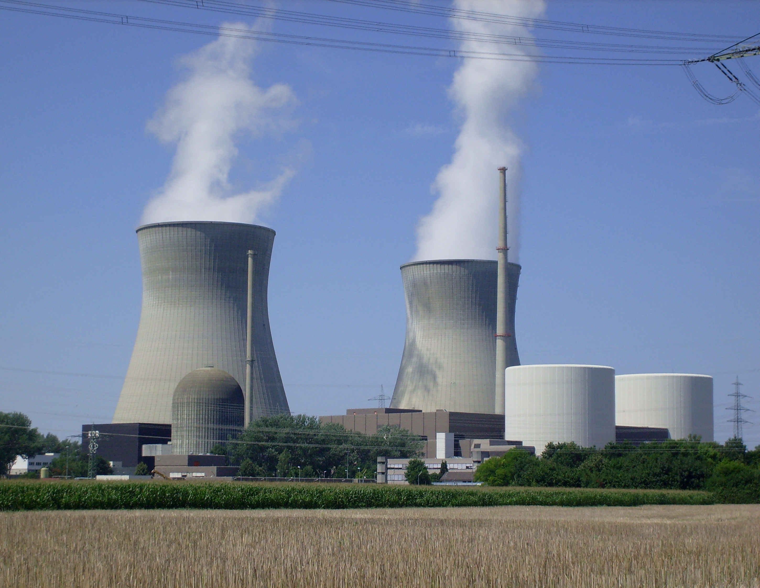
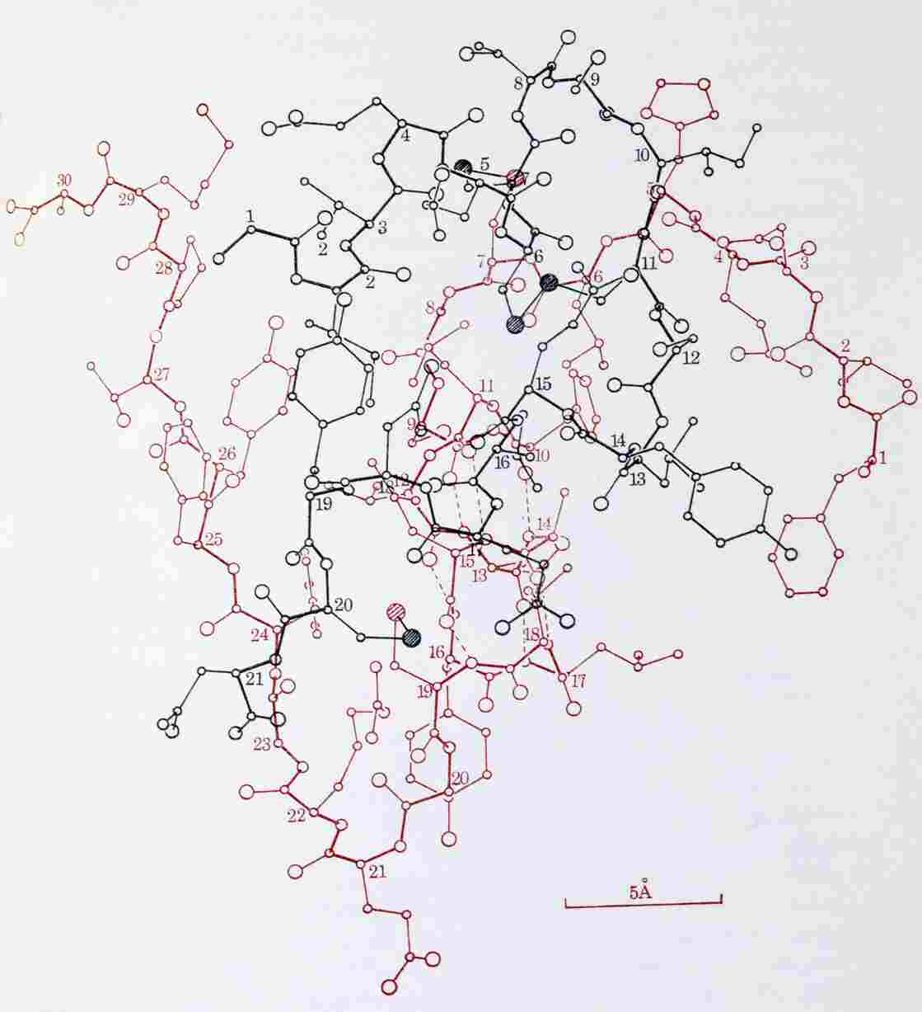
Molecule of Insulin

Slide 11
Founders of 20th Century Physics

Slide 12
Foundations of 20th Century Physics
Quantum Mechanics
Special Relativity
Combination of these fundamental principles – Relativistic Quantum Theory

Slide 13
Pauli, Heisenberg and Fermi

Slide 14
Founders of 20th Century Physics

Slide 15
Founders of 20th Century Physics

Slide 16
Einstein’s Equal?

Slide 17
Paul Dirac with Family

Slide 18
Foundations of 20th Century Physics
Quantum Mechanics
Special Relativity
Combination of these fundamental principles – Relativistic Quantum Theory
Initiated by Paul Dirac

Slide 19
Fundamental Properties of Electrons

Slide 20
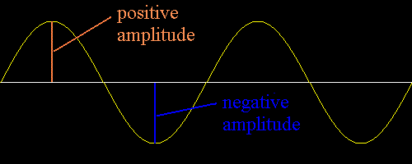
Effect of Complete Rotation
Quantum Mechanics + Special Relativity => Dirac and others showed mathematically that electron can be the type of particle that becomes negative of itself under a complete rotation

Slide 21
Towards a Fundamental Theory of Matter
Interchange between two electrons ⬄ rotate one by 360 deg.

Slide 22
Why Matter Occupies Volume
ψ(e₁, e₂) = - ψ(e₂, e₁)
But if two electrons occupied the same spot in space
ψ(e₁, e₂) = ψ(e₂, e₁)
Wave that both equal to itself and equal to negative of itself must be ZERO
Pauli Exclusion Principle – identical particles like electrons, protons, neutrons cannot be at the same point in space at the same time
This is a fundamental explanation for why matter is made up of fermions and why matter occupies volume

Slide 23
How to Predict Fundamental Forces
“fictitious” forces observed in accelerating frame of reference

Slide 24
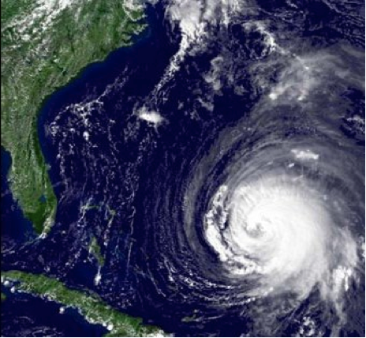
Manifestation of Coriolis Force
Hurricanes appear to rotate in Earth’s frame of reference

Slide 25
Quantum Mechanics force ⬄ particle exchange

Slide 26
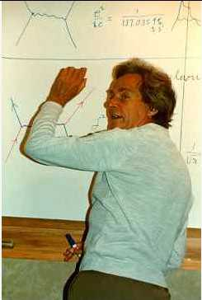
Feynman Diagram: Force by Particle Exchange
Electromagnetic force between two electrons mediated by “photon” exchange
Richard Feynman

Slide 27
Feynman Diagram: Force by Particle Exchange
The most precisely tested theory, ever:
The quantum theory of the electric and magnetic forces, radio waves, light and X-rays:
Measured and predicted magnetic moment of an electron agree within 0.3 parts per trillion accuracy
Electromagnetic force between two electrons mediated by “photon” exchange

Slide 28
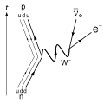
Weak Nuclear Decay
p
ν
The force causing this interaction is described by particles making transitions on a “mathematical sphere”
n
e

Slide 29
Success and Problem of Force Theory
Success: correct mathematical description of all properties of electromagnetic force and the weak nuclear force
Another prediction: force-mediating particles must be massless
Correct prediction for photon – mediator particle of electric and magnetic forces and all electromagnetic waves: radio, light, microwave, x-rays described by massless photons
Problem: for the weak nuclear force causing nuclear beta-decay, the mediator particle, “W boson” is very heavy
Question: How can we preserve the original theory and simultaneously impart mass to the W boson?

Slide 30
Scorecard
Combining quantum mechanics and special relativity gave exact prediction of
Matter particles (fermions)
Force mediating particles (gauge bosons)

Slide 31
Dirac Encore - handed Fermions
Dirac predicted electrons (and all fermions) to be left- or right-handed
Dirac predicted that electrons (and all fermions) need not have the same interactions for left-handed and right-handed
Predated by two decades the Nobel-prize winning discovery that the weak interaction was felt by left-handed fermions only

Slide 32
Mirror Images Behave Differently

Slide 33
“Massive” Problem
Left-handed and right-handed fermions interact differently => they must all be massless
Force-mediators must also be massless
All particles must be massless
Mass cannot be a fundamental property, it must be an emergent property
Mass must arise from within the dynamics of the theory

Slide 34
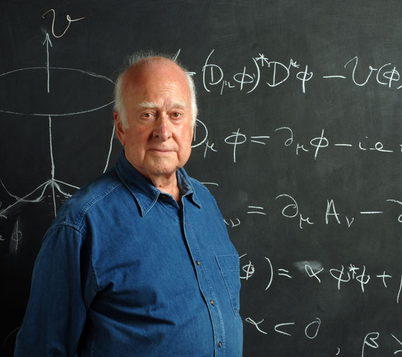
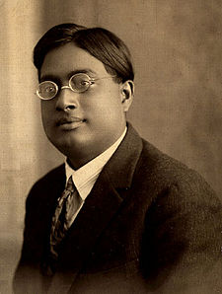
The Higgs Boson
Peter Higgs
Satyendra Nath Bose in 1920’s

Slide 35
Solution to the Problem of Mass
Fill all of space with “Higgs” field
Particles propagating through “empty space”
actually propagating though Higgs field
Interaction of particles with Higgs field slows down the particle ⬄ imparting the property of mass to it

Slide 36
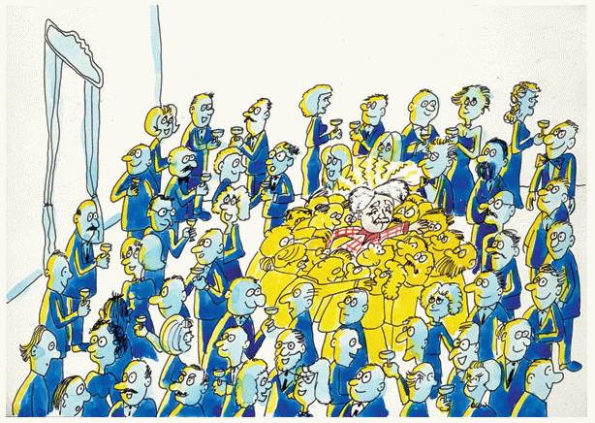
The “Sticky” Higgs Field

Slide 37
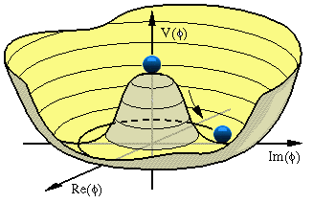
The “Problem” of Particle Physics
As generators of a symmetry, gauge bosons should be massless
Not true in nature for weak interaction: SU(2) generators are W±, Z bosons
W and Z gauge bosons are very massive (W ~ 80 GeV, Z ~ 91 GeV)
postulate of scalar Higgs field which develops a vacuum expectation value via spontaneous symmetry breaking
(from David Miller, UCL)

Slide 38
Implications of Higgs Discovery
Empty space is not really empty
Filled with the Higgs
All fundamental particles interacting with the Higgs field “slow down”
appear to be massive

Slide 39
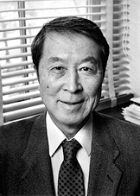
Spontaneous Symmetry Breaking
2008 Nobel Prize in Physics
"for the discovery of the mechanism of spontaneously broken symmetry in subatomic physics"
A prime motivation of Large Hadron Collider: expose the mechanism of Electroweak Symmetry Breaking
Is it the Higgs mechanism?
Yoichiro Nambu

Slide 40
Light versus Heavy Particles – like moving through water
Streamlined
Moves fast through water
analogous to light particle
Not streamlined
Moves slowly through water
analogous to heavy particle

Slide 41
Detecting the Higgs
Why don’t we see and feel the Higgs?
Our senses and instruments detect electrical charge
Higgs is electrically neutral – has no electric and magnetic interaction!

Slide 42
How can we confirm the existence of the Higgs?
Create ripples in the Higgs field
Ripples ⬄ Higgs boson

Slide 43
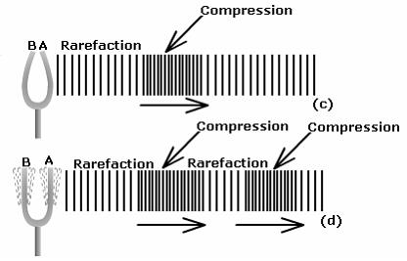
How can we confirm the existence of the Higgs?
Create ripples in the Higgs field
Ripples ⬄ phonons ⬄ Higgs boson

Slide 44
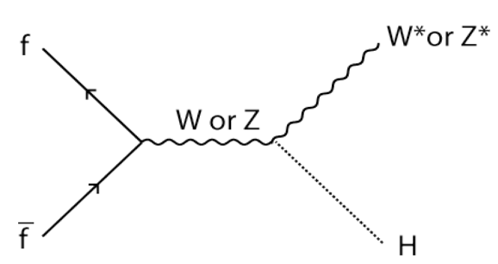
How to Create the Higgs Boson

Slide 45
Evidence of Higgs Boson Production

Slide 46
Observation of Higgs Boson Production

Slide 48
Higgs Discovery Implications
Provide an understanding of all masses of fundamental particles
Revolutionizes our understanding of empty space ⬄ filled with Higgs

Slide 49
Latest Higgs Signals

Slide 50
Latest Higgs Signals

Slide 51
Latest Higgs Signals

Slide 53
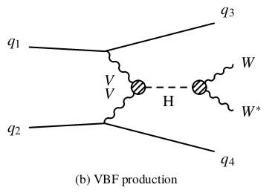
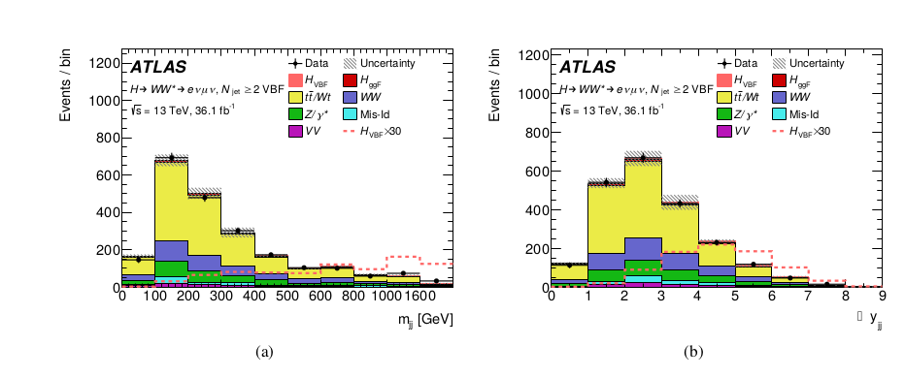
Higgs production via Vector Boson Fusion

Slide 54
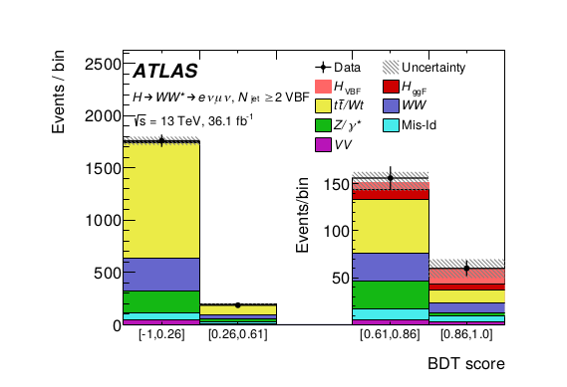
Higgs Signal in Vector Boson Fusion
Vector boson fusion signal nearing 5σ “Discovery” level

Slide 55
Higgs coupling to b quarks

Slide 56
Higgs coupling to τ leptons

Slide 57
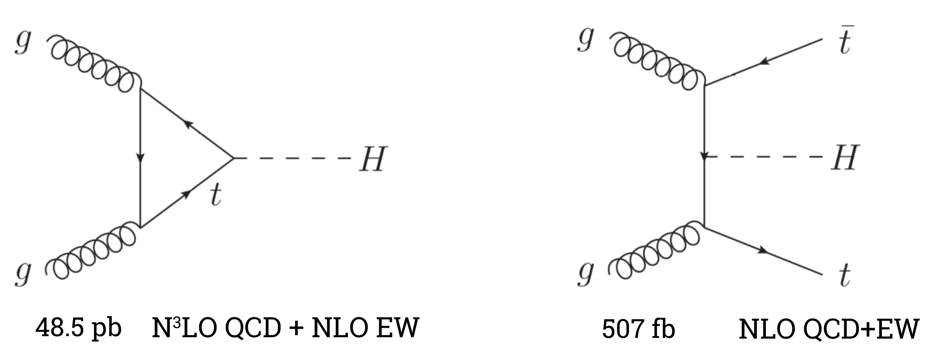
Higgs coupling to top quarks

Slide 59
Higgs self-coupling and HH production

Slide 60
HH final states

Slide 61
HH -> bbττ

Slide 62
HH -> bb γγ

Slide 63
HH Sensitivity

Slide 64
HH in vector boson fusion

Slide 65
Why aren’t we satisfied?
Why does the Higgs field condense all over space ?
We understand other condensation phenomena at the microscopic level…condensation of gases to liquids and solids for example
We need a similar, dynamical explanation for condensation of the Higgs field
Additional ingredients and new physics principles are required to explain this condensation process..
The confirmed theory of fundamental particles and forces – “the Standard Model of Particle Physics’, CANNOT explain this condensation process

Slide 68
Higgs couplings vs particle mass

Slide 69
High-luminosity LHC 2026-2035

Slide 70
Future Colliders

Slide 71
100 km Future Circular Collider or Compact Linear Collider at CERN

Slide 72
International Linear electron-positron Collider in Japan

Slide 73
100 km circular tunnel in China

Slide 74
Higgs in the future

Slide 75
Thank You!

