Slide 1
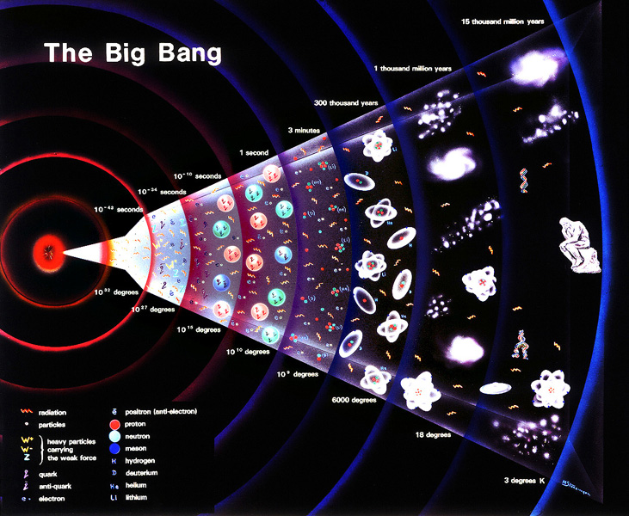
Searching for Dark Matter at the Large Hadron Collider with AI on a silicon chip
Ashutosh Kotwal
Duke University
Indian Institute of Technology, Bombay
June 11, 2025

Slide 2
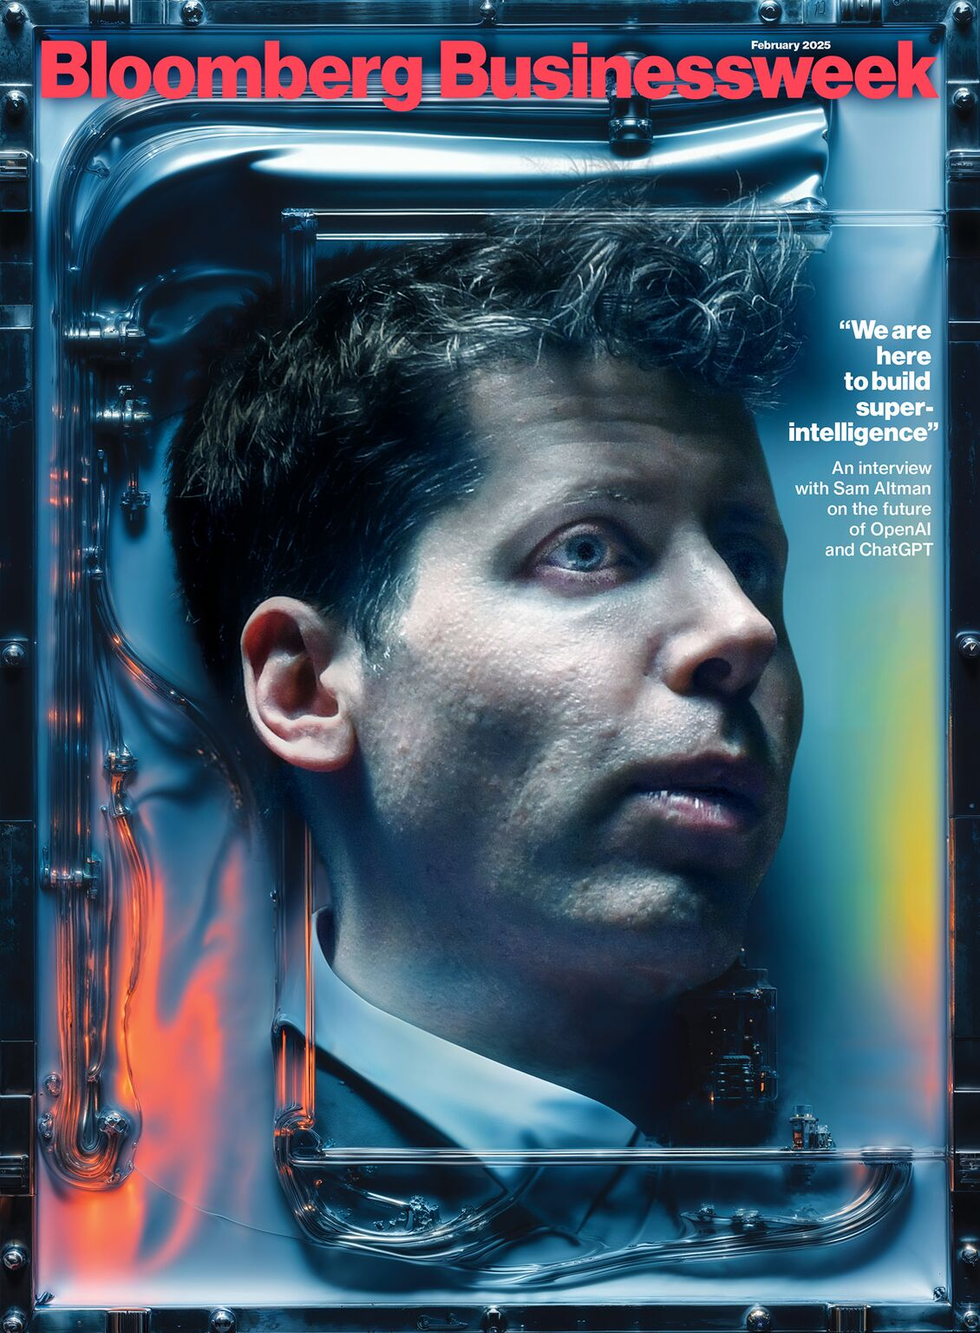

Slide 3
Is this the future we want?

Slide 4
Or a future based on …

Slide 5
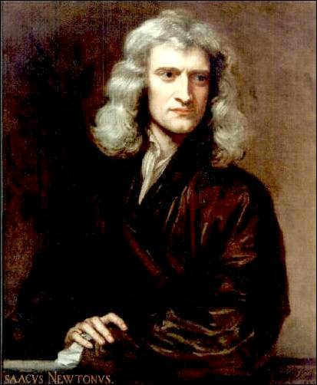
Isaac Newton
Y
X
1687: Space and time are the static stage on which physical processes act
Space and time are disconnected from each other

Slide 6
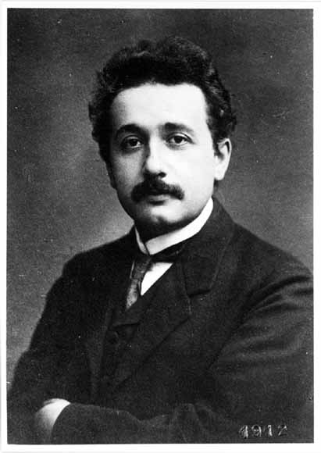
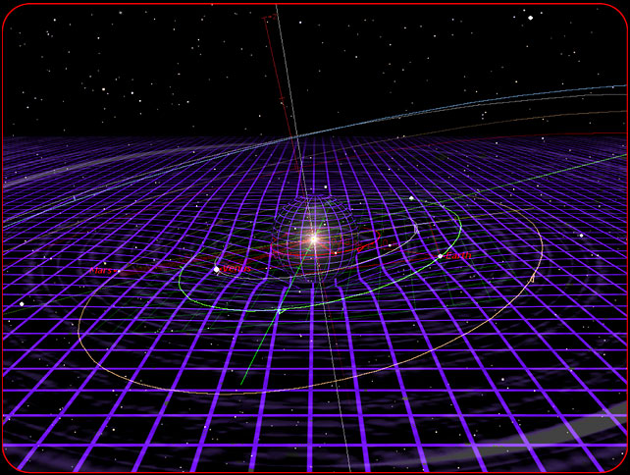
Albert Einstein
1905: 3-space directions and time direction are combined into a single 4-dimensional spacetime
1915: Spacetime is active: curves, expands, shrinks, …

Slide 7
Matter and Energy Curve Space
Curvature of space tells Matter and Energy how to move

Slide 8
Matter and Energy Curves Space
Curvature of space tells Matter and Energy how to move

Slide 9
Matter, Energy (including Light) follows locally straight path
Curvature of space tells Matter and Energy how to move

Slide 10
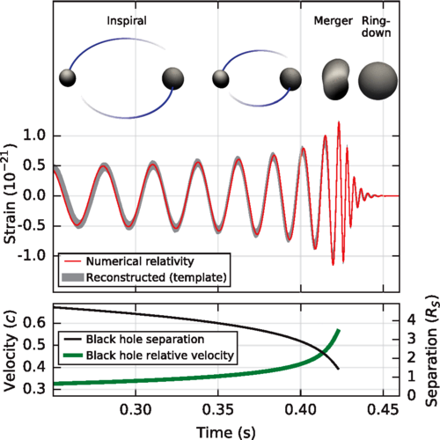
Gravitational Wave from Black Holes Inspiral
Courtesy CalTech/MIT/LIGO Laboratory

Slide 11
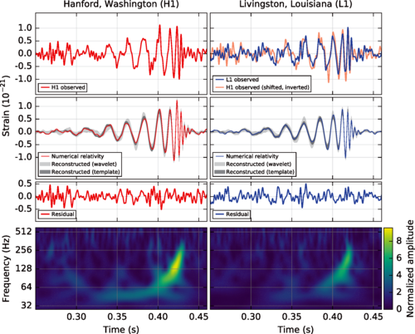
Gravitational Wave Detection
Courtesy CalTech/MIT/LIGO Laboratory

Slide 12
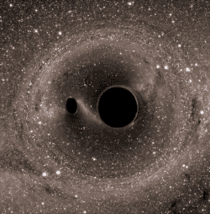
Gravitational Waves from Inspiraling Black Holes
Courtesy CalTech/MIT/LIGO Laboratory

Slide 13
The Expanding Universe

Slide 14
Cosmic Microwave Background
Penzias and Wilson (Bell Labs)
discovered in 1964 a constant microwave radiation coming uniformly from all points in the sky
This radiation was emitted at the beginning of the Universe
(Nobel-prize winning discovery)

Slide 15
Cosmic Microwave Background almost perfectly uniform
Full sky measurement of microwave radiation
0.001% variation with direction in sky, measured by COBE satellite (Nobel-prize winning discovery)

Slide 16
Einstein’s General Relativity Equation explains an expanding Universe For fixed speed of light, causally disconnected parts of the Universe can express a uniform microwave radiation only if these parts were causally connected in the past => Universe must have been much smaller in the past => Supports the Big Bang hypothesis

Slide 18
Cosmic Microwave Background Anisotropy
Full sky measurement of variation of radiation
Improved direction precision measured by WMAP satellite

Slide 19
Cosmic Microwave Background Anisotropy
Full sky measurement of variation of radiation
Further improved direction precision measured by PLANCK satellite

Slide 20
The Mystery of Dark Matter

Slide 21
Centripetal Force

Slide 22
Stars Orbiting a Galaxy
Gravity provides the centripetal force

Slide 23
Measuring Velocity with Doppler Shift of Starlight

Slide 24
Galactic Rotation Curve
Stars’ orbit speed too high ⬄ too much centripetal force

Slide 25
Collision of Galaxy Clusters
Luminous Matter (emitting X-rays) separated from total Mass ⬄ confirms Dark Matter hypothesis

Slide 26
Halo of Invisible Dark Matter around Galaxies
Four times as much dark matter as visible matter

Slide 27
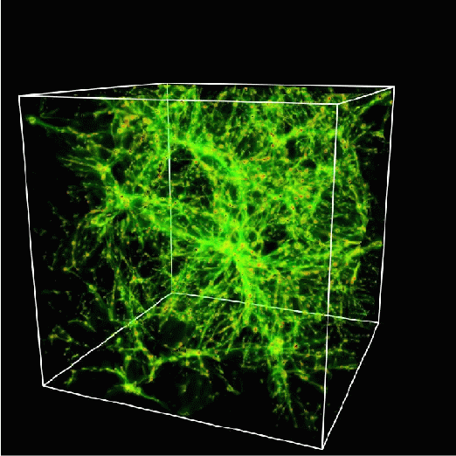
Mapping out the Dark Matter
A lot of dark matter is required to hold galaxies together
It cannot all be made of protons
It must be neutral, stable, heavy
It must be some new form of matter – new fundamental particles?

Slide 30
But Dark Matter cannot radiate energy so remains a huge cloud

Slide 32
Newly Discovered Dark Matter Galaxies
Could the Dark Matter be a cloud of a new type of stable neutral particles produced at the Big Bang?

Slide 33
A Century of Particle Physics Success

Slide 34
Quantum Mechanics force ⬄ particle exchange

Slide 35
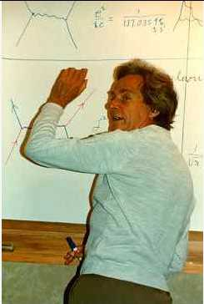
Feynman Diagram: Force by Particle Exchange
Electromagnetic force between two electrons mediated by “photon” exchange
Richard Feynman

Slide 36
Feynman Diagram: Force by Particle Exchange
The most precisely tested theory, ever:
The quantum theory of the electric and magnetic forces, radio waves, light and X-rays:
Measured and predicted magnetic moment of an electron agree within 0.3 parts per trillion accuracy
Electromagnetic force between two electrons mediated by “photon” exchange

Slide 37
Homi Bhabha electron-positron scattering

Slide 38
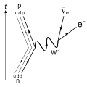
Weak Nuclear Decay

Slide 39
Scorecard
Combining quantum mechanics and special relativity gave exact prediction of
Matter particles (fermions)
Force mediating particles (gauge bosons)

Slide 40
Where we have arrived…
Following the brilliant insights of Paul Dirac and others, we can understand
Why there is matter and antimatter
Why matter occupies volume
How matter interacts via forces
The properties of forces
The Higgs field that explains particle masses

Slide 41
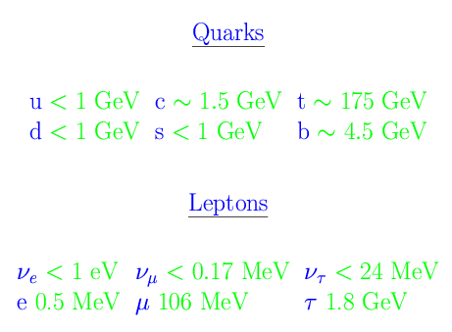
A Century of Particle Physics
Success # 1: discovery of 6 quarks and 6 leptons
12 fundamental fermions: matter particles (and their antimatter counterparts) derived by combining quantum mechanics and special relativity and group theory

Slide 42
A Century of Particle Physics
Success # 1: discovery of 6 quarks and 6 leptons
12 fundamental fermions: matter particles (and their antimatter counterparts) derived by combining quantum mechanics and special relativity and group theory
But the intriguing pattern
of mass values is not
explained – blamed on parametric
Higgs interaction
Why 3 generations?

Slide 43
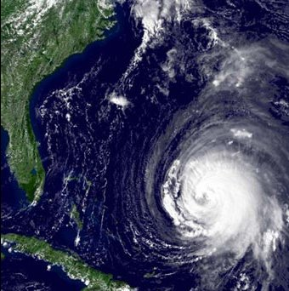
A Century of Particle Physics
Success # 2: principle of gauge invariance for predicting the nature of fundamental forces
matter particles (quarks and leptons) transform in curved internal spaces
The equations of motion predict terms that describe particle interactions with force fields

Slide 44
Dark Matter, Galaxy Formation and the Quantum Foam

Slide 45
Implication of Heisenberg Uncertainty Principle
.ΔE ~ h / Δt
Nature can “borrow” energy of amount .ΔE for a short time .Δt
The shorter the time period of this “energy loan”, the larger the amount of the loaned energy that is available
=> the vacuum is a bubbling foam with high-energy particles popping up and disappearing

Slide 46
The Vacuum as a Quantum Foam

Slide 47
3D Distribution of Galaxies

Slide 48
Origin of Galaxies Requires Dark Matter
Quantum fluctuations at the Big Bang cause density variations
We are seeing the imprint of these density variations on the earliest light
Density variations seeded the accretion of dark matter
Dark matter accretion causes accretion of visible matter
Leading to galaxies we see today

Slide 49
Origin of Galaxies Requires Dark Matter and Quantum Foam at Big Bang

Slide 50
Making Dark Matter at the LHC

Slide 51
How does a particle accelerator work?

Slide 52
LHC below Geneva, Switzerland

Slide 53
LHC Accelerator in Tunnel
Vacuum in the beampipe is better than vacuum in outer space

Slide 54
Feynman Diagram depicting Production of Dark Matter Particles at proton collider

Slide 55
Feynman Diagram depicting Production of Dark Matter Particles at proton collider

Slide 56
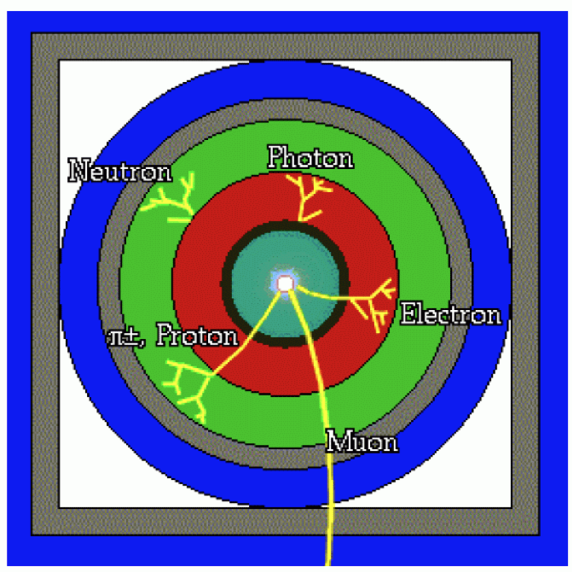
Particle Detector Design
Concentric cylinders of different kinds of detector technologies
Decay products of unstable particles identified

Slide 57
Tracking particle trajectories

Slide 58
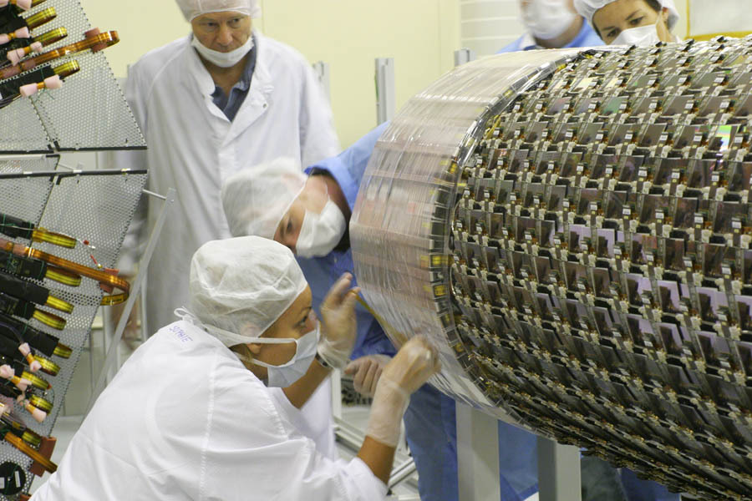
ATLAS Experiment’s Silicon Tracker

Slide 59
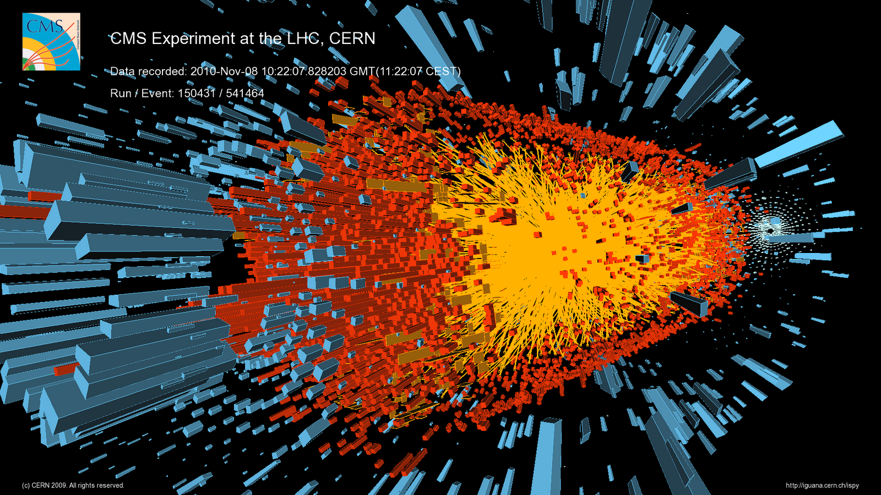
LHC Collisions with very intense beams

Slide 60
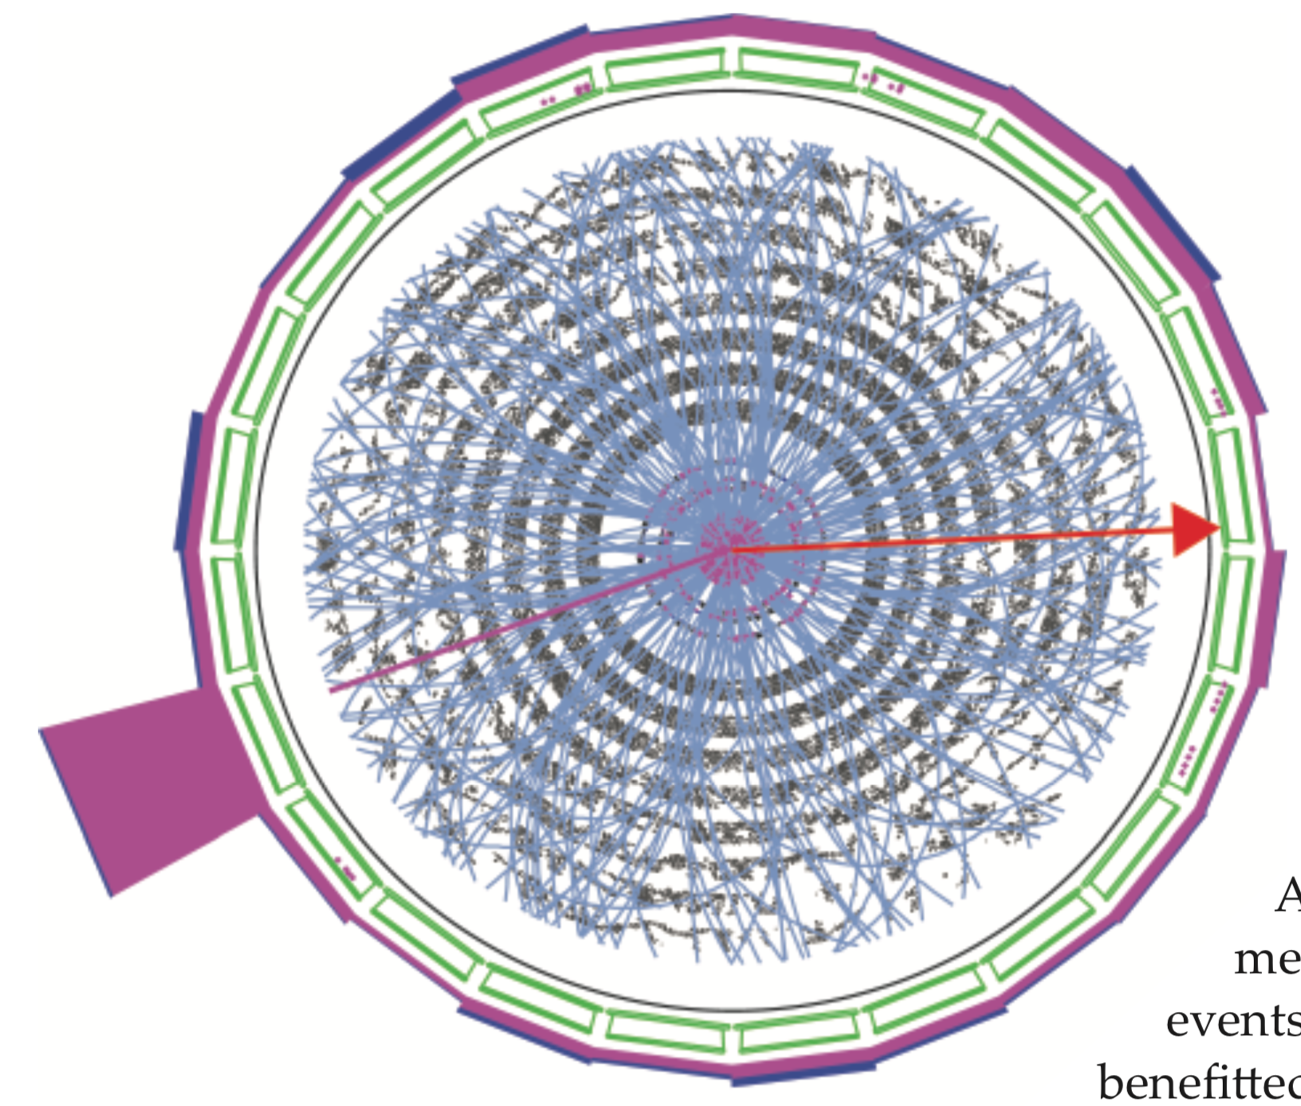
Collisions with very intense beams
Need special AI (Machine Learning) software to associate point measurements with particle trajectories

Slide 61
CMS (Compact Muon Solenoid) Experiment
Very large, very fast “digital camera”
60 million pixels, can take 40 million snapshots per second

Slide 62
CMS (Compact Muon Solenoid) Experiment
Very large, very fast “digital camera”, in 5 years,
2 billion pixels, can take 40 million snapshots per second

Slide 63
Dark Matter Particles
Bridge between cosmology, astrophysics and particle physics
Can all dark-matter signatures be recognized?
no
“disappearing track” signature cannot be recognized at the collision rate of 40 million / sec

Slide 64
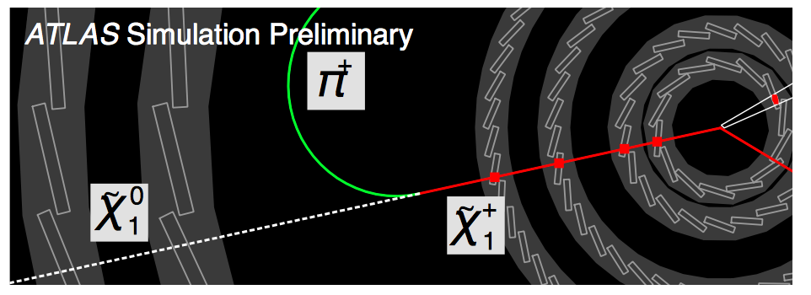
Track Triggering using Silicon Detectors
“disappearing track”

Slide 65
Track Triggering using Silicon Detectors
“disappearing track”
Existing Machine Learning software algorithm too slow by factor of 40

Slide 66
Machine Learning algorithms should be designed for…

Slide 67
Machine Learning algorithms should be designed for…
Correctness?

Slide 68
Machine Learning algorithms should be designed for…
Correctness?
Efficiency?

Slide 69
Machine Learning algorithms should be designed for…
Correctness?
Efficiency?
Conciseness?

Slide 70
Machine Learning algorithms should be designed for…
Correctness?
Efficiency?
Conciseness?
Understandability and Explainability!

Slide 71
Machine Learning algorithms should be designed for…
Correctness?
Efficiency?
Conciseness?
Understandability and Explanability!
Avoid black boxes !!

Slide 72
New Method of Machine Learning
Discussion of graph-computing concept:
A. V. Kotwal, “A fast method for particle tracking and triggering using small-radius silicon detectors”, Nucl. Inst. Meth. Phys. Res. A 957 (2020) 163427
Each hit processed by a specialized computing circuit
Trajectories sorted by smoothness locally
Information sharing between nodes to find smoothest trajectory globally
72

Slide 73
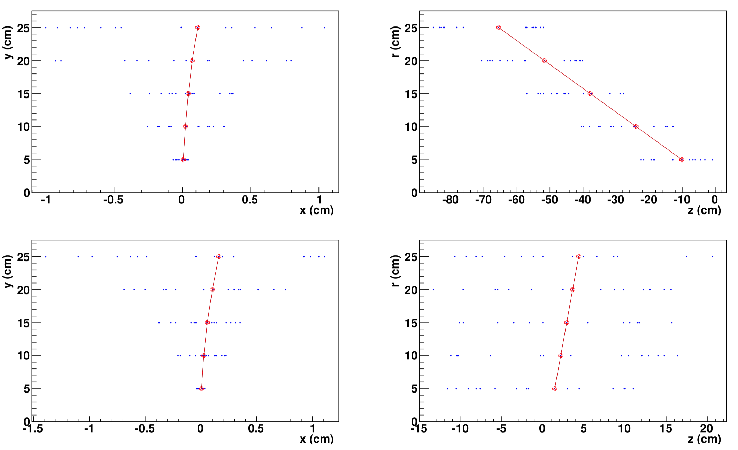
Finding the Charged-particle Trace
73

Slide 74
Results
Efficiency of finding charged-particle parent of dark matter > 99.9%
Tracks found are robust, very small rate for wrong assignments
Published in A. V. Kotwal, Scientific Reports 11, 18543 (2021)
74

Slide 75
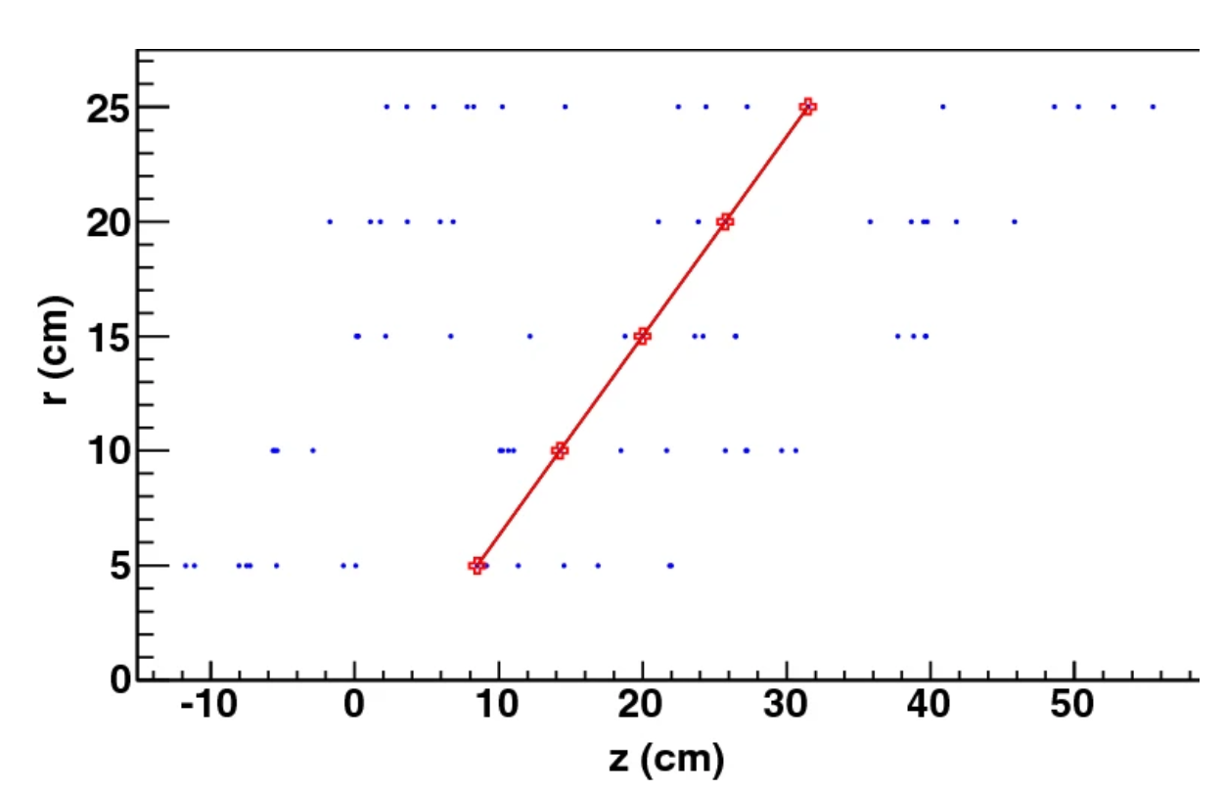
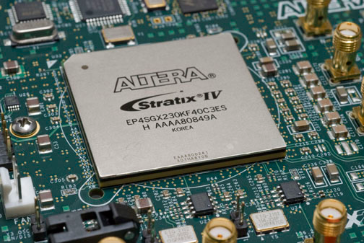
Implementation on a silicon chip
Rapid identification of particles
Uses AI based on graph computing
Each hit is a vertex of a graph
Very low mis-identification rate (0.1%)
250 ns latency and 40 MHz throughput
Implemented as digital circuits on commercial silicon chip

Slide 76
Integrated Circult Implementation of Particle-Finder
Basic functional units are algebraic operations and sorting circuits
Studies conducted with XILINX circuit design tool
Elementary integer additions execute in nanoseconds
Integer comparisons execute in 2 nanoseconds
Parallelized sorting algorithms for tens of integers execute in 10-20 nanoseconds
Modular machine-learning algorithm executes in 250 nanoseconds
Published in A. V. Kotwal et al., Scientific Reports 14, 10181 (2024)

Slide 77
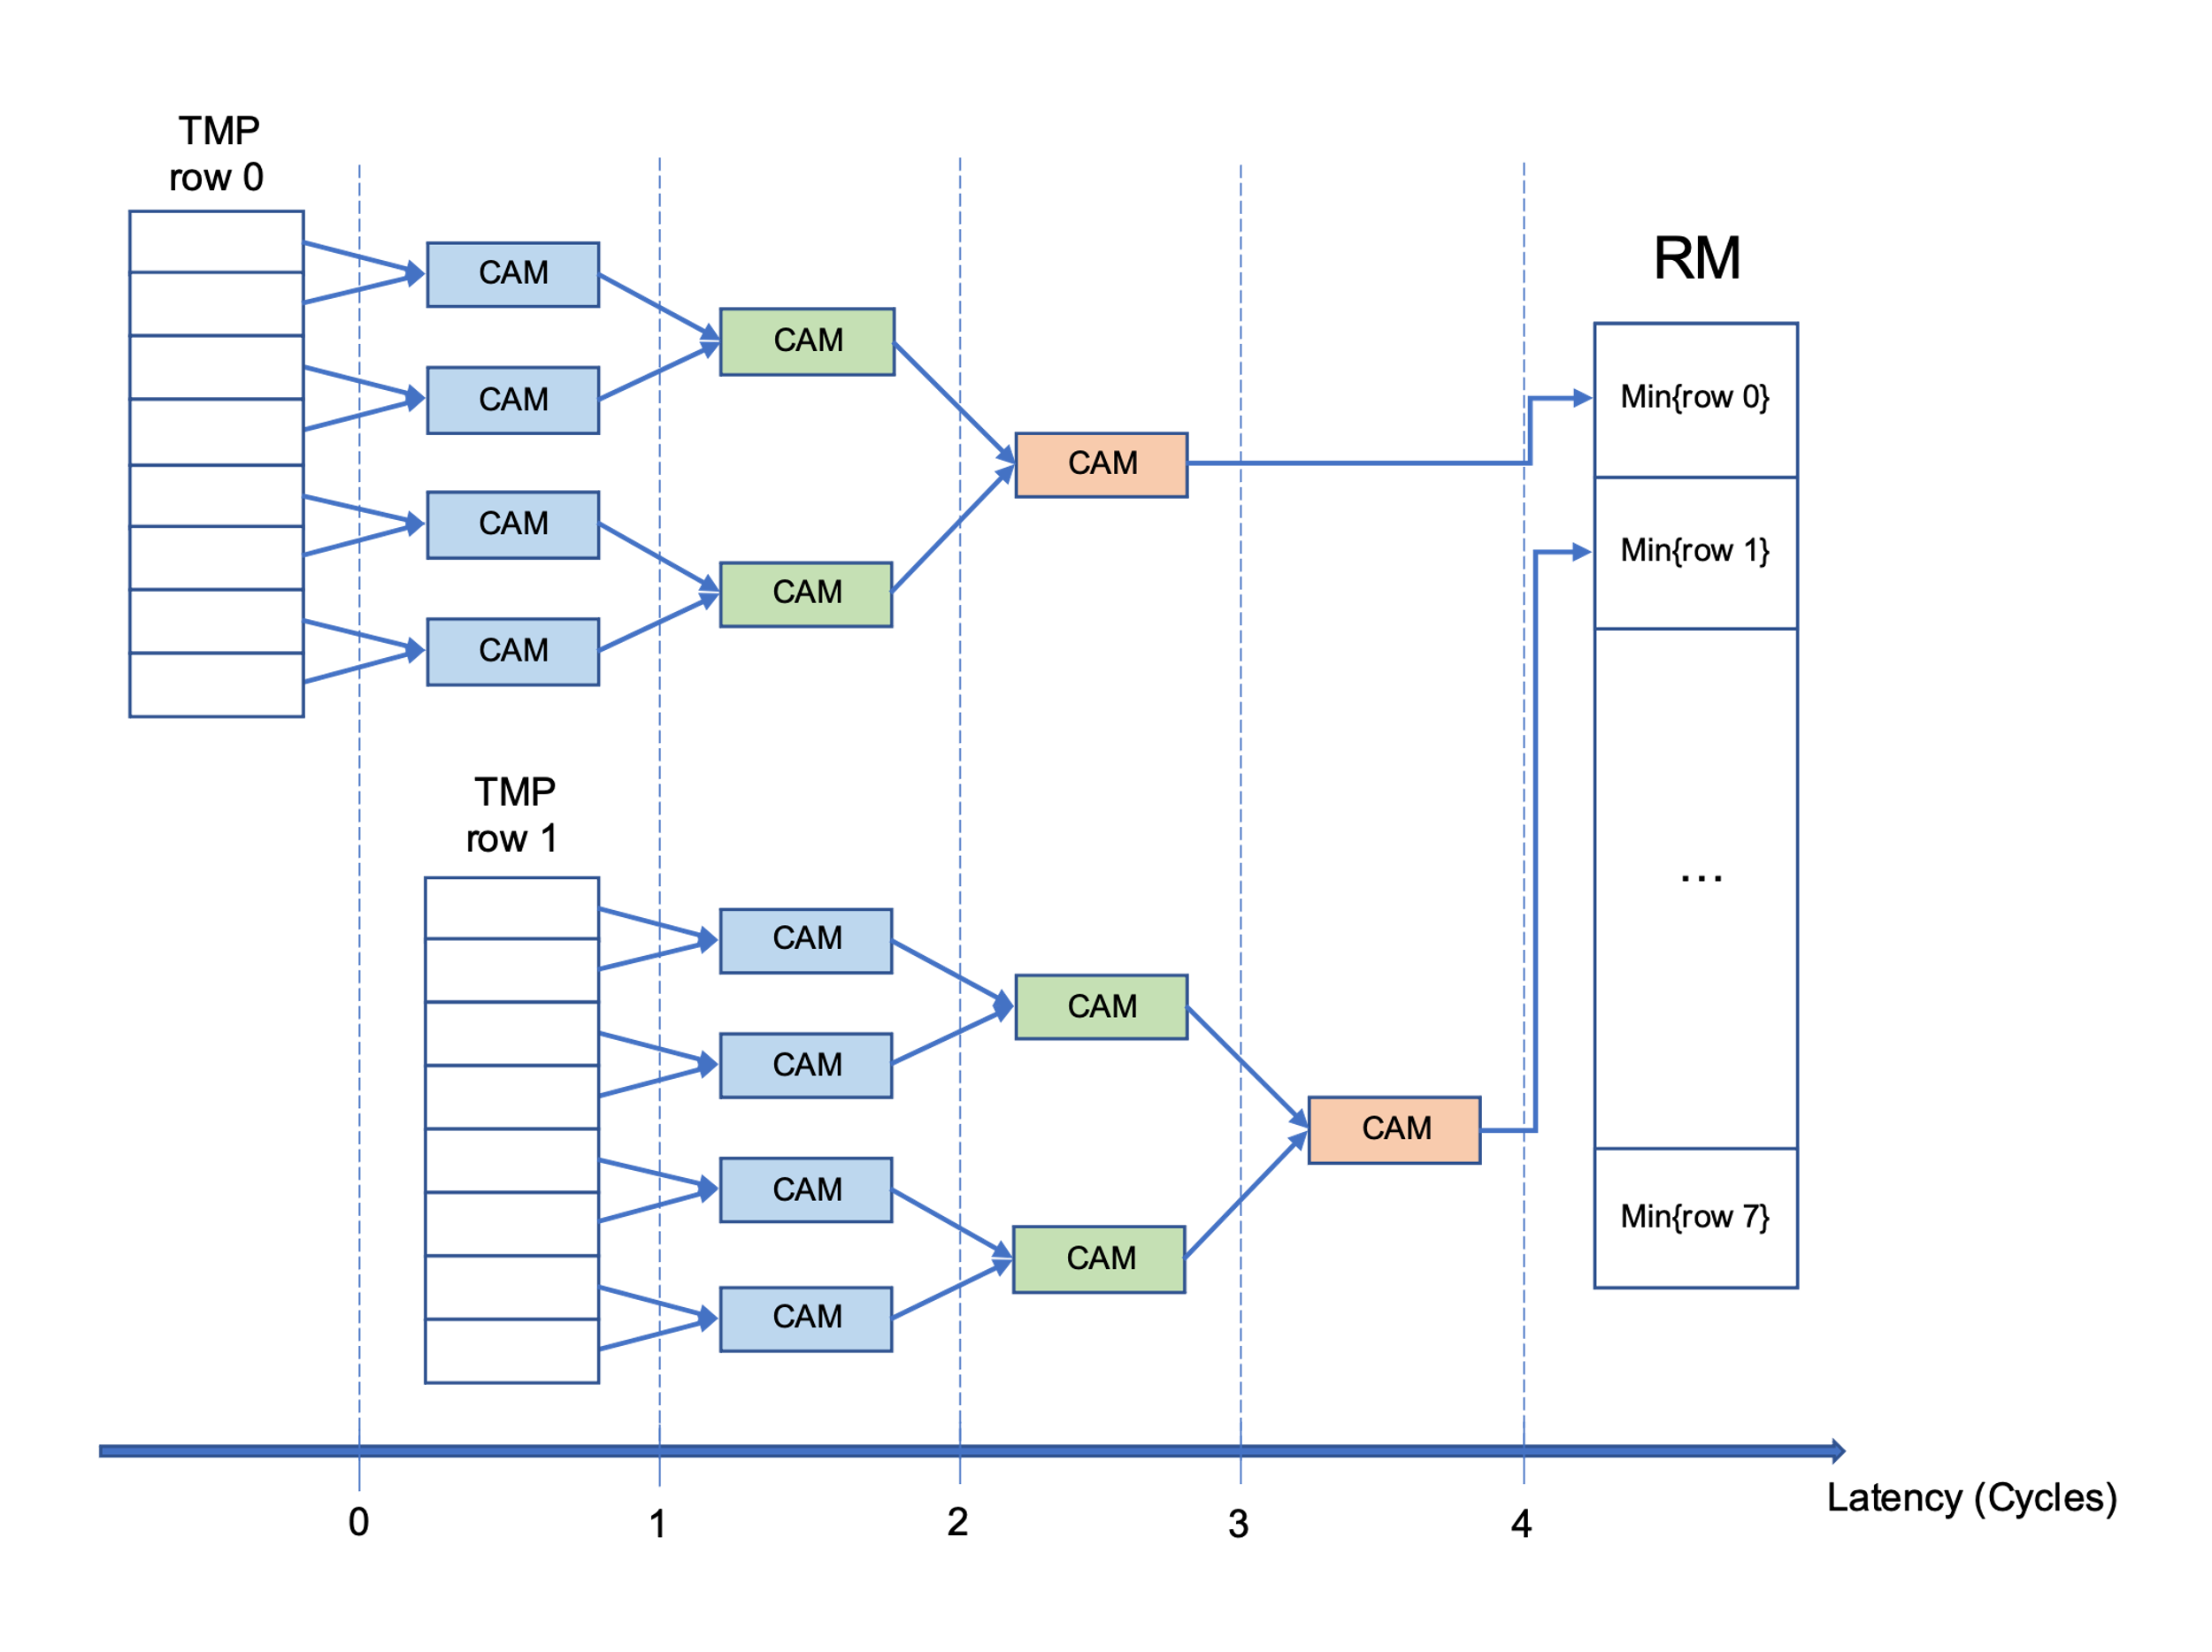
High-speed, efficient minimum-finder
CAM = compare and minimize

Slide 78
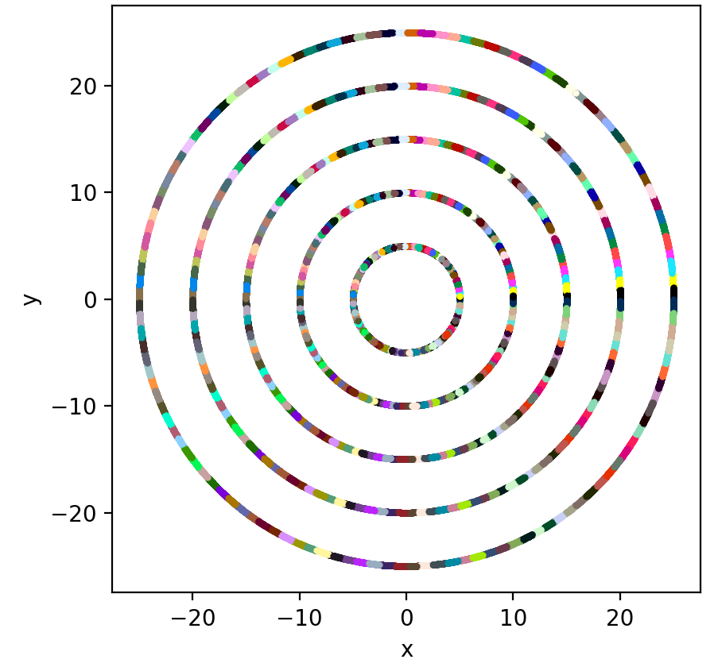
Segment Silicon Detector into slices
Low-momentum
particle
Z-axis View of Detector
High-momentum
particle

Slide 79
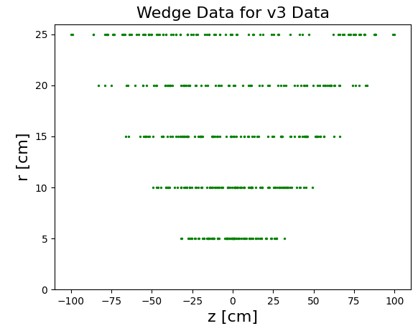
Problem: How to sub-divide each slide?
Any particle trajectory must be fully contained in at least one sub-division of the points
How can we create a sub-division
logic to achieve this?
again, use mathematics!

Slide 80
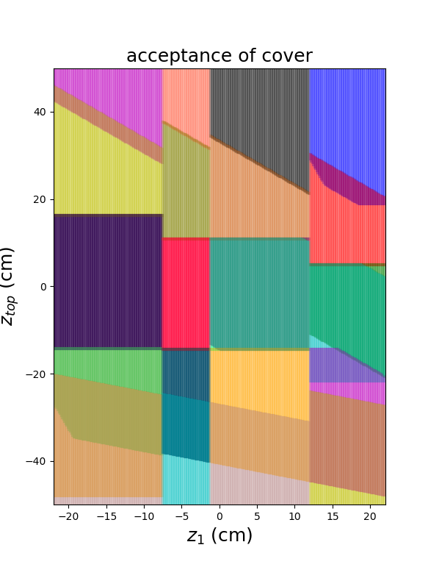
Solution: How to sub-divide each slide
Map each line in real space to a point (z₁, z_{top}) in “parameter space”
Sub-divide parameter space into rectangles using mathematics!
AI based on mathematical logics that are understandable and explainable by humans

Slide 81
Conclusions
Astrophysical and cosmological data support the hypothesis of Dark Matter
A century of particle physics research has converged on a well-tested theory of matter, forces and masses of particles
Next frontier: experimental tests of the hypothesis that Dark Matter consists of new kind(s) of fundamental particles
If produced at the LHC, how can we recognize the signature of this production process?
Implement “understandable AI” algorithms in digital circuits on silicon chips for superfast execution
40 times faster than software method
Can be scrutinized for logical consistency

