Slide 1
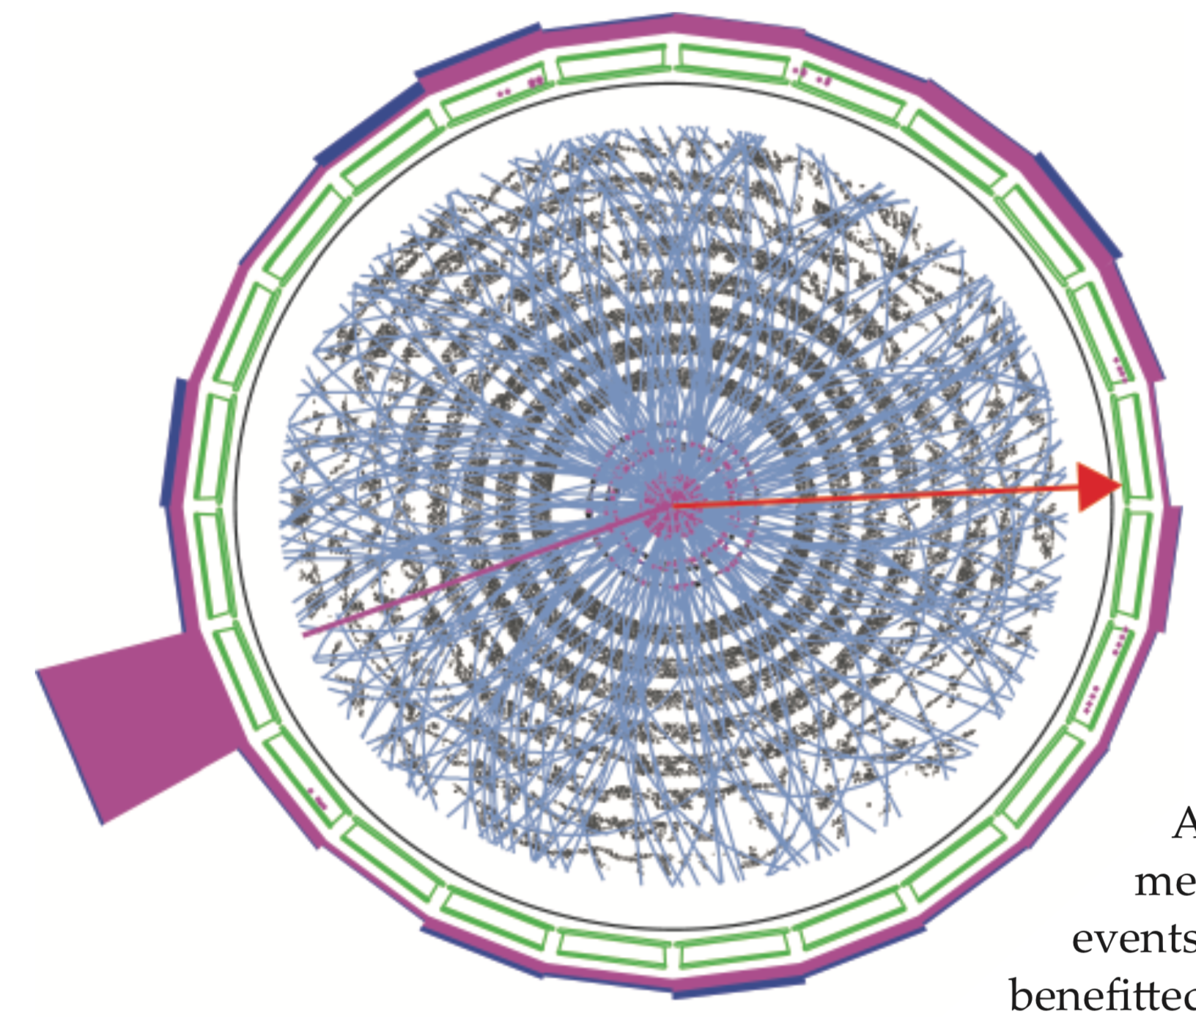
The Heavyweight W boson –
Upset to the Standard Model of Particle Physics
Ashutosh V. Kotwal
Duke University
University of the Witwatersrand
October 21, 2022

Slide 2
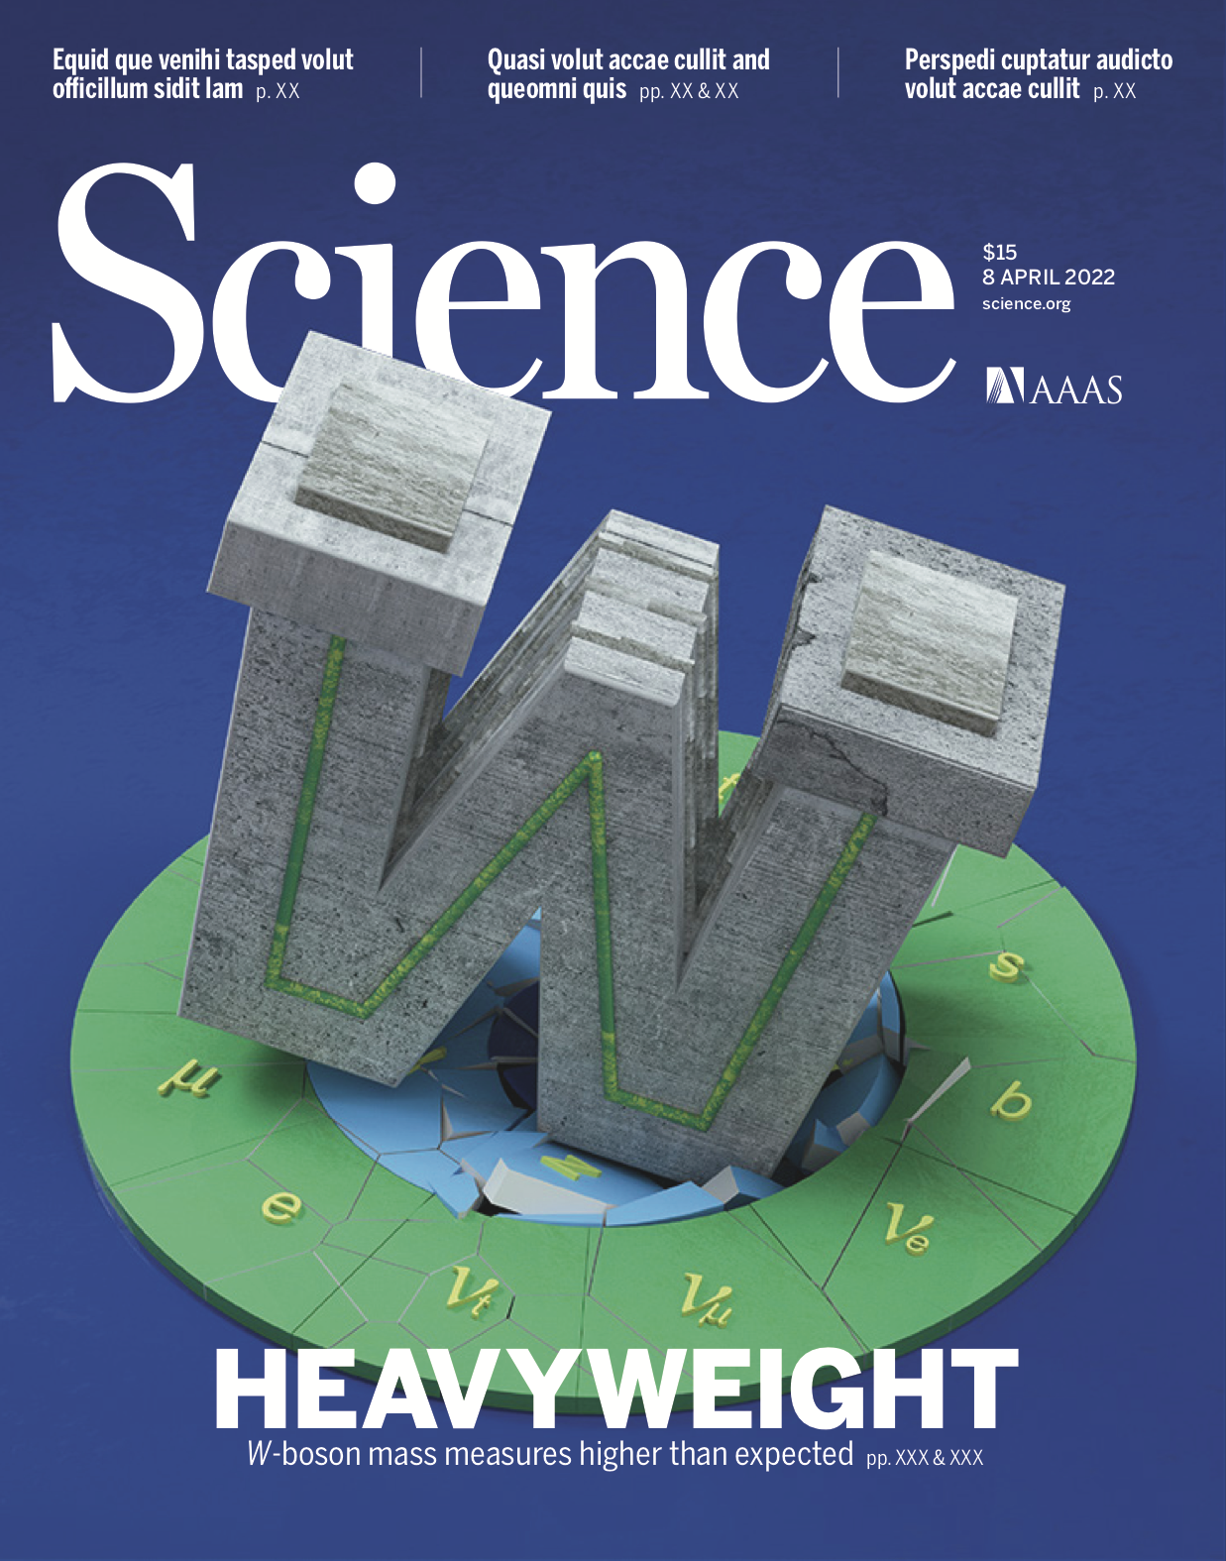
The Heavyweight W boson –
Upset to the Standard Model of Particle Physics
Ashutosh V. Kotwal
Duke University
University of the Witwatersrand
October 21, 2022

Slide 3
Origin of Particle Physics
Search for the constituents of matter has been one of the central themes of physics
Aristotle's “elements” earth, air, fire & water
Chemists understood that molecules were the units carrying chemical properties of materials
Molecules
Atoms
Positive and negative charges
Ernest Rutherford: scattering of probe particles off matter as a means of investigating substructure
Scattering at large angle
due to small, heavy
charged core: atomic nucleus
α
Au

Slide 4
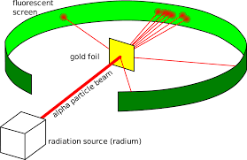
Origin of Particle Physics
Rutherford’s scattering experiment of 1911

Slide 5
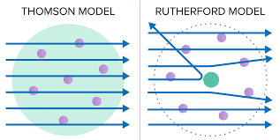
Origin of Particle Physics

Slide 6
From Atoms to Quarks
Technique of scattering exploited repeatedly with beams of higher energy to probe smaller distances
.Δr ~ hc / ΔE
.r
Energy
Atom
10⁻¹⁰ m
10 electron-Volts (eV)
Nucleus
10⁻¹⁵ m
10⁶ eV (MeV)
Proton, neutron
10⁻¹⁸ m
1000 MeV (GeV)
'partons'
<10⁻¹⁸ m
> GeV
Scattering of electrons at high energy (early 1970's at Stanford Linear Accelerator Center) provided evidence of nucleon constituents: quarks
Many particles explained as different combinations of few quarks

Slide 7
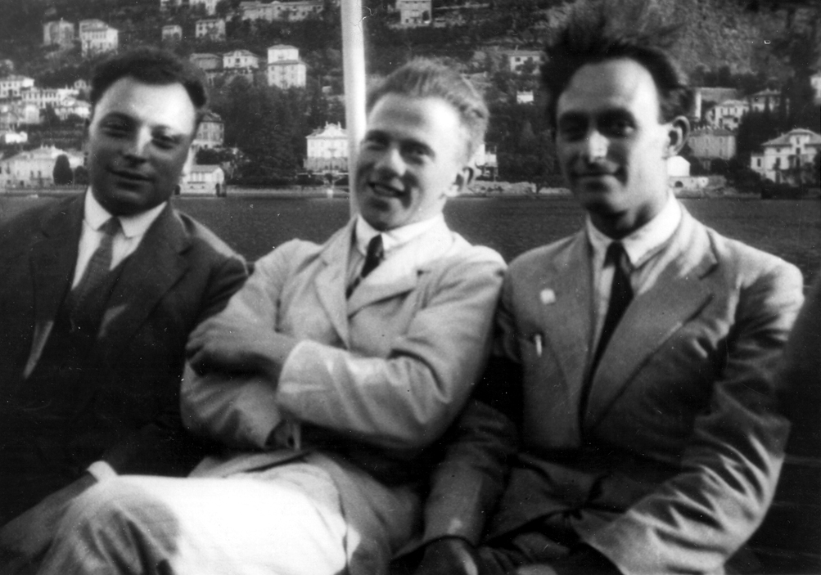
Pauli, Heisenberg and Fermi

Slide 8
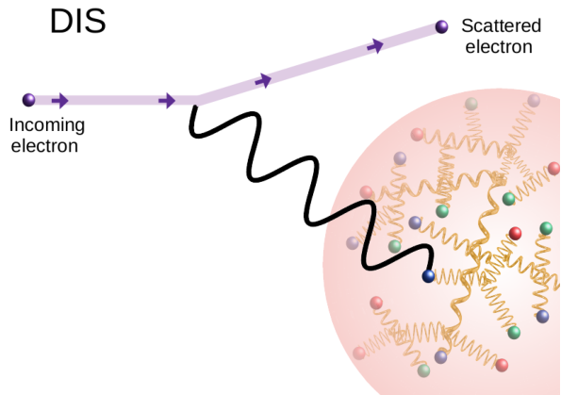
From Atoms to Quarks
DIS = Deep Inelastic Scattering

Slide 9
20th Century Built on Quantum Mechanics
The scientific advances of the 20th century have transformed our lifestyle
Impact of Quantum Mechanics
  All electronics devices, computers and communication
  Nuclear power
  Atomic and molecular manipulation of materials for chemical and biological applications

Slide 10
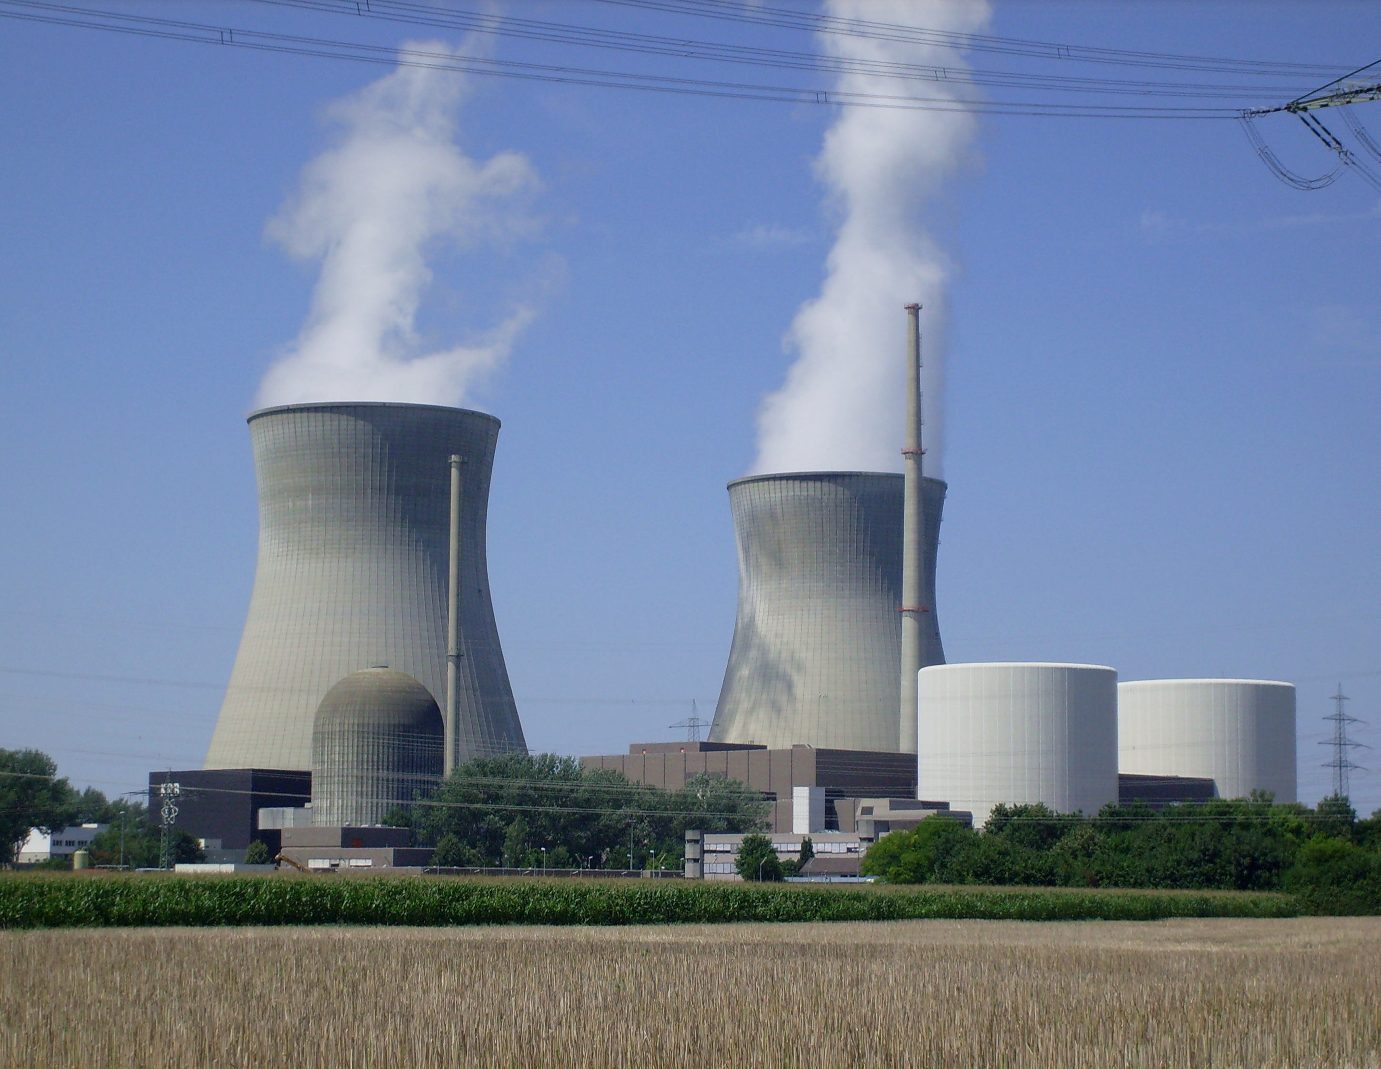
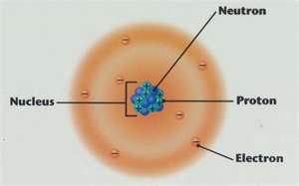

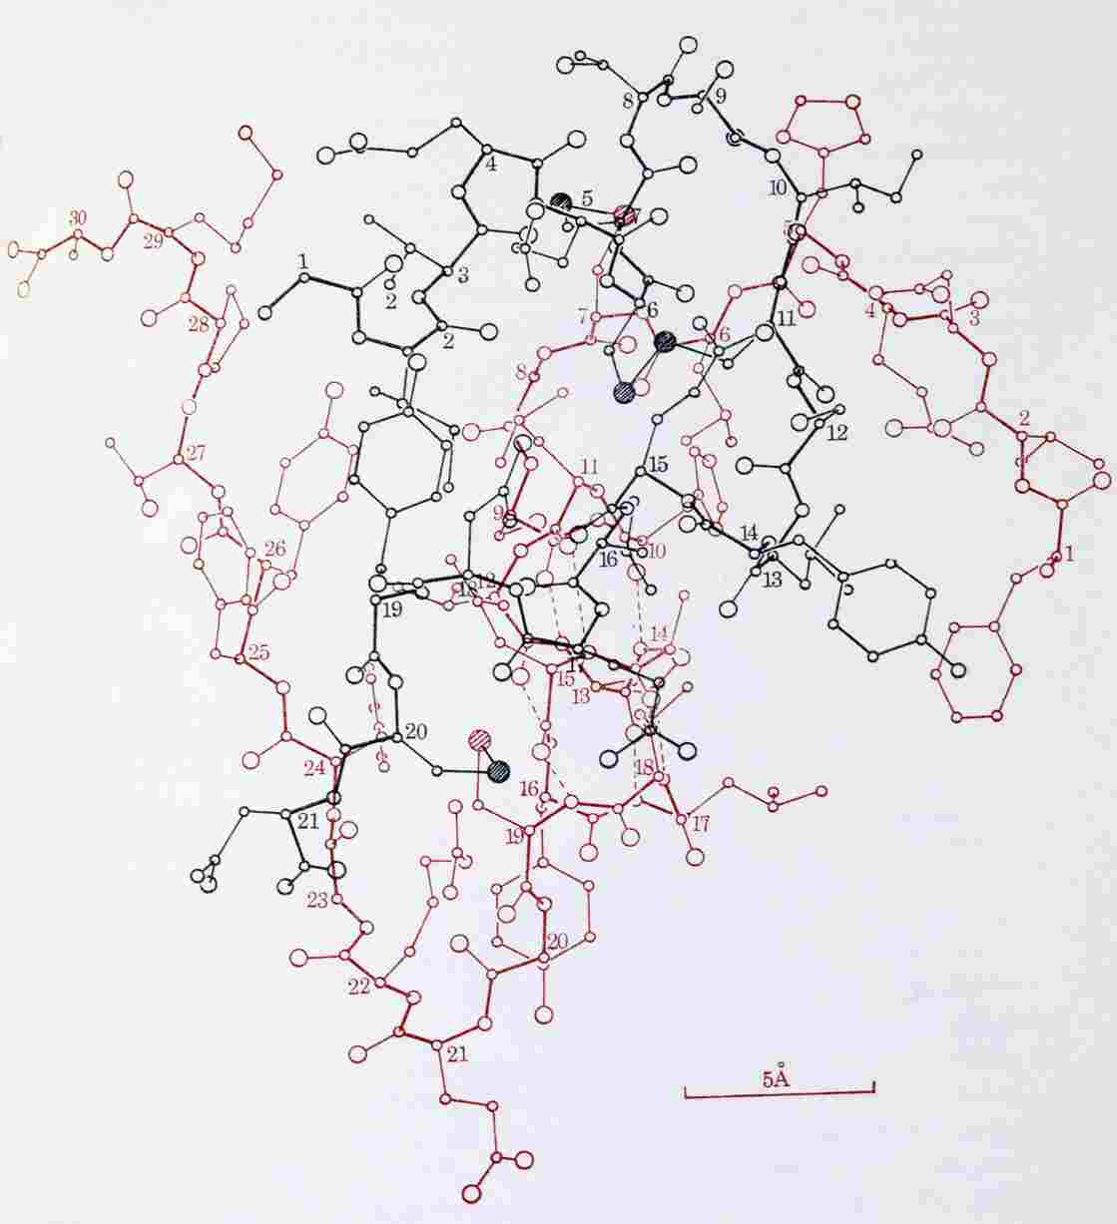
Molecule of Insulin

Slide 11
Foundations of 20th Century Physics
Quantum Mechanics
Special Relativity
Combination of these fundamental principles – Relativistic Quantum Theory

Slide 12
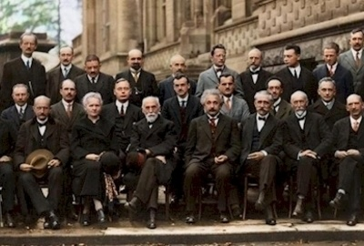
Founders of 20th Century Physics

Slide 13
Foundations of 20th Century Physics
Quantum Mechanics
Special Relativity
Combination of these fundamental principles – Relativistic Quantum Theory
  Initiated by Paul Dirac

Slide 14
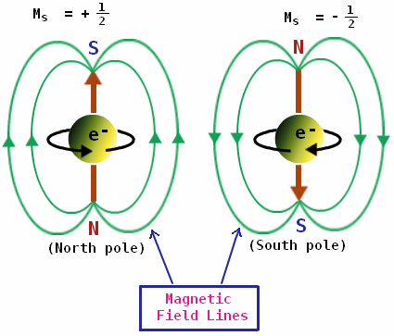
Fundamental Properties of Electrons

Slide 15
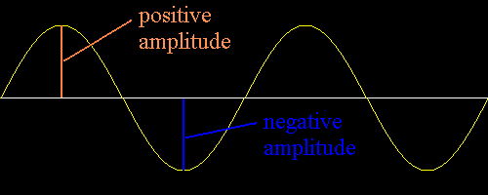
Effect of Complete Rotation
Quantum Mechanics + Special Relativity => Dirac and others showed mathematically that electron can be the type of particle that becomes negative of itself under a complete rotation

Slide 16
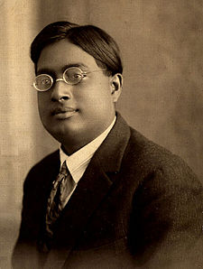
Identical Particles are Indistinguishable
Bose solved a major puzzle in quantum mechanics by proving that particles of the same type are indistinguishable
Satyendra Nath Bose in 1920’s

Slide 17
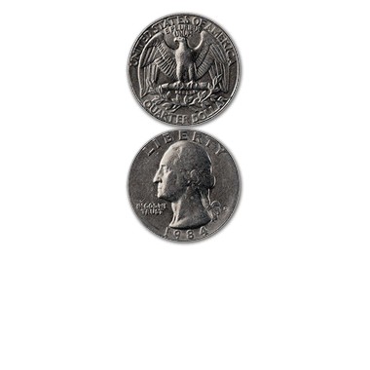
Towards a Fundamental Theory of Matter
Interchange between two electrons ⬄ rotate one by 360 deg.

Slide 18
Why Matter Occupies Volume
ψ(e₁, e₂) = - ψ(e₂, e₁)
But if two electrons occupied the same spot in space
ψ(e₁, e₂) = ψ(e₂, e₁)
Wave that both equal to itself and equal to negative of itself must be ZERO
Pauli Exclusion Principle – identical particles like electrons, protons, neutrons cannot be at the same point in space at the same time
This is a fundamental explanation for why matter is made up of fermions and why matter occupies volume

Slide 19
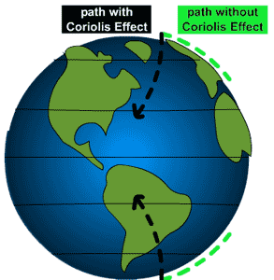
How to Predict Fundamental Forces
“fictitious” forces observed in accelerating frame of reference

Slide 20
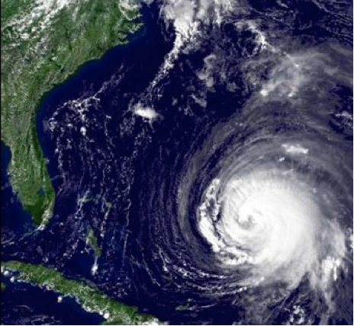
Manifestation of Coriolis Force
Hurricanes appear to rotate in Earth’s frame of reference

Slide 21

Quantum Mechanics force ⬄ particle exchange

Slide 22
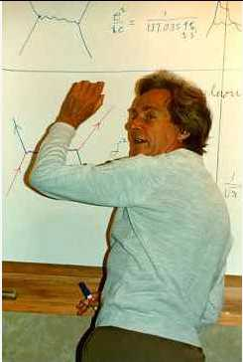
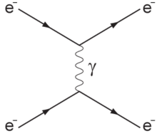
Feynman Diagram: Force by Particle Exchange
Electromagnetic force between two electrons mediated by “photon” exchange
Richard Feynman

Slide 23
Feynman Diagram: Force by Particle Exchange
The most precisely tested theory, ever:
The quantum theory of the electric and magnetic forces, radio waves, light and X-rays:
Measured and predicted magnetic moment of an electron agree within 0.3 parts per trillion accuracy
Electromagnetic force between two electrons mediated by “photon” exchange

Slide 24

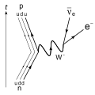

Weak Nuclear Decay
p
ν
The force causing this interaction is described by particles making transitions on a “mathematical sphere”
n
e

Slide 25
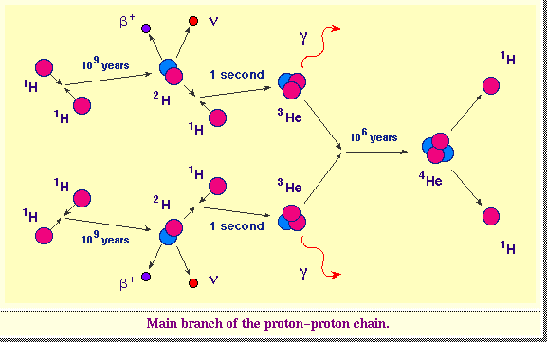
Nuclear Fusion in Sun’s Core
Crucial role of W boson in hydrogen -> helium fusion in Sun’s core

Slide 26
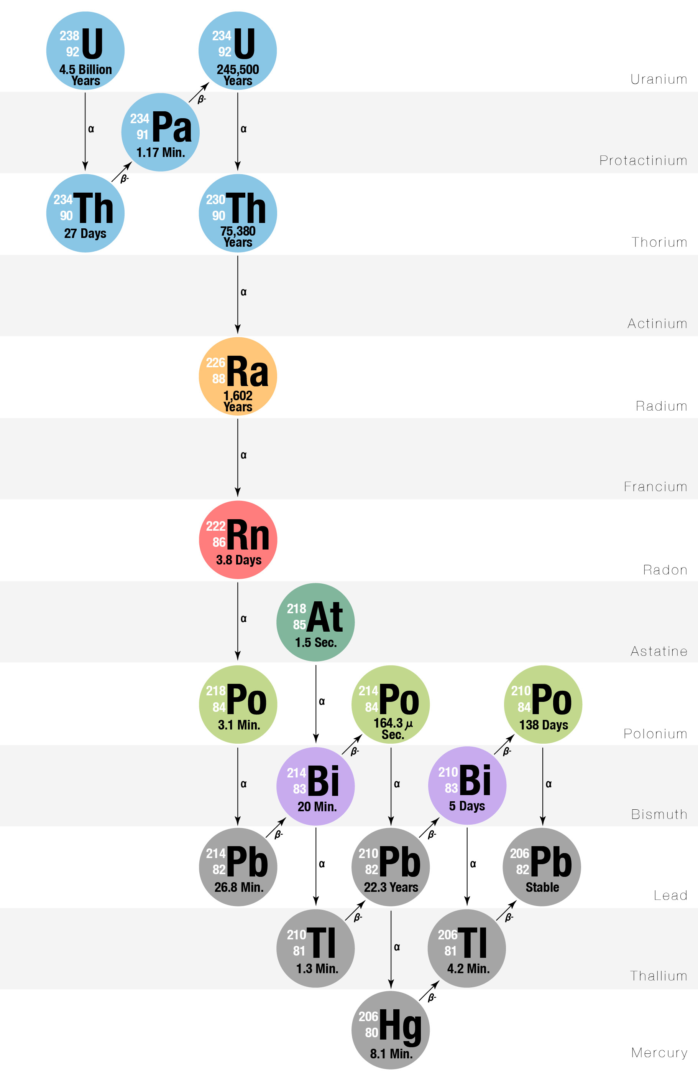
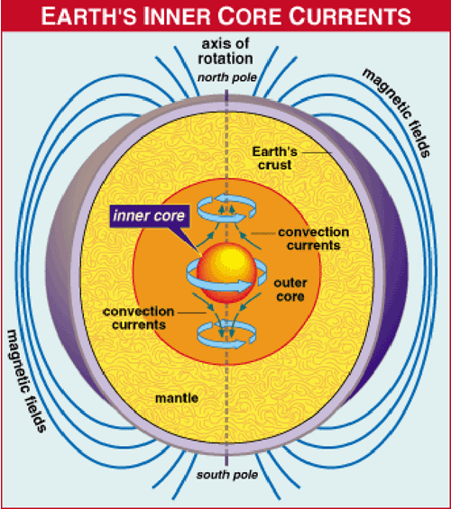
What Keeps the Earth’s Core Molten?
Crucial role of W boson in keeping Earth core molten and generate
protective magnetic shield against harmful solar radiation

Slide 27
Success and Problem of Force Theory
Success: correct mathematical description of all properties of electromagnetic force and the weak nuclear force
Another prediction: force-mediating particles must be massless
Correct prediction for photon – mediator particle of electric and magnetic forces and all electromagnetic waves: radio, light, microwave, x-rays described by massless photons
Problem: for the weak nuclear force causing nuclear beta-decay, the mediator particle, “W boson” is very heavy
Question: How can we preserve the original theory and simultaneously impart mass to the W boson?

Slide 28
How does the W boson Acquire Mass?
Fill all of space with “Higgs” field
Particles propagating through “empty space”
actually propagating though Higgs field
Interaction of particles with Higgs field slows down the particle ⬄ imparting the property of mass to it

Slide 29


Light versus Heavy Particles – like moving through water
Streamlined
Moves fast through water
analogous to light particle
Not streamlined
Moves slowly through water
analogous to heavy particle

Slide 30

How did we confirm the existence of the Higgs?
Create ripples in the Higgs field
Ripples ⬄ Higgs boson

Slide 31
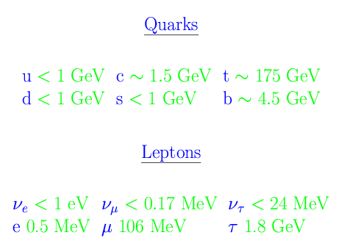
A Century of Particle Physics
Success # 1: discovery of 6 quarks and 6 leptons
12 fundamental fermions: matter particles (and their antimatter counterparts) derived by combining quantum mechanics and special relativity
But the intriguing pattern
of mass values is not explained
– just blamed on
Higgs boson interactions

Slide 32
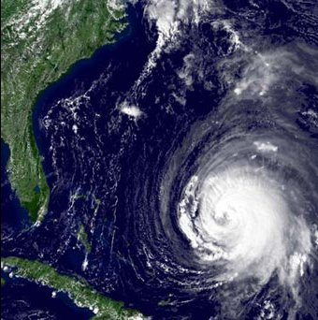
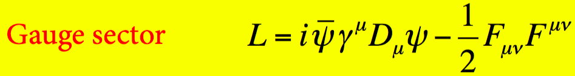
A Century of Particle Physics
Success # 2: principle of gauge invariance for predicting the nature of fundamental forces
  matter particles (quarks and leptons) transform in curved internal spaces
  The equations of motion predict terms that describe particle interactions with force fields

Slide 33
The Vacuum is a Quantum Foam

Slide 34
Implication of Heisenberg Uncertainty Principle
.ΔE ~ h / Δt
Nature can “borrow” energy of amount .ΔE for a short time .Δt
The shorter the time period of this “energy loan”, the larger the amount of the loaned energy that is available
Therefore the vacuum is a bubbling foam with high-energy particles popping up and disappearing

Slide 35
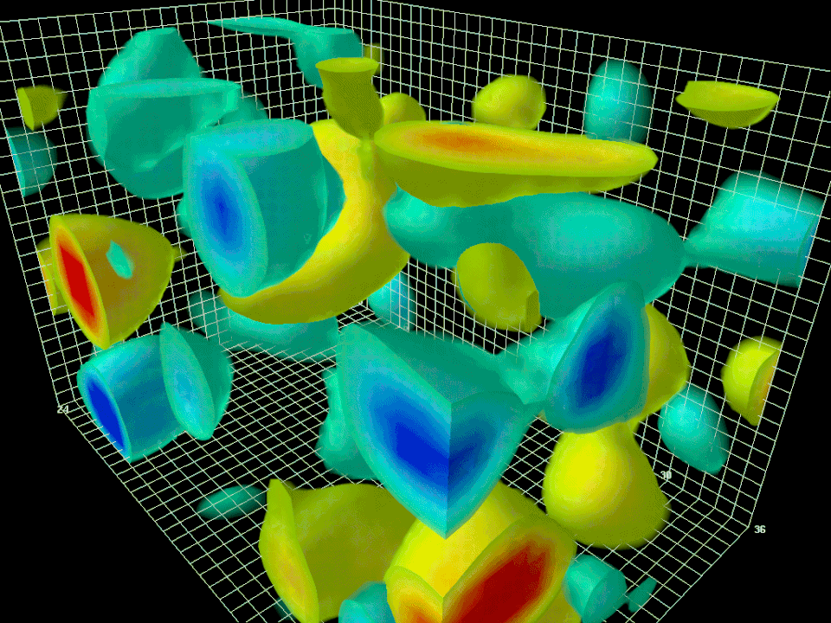
The Vacuum as a Quantum Foam

Slide 36
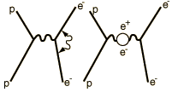
Detecting New Physics through Precision Measurements
Willis Lamb (Nobel Prize 1955) measured the difference between energies of ²S_{½} and ²P_{½} states of hydrogen atom
  Observed one part per million difference in their energies
  States should have the same energy in the absence of vacuum fluctuations
Harbinger of vacuum fluctuations to be calculated by Feynman diagrams containing quantum fluctuations
  Modern quantum field theory of electrodynamics followed ( Nobel Prize 1965 for Schwinger, Feynman & Tomonaga)

Slide 37
From Atoms to Quarks
DIS = Deep Inelastic Scattering

Slide 38
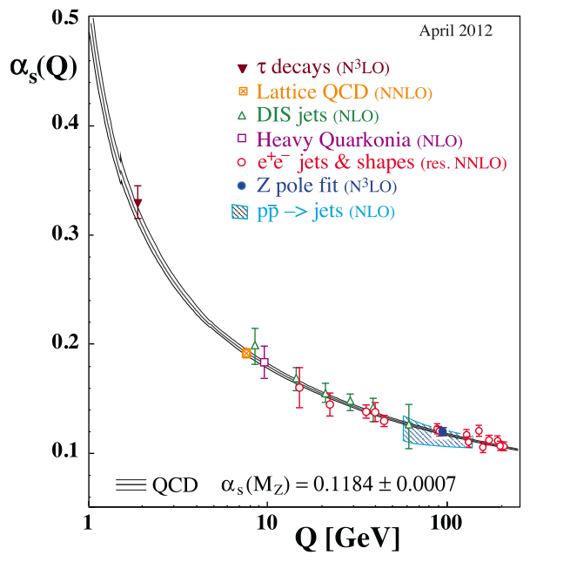

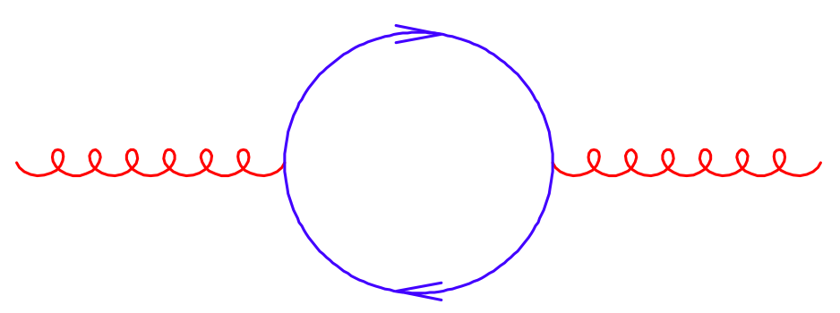
Test of Quantum Fluctuations at High Energy
Changing strength of the strong
force with energy has been
confirmed experimentally

Slide 39
Dark Matter, Galaxy Formation and the Quantum Foam

Slide 40
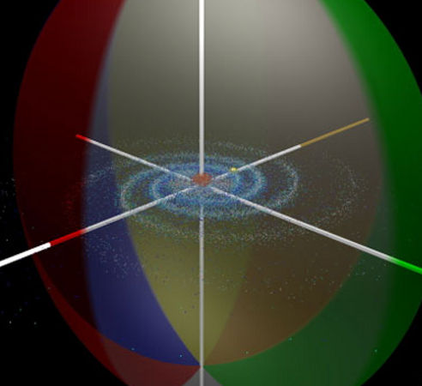
Halo of Invisible Dark Matter around Galaxies
Four times as much dark matter as visible matter

Slide 41
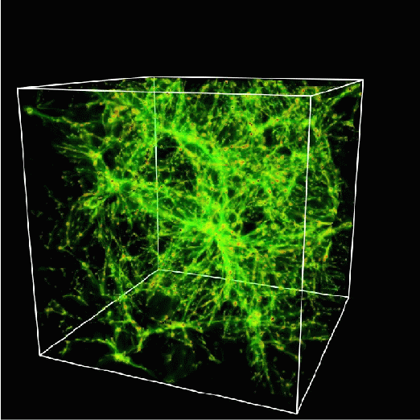
Mapping out the Dark Matter
A lot of dark matter is required to hold galaxies together
It cannot all be made of protons
It must be neutral, stable, heavy
It must be some new form of matter – new fundamental particles

Slide 42
Newly Discovered Dark Matter Galaxies

Slide 43
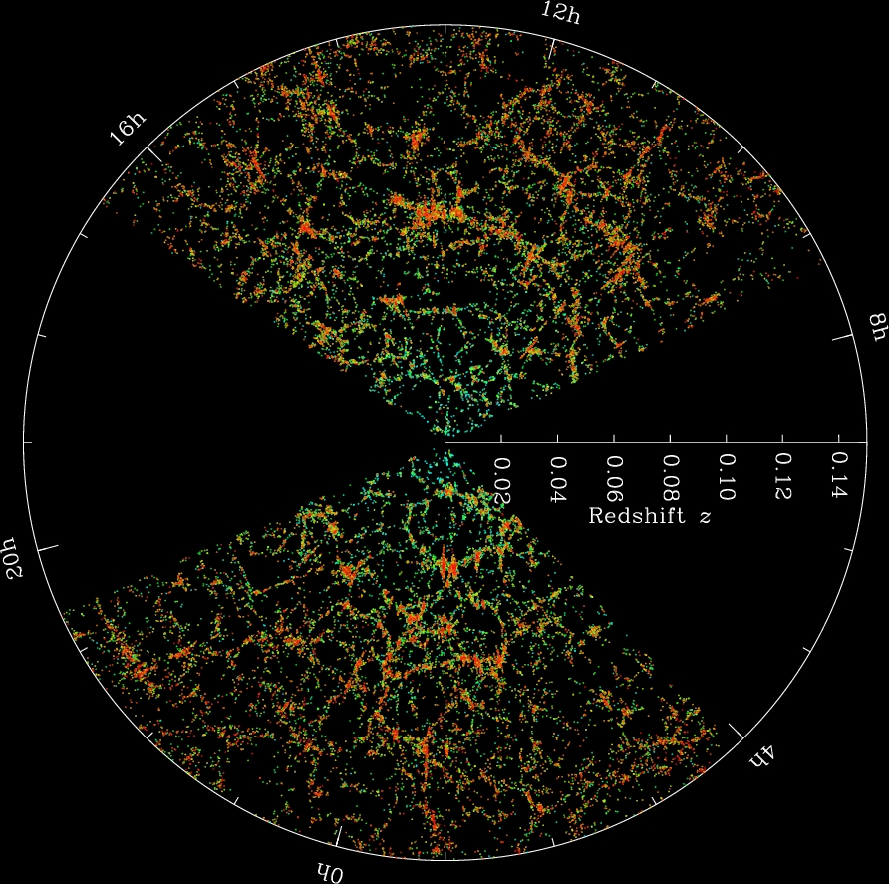
3D Distribution of Galaxies

Slide 44
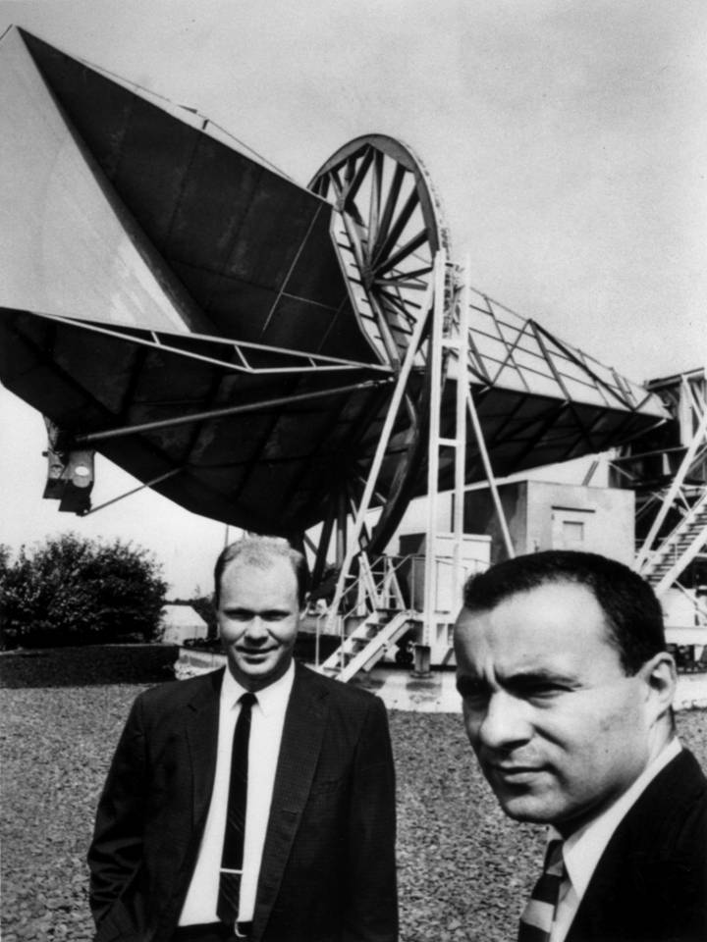
Cosmic Microwave Background
Penzias and Wilson (Bell Labs)
discovered in 1964 a constant microwave radiation coming uniformly from all points in the sky
This radiation was emitted at the beginning of the Universe
Nobel-prize winning discovery

Slide 45
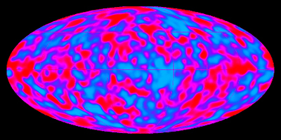
Cosmic Microwave Background Fluctuations
Full sky measurement of variation of microwave radiation
0.001% variation with direction in sky, measured by COBE satellite (Nobel-prize winning discovery)

Slide 46
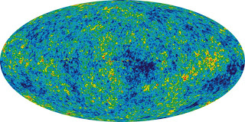
Cosmic Microwave Background Fluctuations
Full sky measurement of variation of radiation
Improved direction precision measured by WMAP satellite

Slide 47
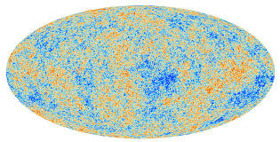
Cosmic Microwave Background Fluctuations
Full sky measurement of variation of radiation
Further improved direction precision measured by PLANCK satellite

Slide 48
Origin of Galaxies Requires Dark Matter
Quantum fluctuations at the Big Bang cause density variations
  We are seeing the imprint of these density variations on the earliest light
Density variations seeded the accretion of dark matter
Dark matter accretion causes accretion of visible matter
  Leading to galaxies we see today

Slide 49
The Vacuum Quantum Foam and the W boson Mass

Slide 50
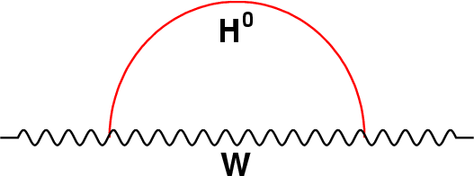
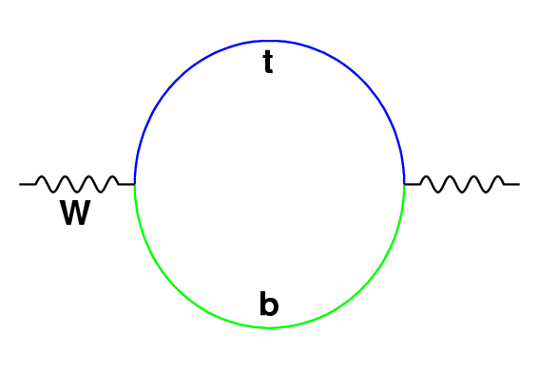
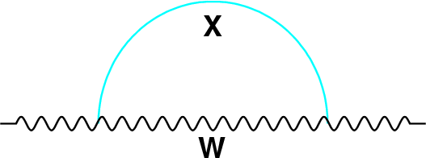
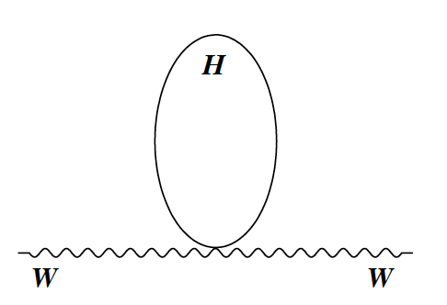
Motivation for Precision Measurement of W boson Mass
Quantum fluctuations due to top quark and Higgs boson and (potentially) undiscovered particles
Standard Model calculation of the quantum fluctuations:
Since we know top quark and Higgs boson masses, comparing measured and calculated values of W boson mass tells us about new particles “X” beyond the Standard Model

Slide 51
Motivation for Precision Measurement of W boson Mass
The mass of the W boson is precisely calculable in Standard Model theory
  The Higgs boson was the last missing component of the model
The W boson mass is calculated to accuracy of 0.01%
  Standard Model expectation
  M_{W} = 80,357 ± 4_{inputs} ± 4_{theory} MeV
A target for comparison to experimental measurement

Slide 52
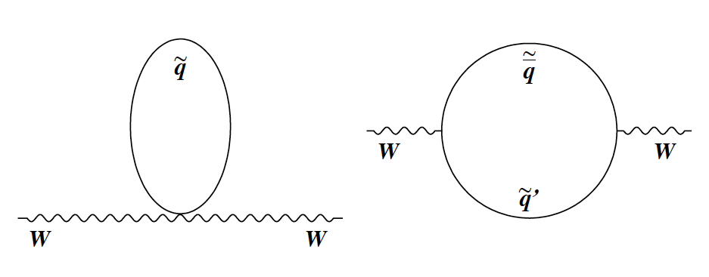
Quantum Fluctuations from Supersymmetric Particles
Quantum fluctuations involving supersymmetric particles contribute to the W boson mass
Supersymmetric particle could constitute dark matter

Slide 53
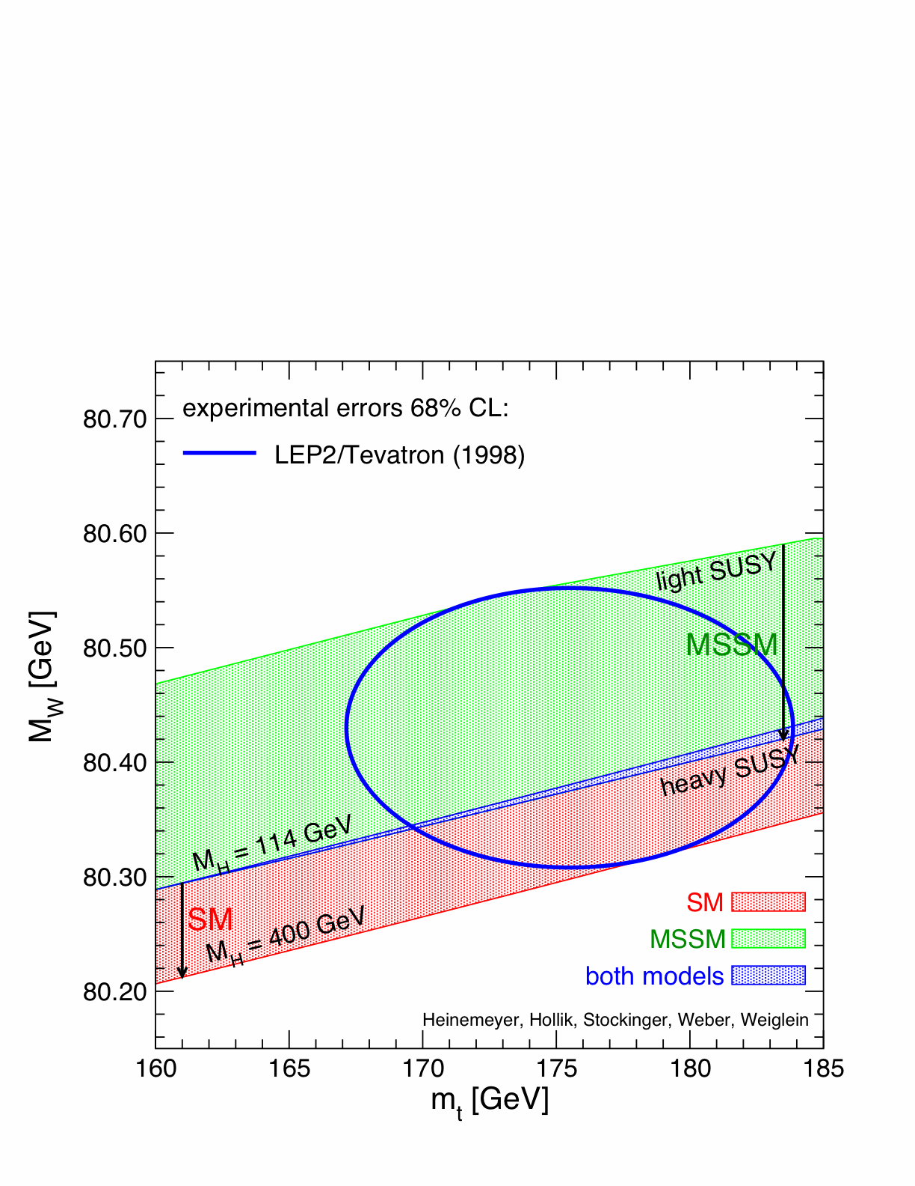
2022 Status of M_{W} vs M_{top}
Standard Model
after 2012 Higgs
discovery
Science 376, 170 (April 7, 2022); DOI: 10.1126/science.abk1781

Slide 54
How to Measure the W boson Mass to 0.01% accuracy

Slide 55
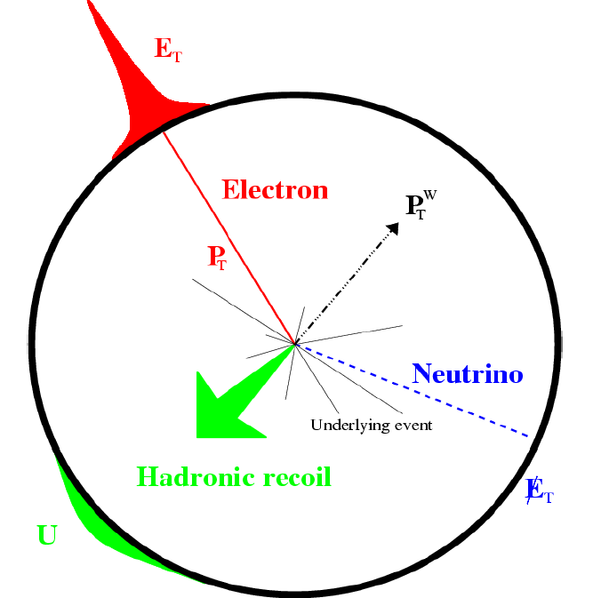
W Boson Production in Proton-Antiproton Collisions
Quark
Gluons
W
Lepton
Antiquark
Neutrino
Quark-antiquark annihilation
produces W boson
W boson decays to neutrino,
accompanied by electron or muon
Lepton (electron or muon) momentum carries most of W mass
information, can be measured precisely (achieved 0.004%)

Slide 56
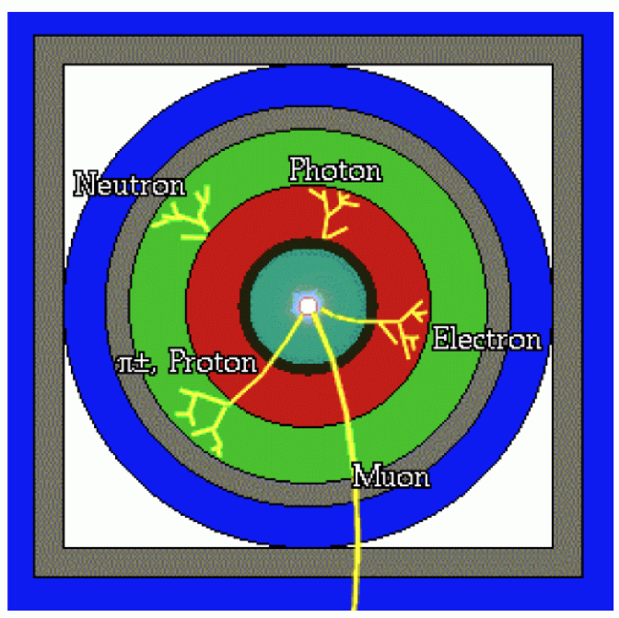
Particle Detector Design
Concentric cylinders of different kinds of detector technologies
Decay products of unstable particles identified

Slide 57
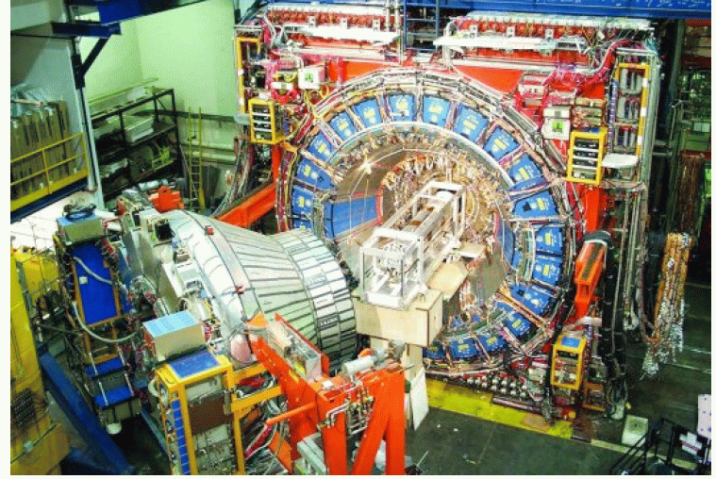
Collider Detector at Fermilab (CDF)
Muon
detector
Central
hadronic
calorimeter
Central EM
calorimeter
Drift
chamber

Slide 58
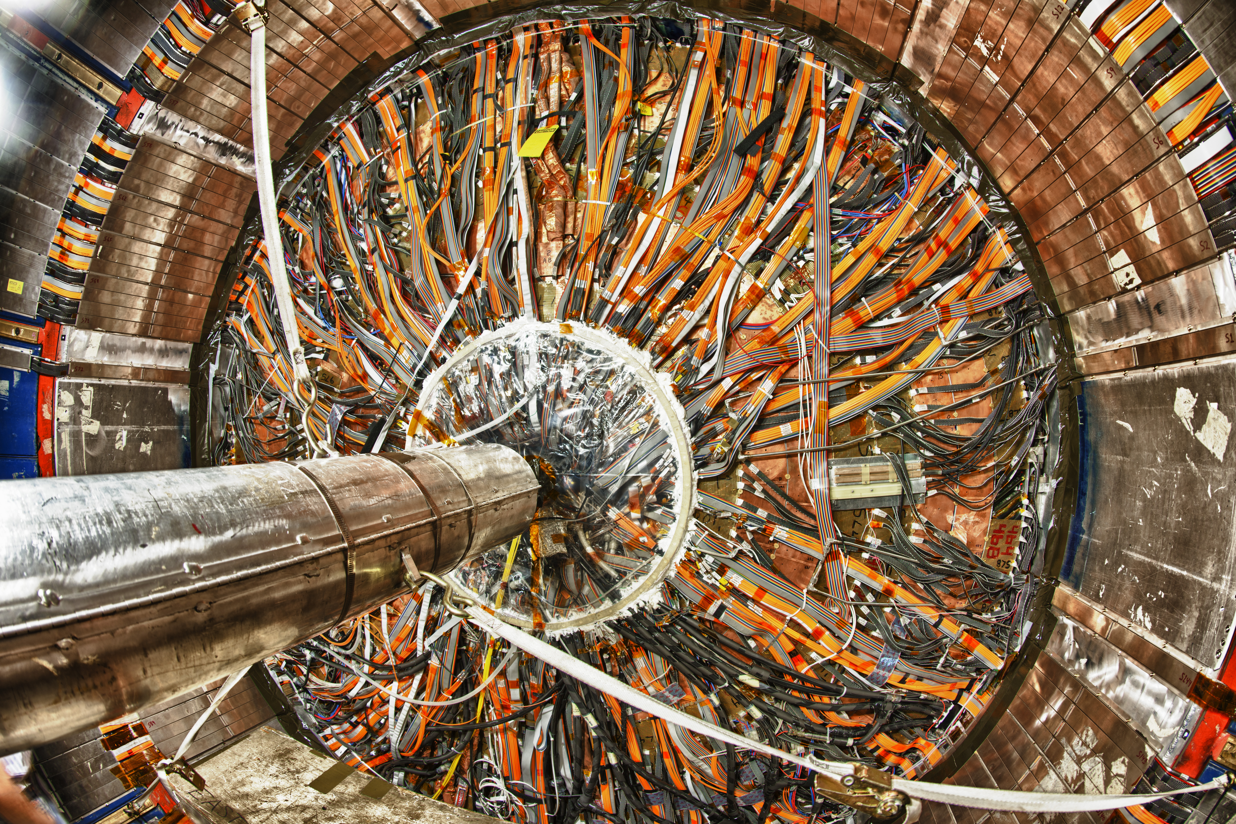
Collider Detector at Fermilab (CDF)
58

Slide 59
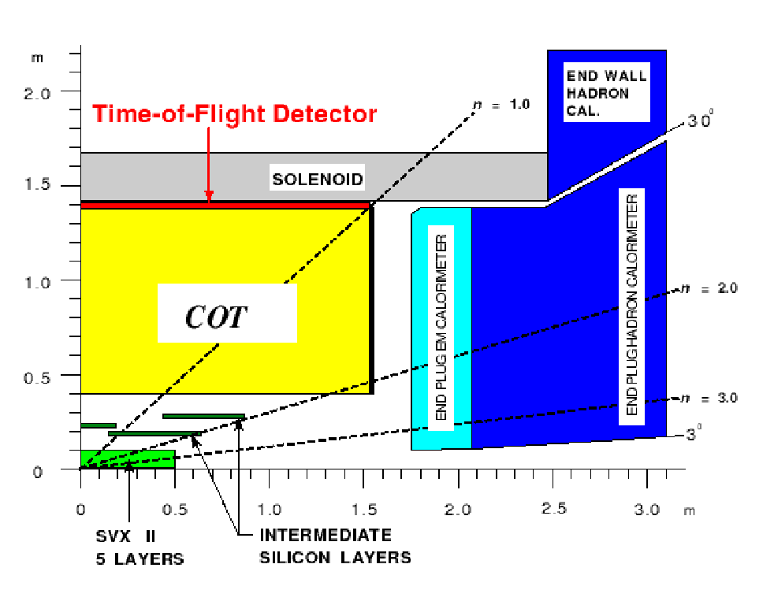
Quadrant of Collider Detector at Fermilab (CDF)
Axial magnetic
field from
solenoid
Central hadronic calorimeter
calorimeter
provides precise
electron energy
measurement
Central electromagnetic calorimeter
.η = 1
drift chamber provides
precise particle momentum
measurement
Calorimeters measure
all other particles

Slide 60

CDF Particle Detector – Drift Chamber

Slide 61
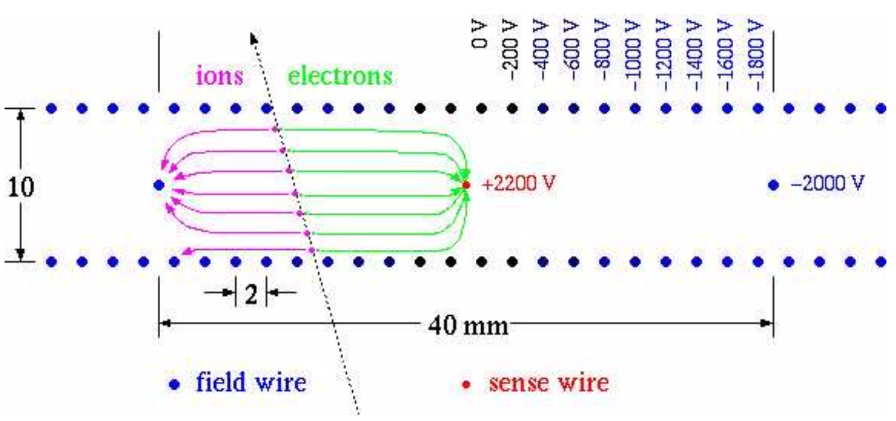
Drift Chamber Operation
Records the position of the charged particle as it passes near the high-voltage sense wire
drift time x drift velocity = drift distance

Slide 62
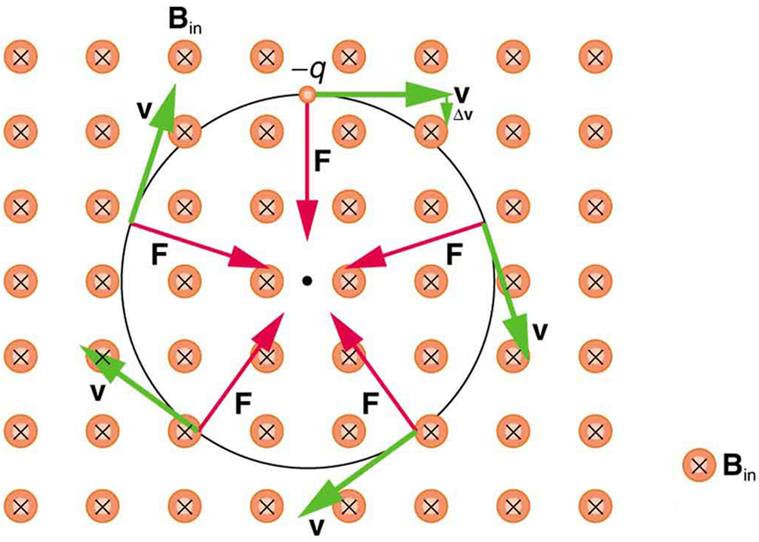
Charged Particle in Magnetic Field
Circular trajectory of a charged particle in a
perpendicular magnetic field

Slide 63
W boson Production Event
electron
hadronic
calorimeter
inferred neutrino
Central
outer
tracker
(COT)
electron
calorimeter

Slide 64
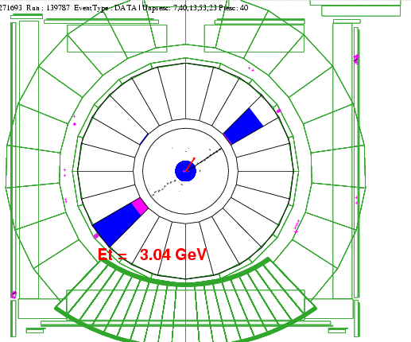
Measurement of Drift Chamber Wire Positions
Use cosmic rays for wire-by-wire position measurements
Fit points on both sides simultaneously to a single helix (Ashutosh V. Kotwal , H. Gerberich and C. Hays, NIMA 506, 110 (2003)

Slide 65


Accuracy of Position Measurements
(Ashutosh V. Kotwal & Chris Hays, NIM A 762 (2014) pp 85-99)
before alignment
Residual (microns)
(φ)
after alignment
(φ)
Final position accuracy of 1 μm (initially 50 μm)

Slide 66

Consistency of alignment procedure
(Ashutosh V. Kotwal & Chris Hays, NIM A 762 (2014) pp 85-99)
Fit separate helices to cosmic ray tracks
Compare track parameters of the two tracks: a measure of track parameter bias

Slide 67

Consistency of alignment procedure
(Ashutosh V. Kotwal & Chris Hays, NIM A 762 (2014) pp 85-99)
track parameter
bias versus
azimuth
solid = before alignment
open = after alignment
azimuth
azimuth
azimuth

Slide 68

Consistency check of alignment procedure
(AVK & CH, NIM A 762 (2014) pp 85-99)
track parameter bias versus polar angle
solid = before alignment
open = after alignment
polar angle
polar angle
polar angle

Slide 69
W boson Production Event
electron
hadronic
calorimeter
inferred neutrino
Central
outer
tracker
(COT)
electron
calorimeter

Slide 70
Custom Monte Carlo Detector Simulation
A complete detector simulation of all quantities measured in the data
First-principles simulation of tracking
  particles propagated through a high-resolution map of material properties
  At each material interaction, calculate
    Ionization energy loss according to detailed formulae and Landau distribution
    Generate bremsstrahlung photons using detailed cross section and spectrum calculations
    Simulate photon conversion and Compton scattering
    Propagate bremsstrahlung photons and conversion electrons
    Simulate multiple Coulomb scattering, including non-Gaussian tail
  Simulate position measurements and perform full helix fit as with data

Slide 71

Custom Monte Carlo Detector Simulation
A complete detector simulation of all quantities measured in the data
First-principles simulation of tracking
  particles propagated through a high-resolution 3-D lookup table of material properties for silicon detector and drift chamber
  At each material interaction, calculate
    Ionization energy loss according to complete Bethe-Bloch formula
    Generate bremsstrahlung photons down to 4 MeV, using detailed cross section and spectrum calculations
    Simulate photon conversion and compton scattering
    Propagate bremsstrahlung photons and conversion electrons
    Simulate multiple Coulomb scattering, including non-Gaussian tail
  Deposit and smear hits on COT wires, perform full helix fit including optional beam-constraint
Calorimeter
e⁺
γ
e⁻
e⁻
e⁻

Slide 72

Momentum Calibration
Well-known ϒ (Upsilon) particle mass is measured and compared to previously known mass value
Achieved precision of 25 parts per million on momentum calibration
Data
Simulation

Slide 73


Momentum Calibration
Well-known J/ψ particle mass is measured and compared to previously known mass value
  In bins of 1/p_{T}(μ) to simultaneously measure and correct for ionization energy loss
per mille
J/ψ μμ mass fit (bin 8)
Data
Simulation
Fig. S9
Fig. 2

Slide 74

Momentum Calibration Uncertainties
Systematic uncertainties on momentum (parts per million)
Table S2
ΔM_{W,Z} = 2 MeV

Slide 75

Proof of Momentum Calibration
We measure the Z boson mass and it agrees with previous measurement of 91188 MeV from CERN electron-positron collider
We measure M_{Z} = 91192.0 ± 7.5 MeV
Data
Simulation
M(μμ) (GeV)

Slide 76

Momentum Calibration
Final calibration using the J/ψ, ϒ and Z bosons for calibration
Combined momentum calibration correction:
  Δp/p = ( -1389 ± 25) parts per million
per mille
ΔM_{W} = 2 MeV
Fig. 2

Slide 77
W boson Production Event
electron
hadronic
calorimeter
inferred neutrino
Central
outer
tracker
(COT)
electron
calorimeter

Slide 78

Calorimeter Simulation for Electrons and Photons
Energy response calculated using detailed GEANT4 simulation of calorimeter
  Leakage of energy
  Absorption in upstream
  Dependence on incident
  angle and energy
Parameters in the calculation are extracted from data
(AVK & CH, NIM A 729 (2013) pp 25-35)

Slide 79

Electron and Photon Calorimeter Calibration
E/p peak from W eυ decays provides measurement of calorimeter energy response, with the following uncertainties:
ΔS_{E} = (43_{stat} ± 30_{non-linearity} ± 34_{X0} ± 45_{Tracker}) parts per million
ΔM_{W} = 6 MeV
Data
Simulation
Low tail used for tuning calorimeter thickness
High tail of used for tuning model of
radiative material
Fig. 2
E_{CAL} / p_{track}

Slide 80

Proof of Calorimeter Calibration using Z boson mass Measurement
  Consistent with previous measurement from CERN (91188 MeV)
  M_{Z}=91194.3±13.8_{stat}±6.5_{calorimeter}±2.3_{momentum}±3.1_{QED}±0.8_{alignment} MeV
Data
ΔM_{W} = 5.8 MeV
Simulation
Fig. 3
M(ee) ( GeV)

Slide 81
W Boson Production in Proton-Antiproton Collisions
Quark
Gluons
W
Lepton
Antiquark
Neutrino
Quark-antiquark annihilation
produces W boson
W boson decays to neutrino,
accompanied by electron or muon
Lepton (electron or muon) momentum carries most of W mass
information, can be measured precisely (achieved 0.004%)

Slide 82

Matching Calculated and Observed Distributions
We perform a very accurate calculation of the momentum of the electron or muon emanating from the W boson decay
We perform a very accurate comparison of this momentum distribution between the observed data and the calculation
M_{W} = 81 GeV
calculation
M_{W} = 80 GeV
We used advanced statistical methods to quantify this comparison and infer the W boson mass

Slide 83

Fit to Electron Momentum Distribution from W boson decay

Slide 84


W Boson Mass Fits
muons
Fig. 4
electrons
Fig. 36

Slide 85

Summary of W boson Mass Fits
Table 1
Consistency between two channels and three kinematic fits

Slide 86

Combinations of Fit Results
Table S9
Combined electrons (3 fits): M_{W} = 80424.6 ± 13.2 MeV, P(χ²) = 19%
Combined muons (3 fits): M_{W} = 80437.9 ± 11.0 MeV, P(χ²) = 17%
All combined (6 fits): M_{W} = 80433.5 ± 9.4 MeV, P(χ²) = 20%

Slide 87

New CDF Result Uncertainties
Table 2

Slide 88
2022 Status of M_{W} vs M_{top}
Standard Model
after 2012 Higgs
discovery
Science 376, 170 (April 7, 2022); DOI: 10.1126/science.abk1781

Slide 89

Epilogue

Slide 90
The Heavyweight W boson
&
The Mystery of the Missing
AntiMatter

Slide 91
Matter-AntiMatter Symmetry
Laws of nature have been proven to be (almost) exactly identical for matter and antimatter
There should be equal amounts of matter and antimatter in the Universe
Where is the MISSING antimatter?
WE need an excess of matter over antimatter in order for galaxies, stars, planets and us to exist…

Slide 92

Sakharov Conditions for Matter Excess
Andrei Sakharov calculated three conditions that must exist in early Universe for creation of matter excess
The Standard Model of Particle Physics satisfies only one of these conditions

Slide 93
Sakharov Conditions for Matter Excess
If the Higgs boson had a partner
i.e. a second Higgs-like particle existed…
The second Sakharov condition can be satisfied !

Slide 94

Higgs Condensation after Big Bang aided by Higgs-like Partner
Higgs droplets form and expand, filling the whole Universe
Satisfies second Sakharov Condition
Higgs-like partner’s existence increases the W boson mass by the observed 0.1%

Slide 95
Summary
  The W boson mass is sensitive to new laws of nature through quantum fluctuations
  New measurement is twice as precise as previous measurements
    M_{W} = 80433.5 ± 9.4 MeV
  Significant difference from Standard Model calculation of M_{W} = 80,357 ± 6 MeV
  significance of 7.0σ (>5σ is considered scientific discovery)
  The Higgs boson is not the end of the story
Thank you for your attention !

Slide 96

W Boson Mass Measurements from Different Experiments
Fig. 5
SM expectation: M_{W} = 80,357 ± 4_{inputs} ± 4_{theory} (PDG 2020)
LHCb measurement : M_{W} = 80,354 ± 23_{stat} ± 10_{exp} ± 17_{theory} ± 9_{PDF} [JHEP 2022, 36 (2022)]

Slide 97


Slide 98


