Slide 1
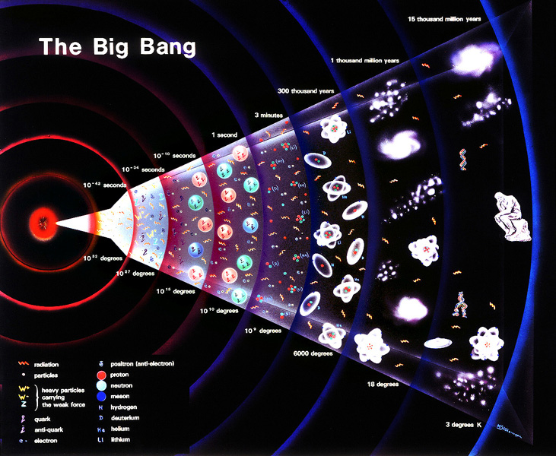
Research in Particle Physics
Ashutosh Kotwal
Duke University
National Center for Performing Arts, Mumbai
June 10, 2025

Slide 2
Why particle physics?

Slide 3
Why particle physics?

Slide 4
Why particle physics?
pain
pleasure

Slide 5
Why particle physics?
pain
pleasure

Slide 6
Why particle physics?
spirituality
pain
pleasure

Slide 7
Why particle physics?
spirituality
curiosity
pain
pleasure

Slide 8
Why particle physics?
spirituality
curiosity
pain
pleasure
Particle physics is curiosity-driven research … discovery science

Slide 9
After a century of particle physics, where have we arrived?
Following the brilliant insights of Paul Dirac and others, we can understand
Why there is matter and antimatter
Why matter occupies volume
How matter interacts via forces
The properties of forces
The Higgs field that explains fundamental particle masses

Slide 10
Homi Bhabha electron-positron (anti-electron) scattering

Slide 11
The Higgs boson and Dark Matter are both intimately connected with properties of empty space…
(or what we thought was “empty space”)
…Making these phenomena unlike any other we have observed in the past

Slide 12
New Mysteries to Solve…
Higgs is a completely new kind of ‘stuff’ in Nature
It is not matter and it is not a force
How and why does it exist?
Is it made up of something else?
What is Dark Matter? We have no clue !!
Is it some mysterious particles made in the Big Bang?
Why is there more matter than antimatter in the Universe?
Should have been created in equally in the Big Bang

Slide 13
W boson drives Nuclear Fusion in Sun’s Core
Crucial role of W boson in hydrogen -> helium fusion in Sun’s core

Slide 14
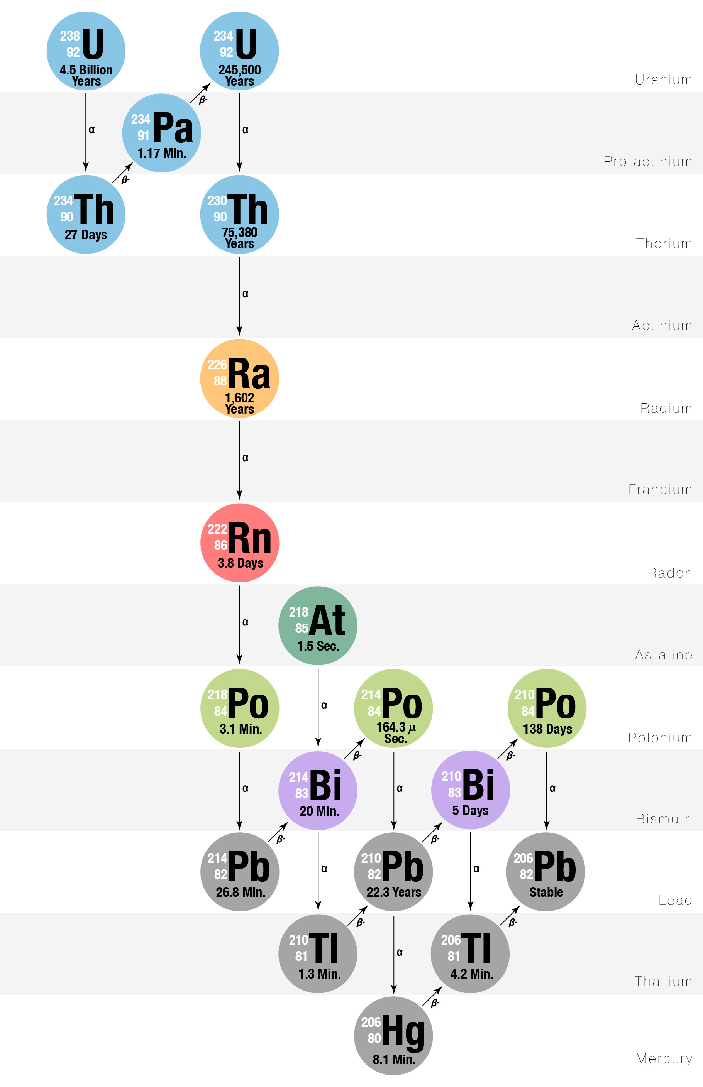
W boson Helps Keep the Earth’s Core Molten
Crucial role of W boson in keeping Earth core molten and generate
protective magnetic shield against harmful solar radiation

Slide 15
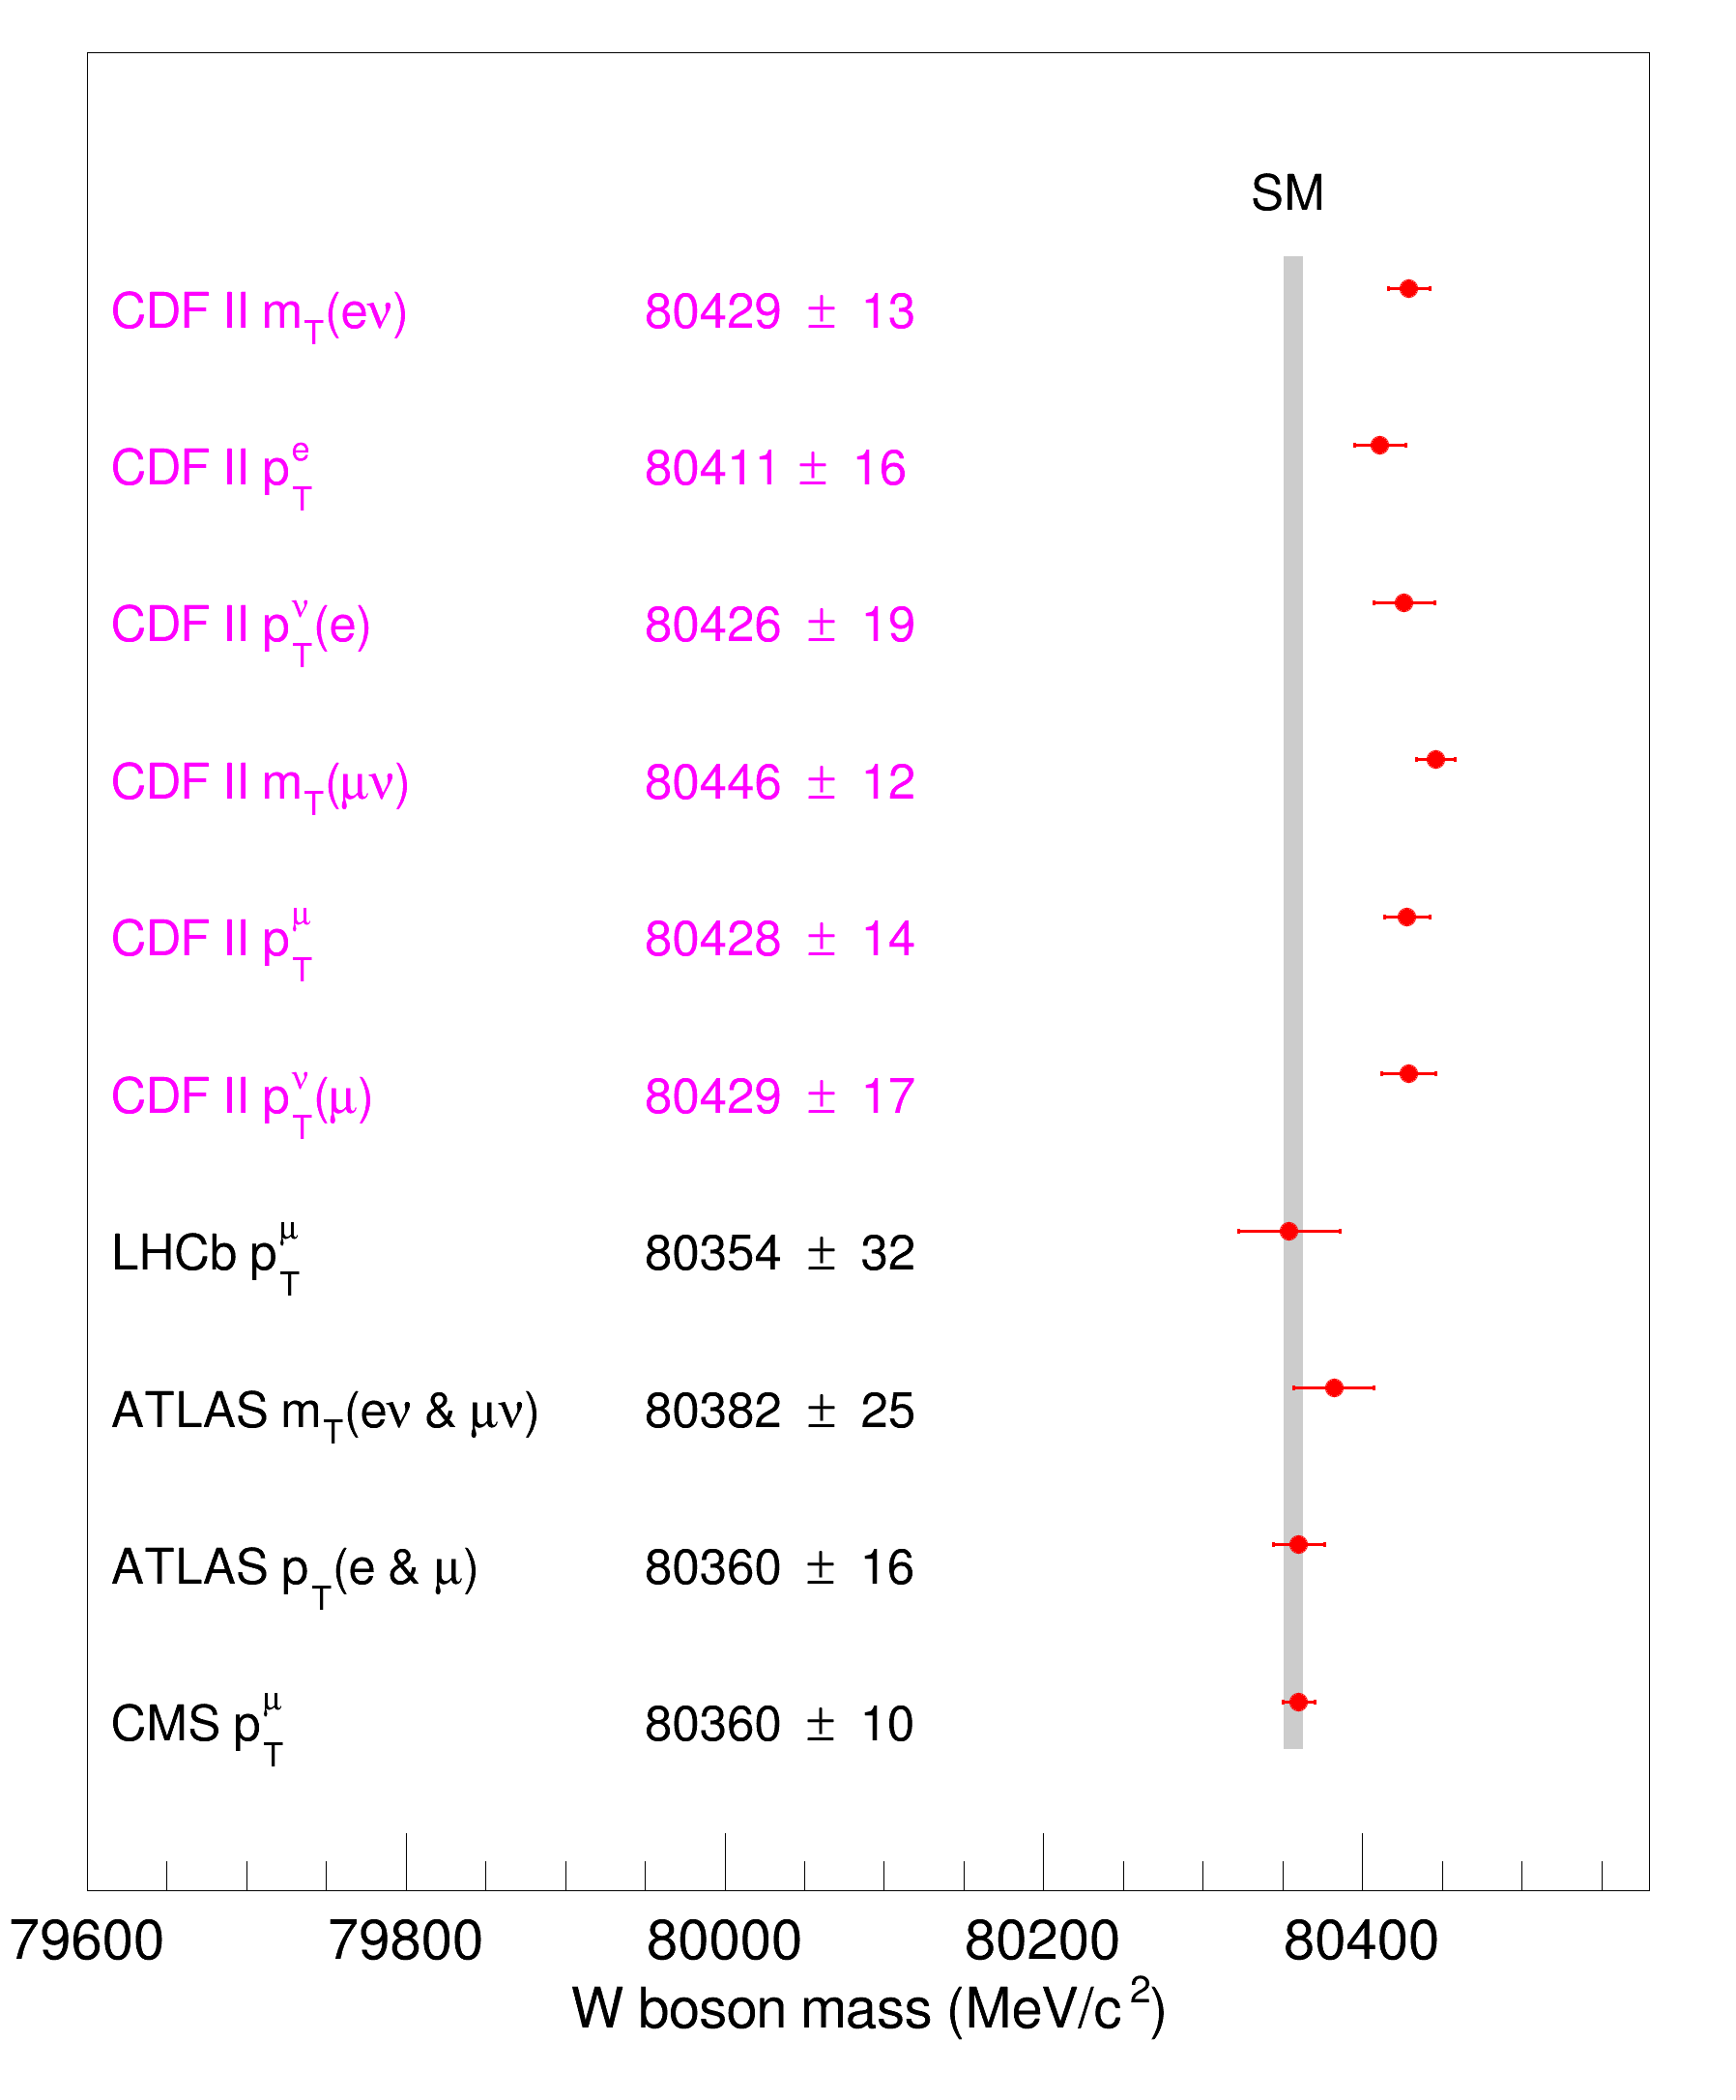
My measurement of
W boson mass is much
higher than Standard Model
theory prediction (80357)

Slide 16
My measurement of
W boson mass is much
higher than Standard Model
theory prediction (80357)
Implies existence of new
physics law of Nature

Slide 17
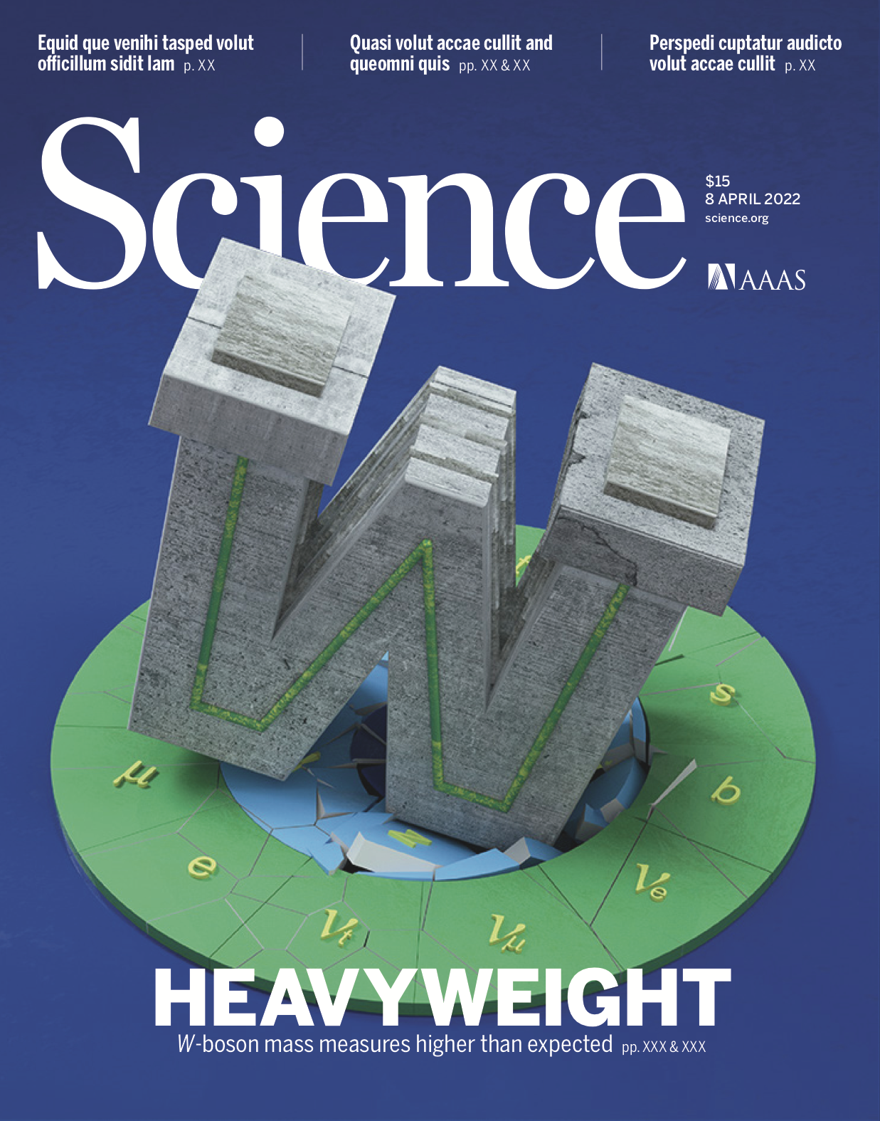
The Heavyweight W boson – Upset to the Standard Model of Particle Physics

Slide 18
New Physics Implications of Heavyweight W boson
Modifications of the Higgs Theory
Supersymmetry
Constituents of the Higgs boson
Dark Matter particles
New fundamental forces

Slide 19
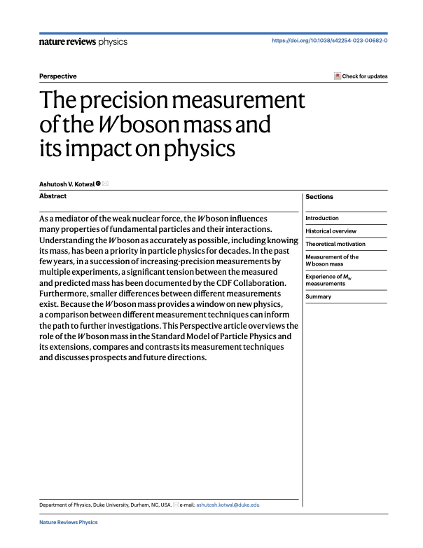

Slide 20
The Higgs boson is not the end of the story

Slide 21
The Mystery of Dark Matter

Slide 22
Stars Orbiting a Galaxy

Slide 23
Halo of Invisible Dark Matter around Galaxies
Four times as much dark matter as visible matter

Slide 25
But Dark Matter cannot radiate energy so remains a huge cloud

Slide 26
Making Dark Matter at the LHC

Slide 27
Large Hadron Collider below Geneva, Switzerland

Slide 28
LHC Accelerator in Tunnel

Slide 29
Theory of Production of Dark Matter Particles

Slide 30
Theory of Production of Dark Matter Particles

Slide 31
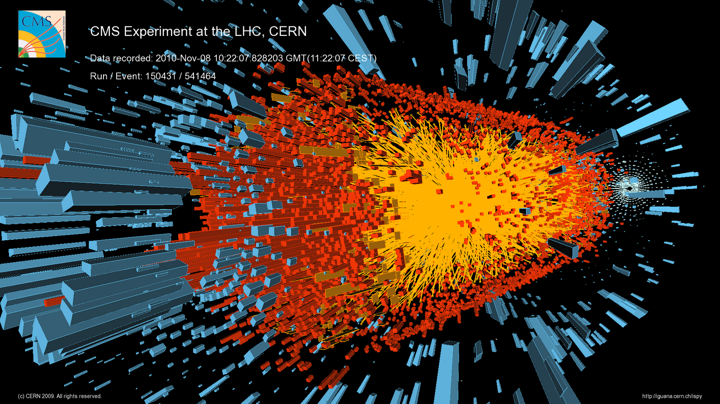
LHC Collisions with very intense beams

Slide 32
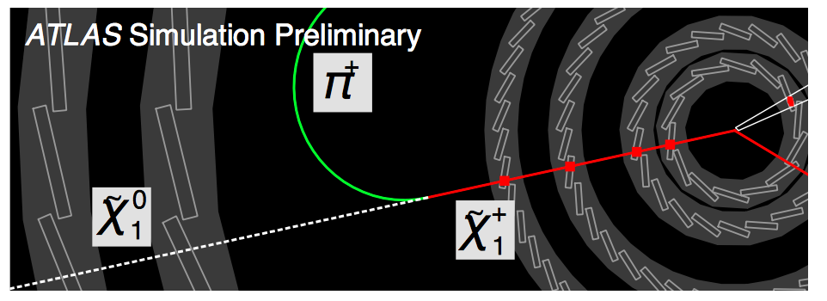
Particle Identification using Silicon Sensors
“disappearing particle”
Dark Matter particle
“disappearing particle” signature cannot be recognized at the collision rate of 40 million / second

Slide 33
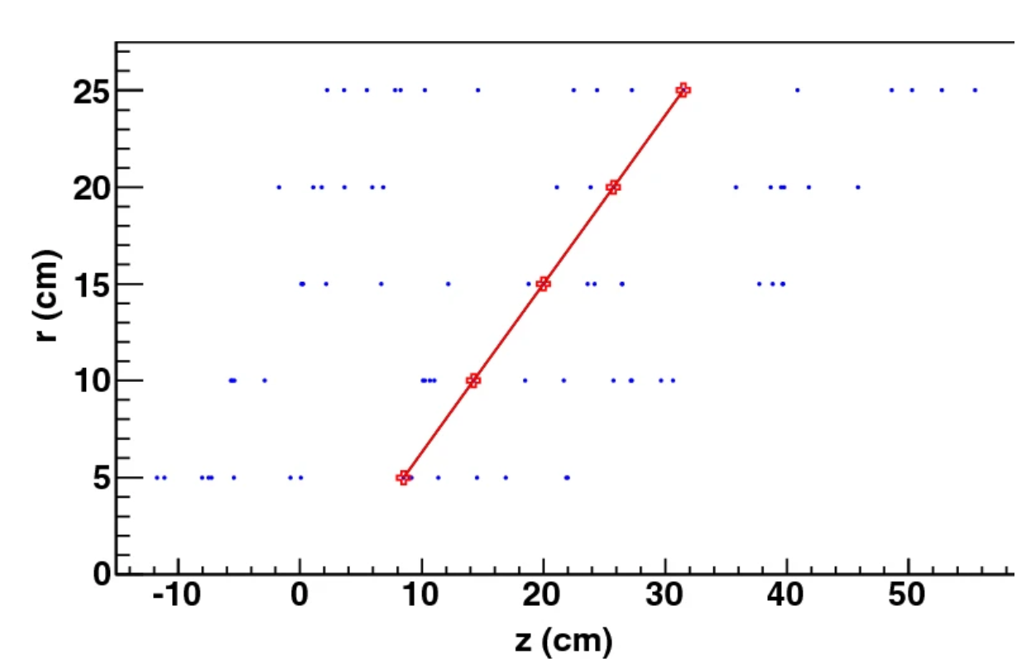
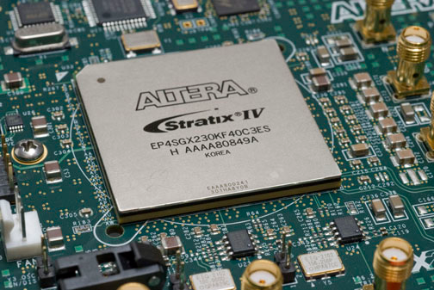
Invention of Super-fast silicon chip
Rapid identification of disappearing particles, @ 40 million / second
A. V. Kotwal, Nucl. Inst. Meth. A 957 (2020) 163427
A. V. Kotwal, Scientific Reports 11, 18543 (2021)
A. V. Kotwal et al., Scientific Reports 14, 10181 (2024)
A. V. Kotwal, submitted to Nature Scientific Reports
Implemented in silicon integrated circuit

Slide 34
Life after LHC?
Interest in China, Europe, and USA to build higher-energy colliders
Can we build an even bigger (and more expensive) tunnel ?

Slide 35
Life after LHC?
A possible big tunnel east of Beijing, China
(from presentation by Prof. Yifang Wang, Director of IHEP Beijing, on 13 February 2014, Geneva)

Slide 36
Life after LHC?
A possible big tunnel close to CERN, Geneva, Switzerland

Slide 37
Life after LHC?
A possible even bigger tunnel close to Chicago, USA

Slide 38
Better Idea – Muon Collider
Muons are short-lived subatomic
Particles produced in atmosphere
– rain down on us continuously
We can produce and accelerate them
A muon collider will be 20x higher energy
than electron collider
A muon collider will be 10x smaller in
size than electron and proton collider
I am working on the design of a muon collider

Slide 39
Bringing Physics Techniques to Biology
Nematodes (worms) 1 mm long
routinely used in biology research
Quantitative techniques for recording
and analyzing data are routinely used
in physics
I am working on bringing these together:
Using AI to identify and digitize worm images, analyze motion using
physics principles
I am collaborating with biologists and medical physicists at Duke to use worms as sensors of environmental factors

